Slide 2
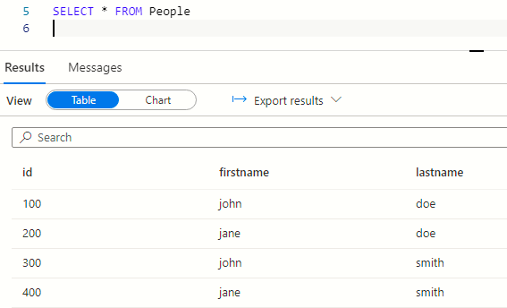

Azure Synapse query editor
CSV file

