Slide 2


Web App

Slide 3
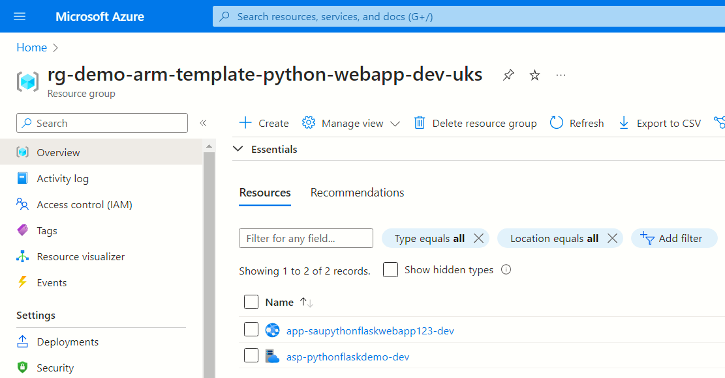
App service plan
Web App

