Slide 2
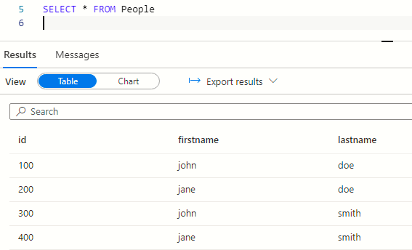

Azure Synapse query editor
CSV file

Slide 3

Power BI
Python/Pandas
Analyst
Contoso
Stocks CSV
Energy prices CSV
Commodities CSV

Slide 4

Storage account
Synapse – serverless – external tables
SELECT * FROM Stocks
External CSVs
Stock prices container
SELECT * FROM CoalPrices
Energy prices container
SELECT * FROM Commodity
Commodity prices container

