Slide 2
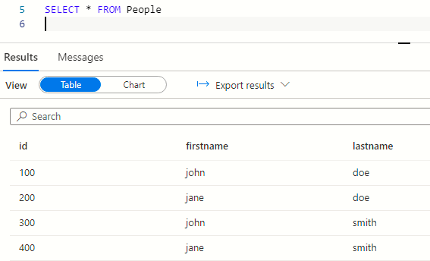

Azure Synapse query editor
CSV file

Slide 3

Power BI
Python/Pandas
Analyst
Contoso
External sources and parties
Stocks CSV
Energy prices CSV
Commodities CSV
Notes:
Power-Contoso-Overview.png

Slide 4

Storage account
Synapse – serverless – external tables
SELECT * FROM Stocks
External CSVs
Stock prices container
SELECT * FROM CoalPrices
Energy prices container
SELECT * FROM Commodity
Commodity prices container
Notes:
Power-Csv-to-external-tables.png

Slide 5
Create a Synapse resource
Create storage account and container(s) for CSV files
Start
Write Spark code for data analysis
Create external tables
Create external data sources
Enable GIT integration
Allow data scientists to query data using SSMS/Pandas

Slide 6
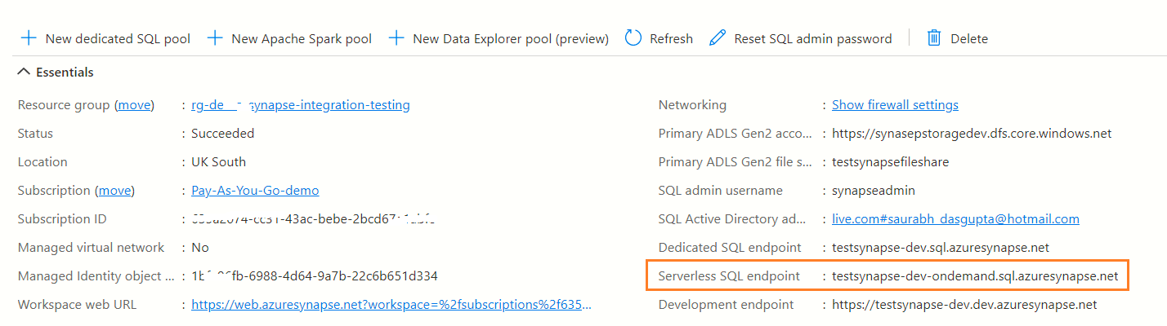
Start
Create a Synapse resource
az synapse workspace create –name mysynapse-dev –location uksouth
This would gives us a SQL serverless end point

Slide 7
Create storage account for CSV files
az storage account create –-name mystorage
The CSV feeds will reside here
Create container(s) under this storage account
1 per CSV source
az storage container create –-name commodityprices –-account-name mystorage

Slide 8
Create a credential to allow SQL to access storage account
CREATE DATABASE SCOPED CREDENTIAL MYCREDENTIAL WITH IDENTITY = 'Managed Identity';
PRINT 'created credential MYCREDENTIAL'
az role assignment create –-assignee <identity of synapse> --role <Blob reader>
Using managed identity avoids hard coding access keys
Notes:
Power-dev-flow-create-credential.png

Slide 9
Create external data sources
CREATE EXTERNAL DATA SOURCE COMMODITYDATASOURCE
WITH (
LOCATION = 'https://mystorage.blob.core.windows.net/commodityprices',
CREDENTIAL = MYCREDENTIAL
)
PRINT 'Created external datasource COMMODITYDATASOURCE'
GO

Slide 10
Create external tables
PRINT 'Creating table Commodity prices'
GO
CREATE EXTERNAL TABLE CommodityPrice (
commodityid INT,
price float,
[date] datetime2,
countrycode nvarchar(10),
) WITH (
LOCATION = ‘/Commodities.csv',
DATA_SOURCE = COMMODITYDATASOURCE,
FILE_FORMAT = CSVFORMAT
);
This table can now be accessed like any SQL table
SQL views on this table can also be created if necessary

Slide 11
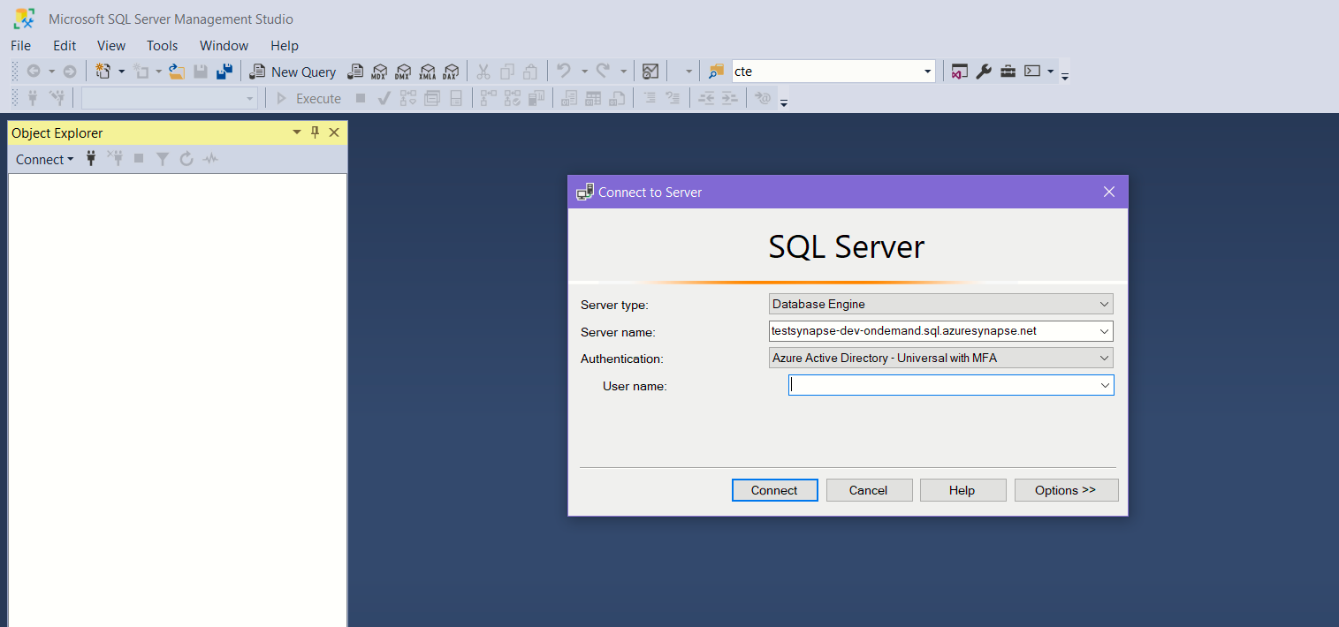
Run queries via SQL Management Studio

Slide 12
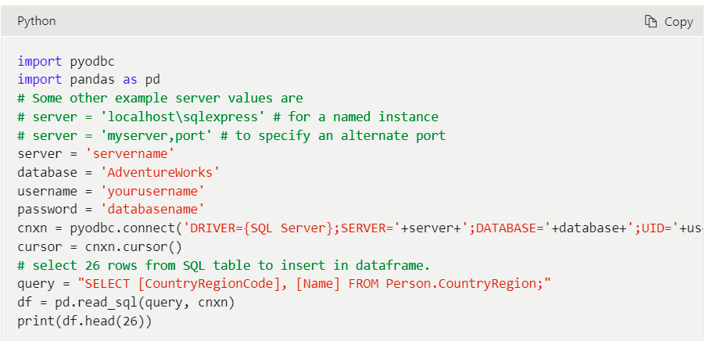
Data science analysis using Pandas
Notes:
Power-dev-flow-pandas.png

Slide 13
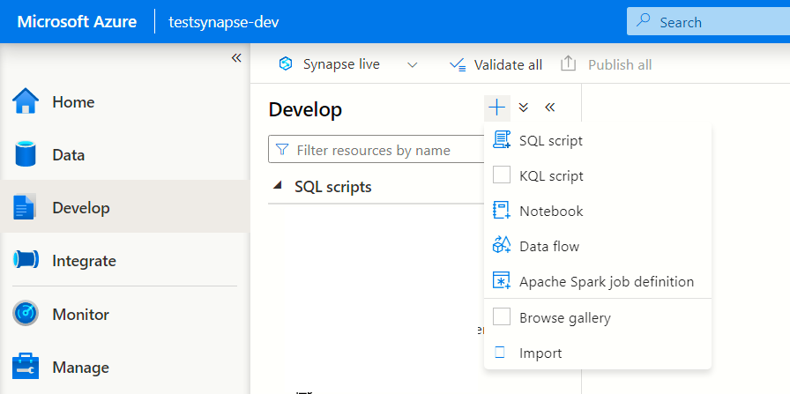

Slide 14
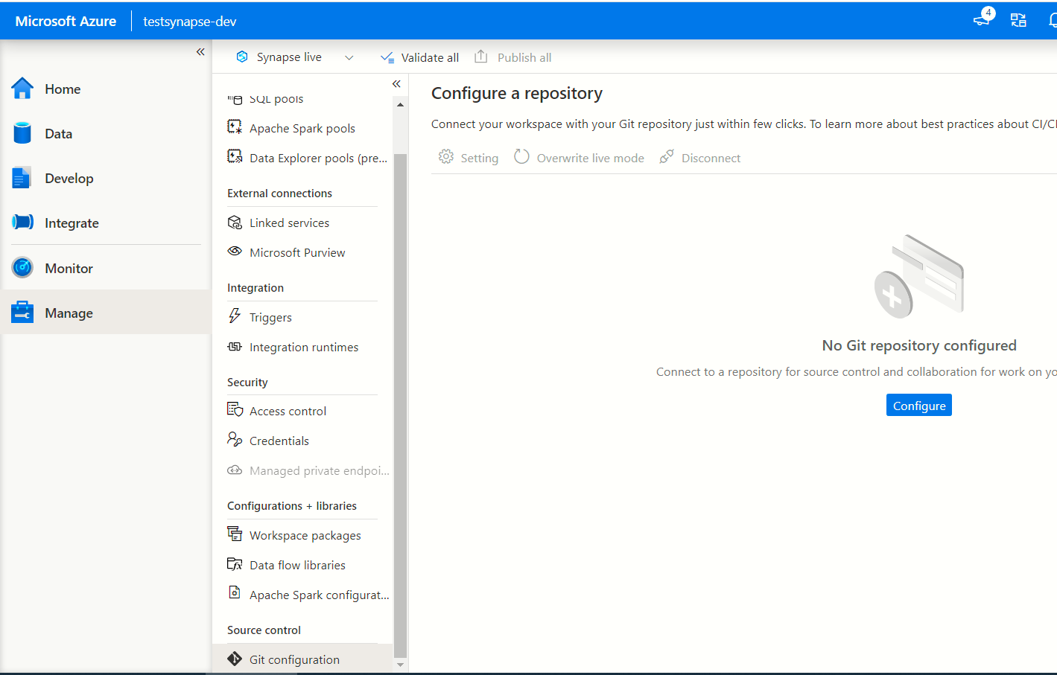

Slide 15
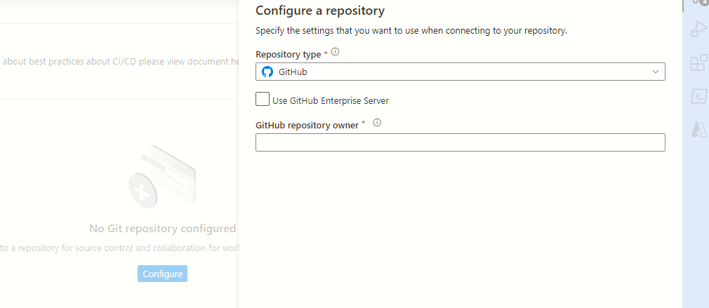

Slide 16
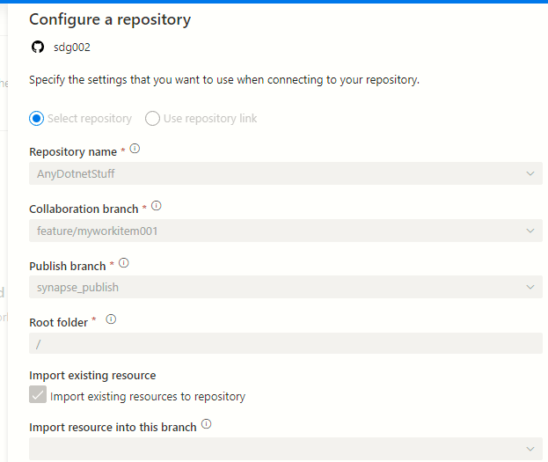
GITHUB repo
The branch where your files get saved
The branch where files get merged

Slide 17
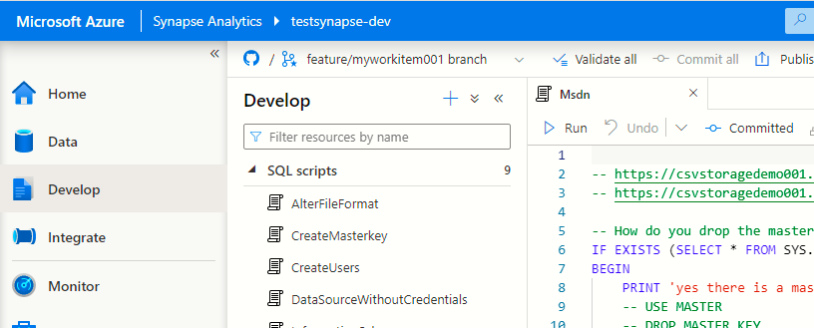
Synpapse script editor is now wired up to the collaboration branch

Slide 18
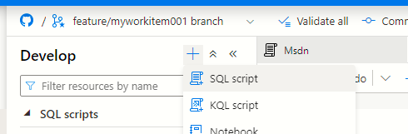
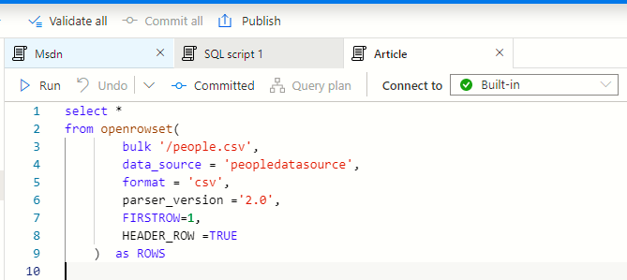
Create a new SQL script
Write a simple SQL query to read the CSV file and press Publish button

Slide 19
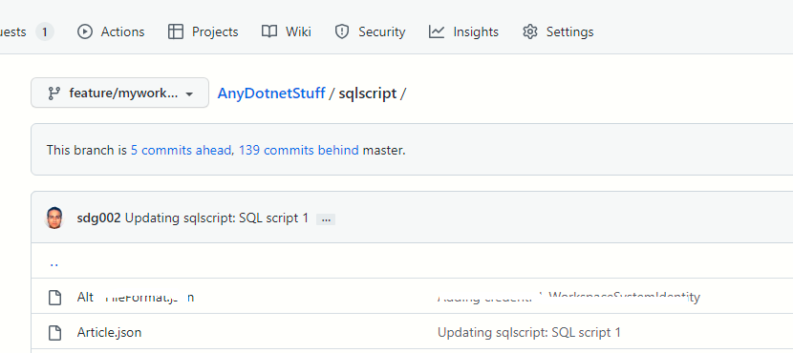
Head over to Github and you will notice that the same file is now saved to GIT

Slide 20
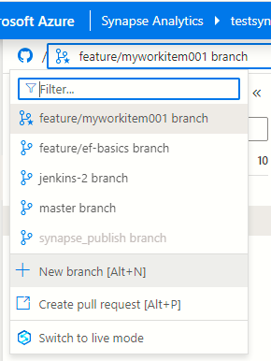
Create a pull request

Slide 21
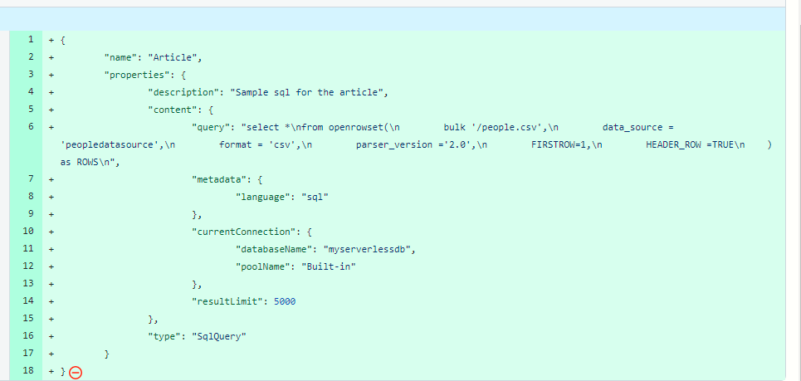
This was our original query!!

Slide 22
PR approved, merge with master
| deploy.ps1
| uploadsamplecsv.ps1
|
|
+---sql
| createfileformats.sql
| createmasterkey.sql
| generic-external-table.sql
| managed-identity-credential.sql
| new-serverless-database.sql
|
+---table-sql
| Address.sql
| People.sql
|
Deploy new SQL to DEV Synapse instance
Devops CI/CD kicks in
Raise pull request
Add new table SQL
Add new CREATE TABLE sql files here
Create a feature branch

Slide 23
|
|+---infra
| deploy.ps1
| uploadsamplecsv.ps1
|
|
+---common-sql
| createfileformats.sql
| createmasterkey.sql
| managed-identity-credential.sql
| new-serverless-database.sql
|
+---table-sql
| Address.sql
| People.sql
|
|
+---synapse-tests
|
|
Azure CLI/PowerShell scripts to deploy Synapse and SQL objects via CI/CD
.SQL files to create common objects
Add a .SQL file for every CREATE TABLE statement
VS.NET Integration tests (C#)

Slide 24
Developer work flow
Add new ‘CREATE TABLE’ SQL file
Create a feature branch
Devops CI/CD kicks in
Raise pull request
Deploy new SQL to DEV Synapse instance using Azure CLI/PowerShell
Pull request is approved
Deploy new SQL to UAT Synapse instance using Azure CLI/PowerShell
PR approved, merge with master
Trigger automated deployment on PROD when approved
Notes:
Power-proposed-solution-dev-workflow.png

Slide 25
Notes:
Power-proposed-solution-inside-synapse-workspace.png

