Slide 1
Step 3
All secrets are read from environment variables using the
${variable_name} notation
[OILSCRAPER]
api_username = some_user_name
api_key = ${OIL_API_KEY}
output_folder = ${USERPROFILE}\oil\out
Base settings
Step 1
3 config files
[OILSCRAPER]
api_username = dev_user_name
output_folder = \\devserver\scrapers\oil\out
Settings.ini
Settings.dev.ini
Settings for DEV environment
Settings.prod.ini
Step 2
Use os.environ[“environment”] to load the environment specific config file
[OILSCRAPER]
api_username = prod_user_name
output_folder = \\prodserver\scrapers\oil\out
Settings for PROD environment

Slide 2
Base settings
Settings.ini
Settings.dev.ini
Settings.prod.ini
Settings for DEV environment
Settings for PROD environment

Slide 3
Base settings
[OILSCRAPER]
api_user = some_user_name
api_key = ${OIL_API_KEY}
output_folder = ${USERPROFILE}\oil\out
Environment=DEV
Environment=PROD
[OILSCRAPER]
api_user = dev_user_name
output_folder = \\devserver\scrapers\oil\out
[OILSCRAPER]
api_user = prod_user_name
output_folder = \\devserver\scrapers\oil\out
Final settings
[OILSCRAPER]
api_user = [dev/prod user name]
api_key = ${OIL_API_KEY}
output_folder = [dev/prod folder]

Slide 4
Base settings.ini file
Environment specific settings(DEV/PROD).ini
Environment variable overrides
Final configuration

Slide 5
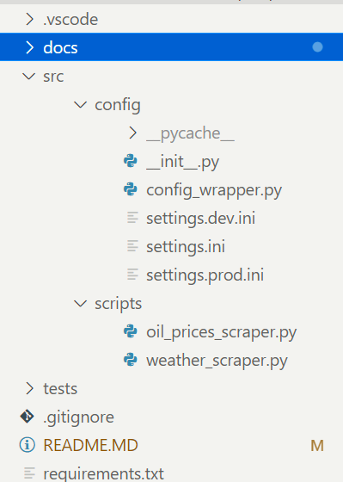
Wrapper over ConfigParser
DEV settings file
Base settings file
PROD settings file
Consume ConfigParser here

Slide 6
