Slide 2
Original image -2 strong line candidates
Line 1
Line 2

Slide 3
First run of RANSAC – Detect Line 1
Line 1

Slide 4
Remove inliers from Line 1

Slide 5
Second run of RANSAC – Detect Line 2
Line 2

Slide 6
Remove inliers from Line 2
Line 2
Line 1

Slide 7
Third run of RANSAC – No more points left
Line 2
Line 1

Slide 8
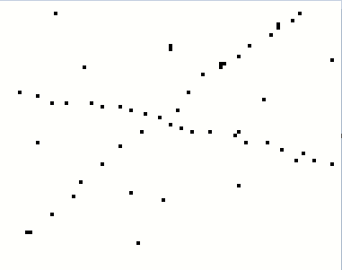
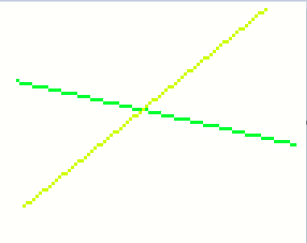

Slide 9
