Slide 2
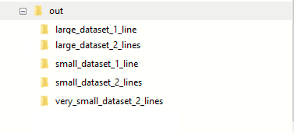
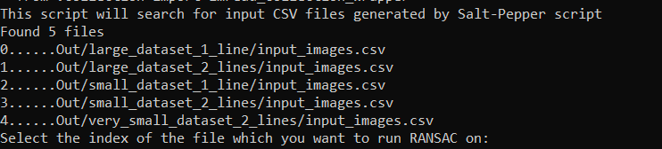
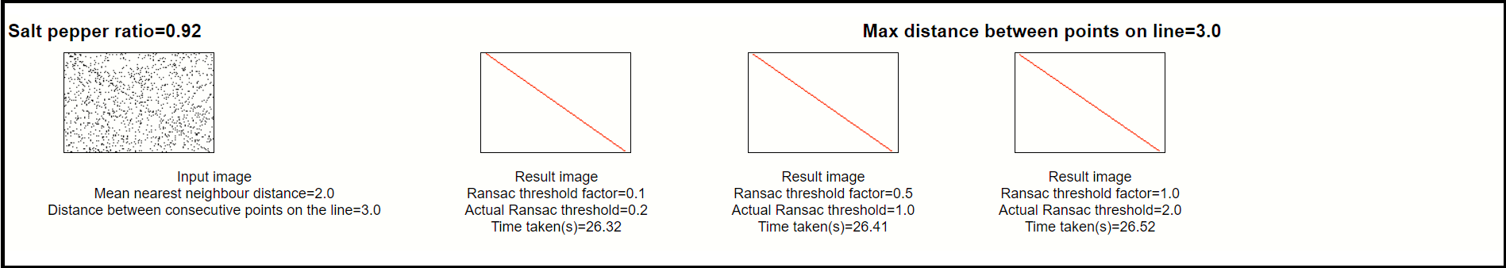
Generate Noisy images
(SaltPepperNoise.py)
Start
SaltPepperNoise.py
Generate Noisy images
(SaltPepperNoise.py)
ExecuteRansac.py
PlotResultsSideBySide.py
End

