Slide 3
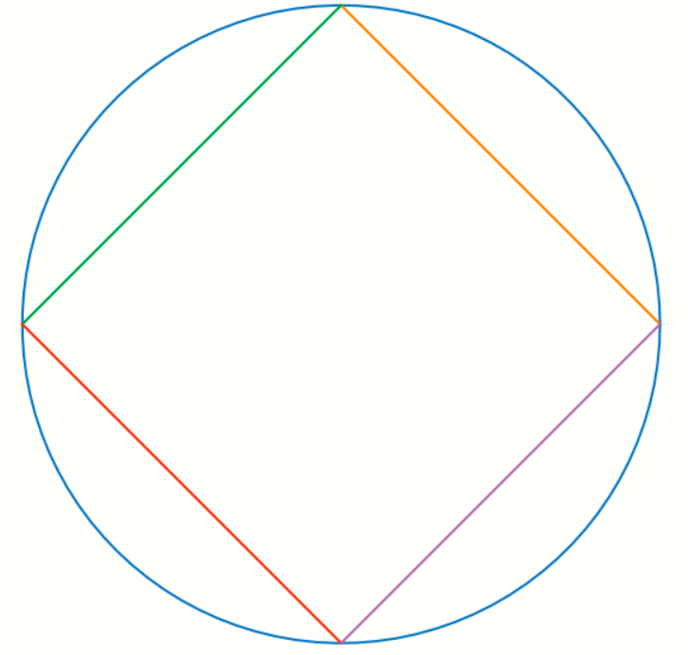

Slide 4
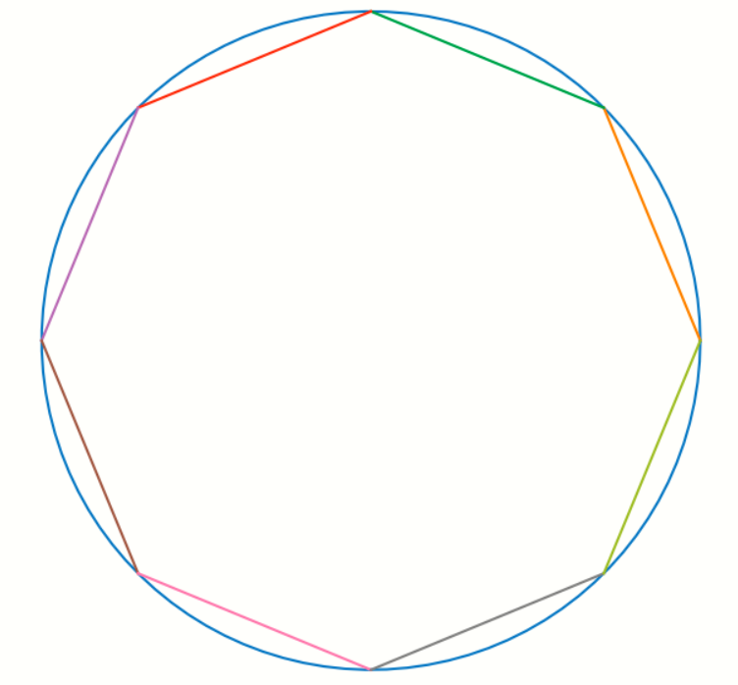
Notes:
8-sides

Slide 5
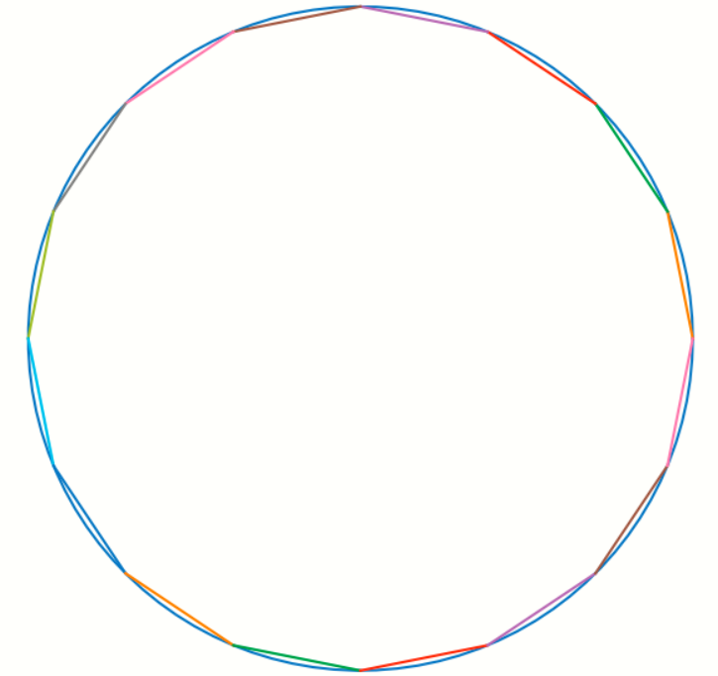

Slide 6




r
s
(${2s)}^{2}=r^{2}+r^{2}$
90
$${4s}^{2}={2r}^{2}$$
s
r
$$s= \frac{r}{\sqrt{2}}$$
2s
$$perimeter=4 ∗2s=8∗\frac{r}{\sqrt{2}}$$

Slide 7
Square of side S0
r
r
S1
1/2S0
From 4 to 8 sides
90
90
1/2S0
r
r
Octagon of side S1
S0
Can we come up a formula that gives us the value of S1 given S0
Notes:
4-to-8-sides.png

Slide 8


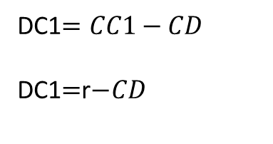





1. D bisects AB
AC is the radius r
AC=CB =r
AB is known from previous calculation and this is 2S0
The segment CC1 bisects AB
CC1=r=AC=BC
What do we want to find?
Find AC1 also denoted as 2S1
Why are we doing this?
If we can find a formula that gives us AC1 from AB then we can recursively sub-divide AC1 into smaller segments.
AD$=AB/2$ $=$ S0 $/2$
2.Using Pythagoras theorem
A
$${CD}^{2}+{AD}^{2}=r^{2}$$
r
$${DC1}^{2}+{AD}^{2}={AC1}^{2}$$
AB/2=S0
C
D
C1
3.D splits the radius CC1
DC1$=CC1−CD$
DC1$=$r$−CD$
B
4. Combining the above equations
S0
AD$=AB/2$ $=$ S0 $/2$
${CD}^{2}=$ $r^{2}−{AD}^{2}$
DC1 $=$r$− CD$
${AC1}^{2}={DC1}^{2}+{AD}^{2}$ $={(S1)}^{2}$
Notes:
4-to-8-sides-calculation.png

Slide 9
Iteration number (n) | Number of sides | Length of one side of the regular polygon | Perimeter
0 | 4 | S0 | 4*S0
1 | 8 | S1 | 8*S1
2 | 16 | S2 | 16*S2
Notes:
Summary-table.png

Slide 10
Iteration number (n) | Number of sides | Length of one side of the regular polygon | Perimeter | Calculated PIE
0 | 4 | 1.414213562373095 | 5.656854249492381 | 2.8284271247461903
1 | 8 | 0.7653668647301797 | 6.122934917841437 | 3.0614674589207187
2 | 16 | 0.3901806440322566 | 6.242890304516106 | 3.121445152258053
3 | 32 | 0.19603428065912124 | 6.2730969810918795 | 3.1365484905459398
4 | 64 | 0.09813534865483604 | 6.280662313909507 | 3.1403311569547534
5 | 128 | 0.04908245704582458 | 6.282554501865547 | 3.1412772509327733
6 | 256 | 0.02454307657143985 | 6.283027602288603 | 3.1415138011443013
7 | 512 | 0.01227176929830895 | 6.283145880734184 | 3.141572940367092
8 | 1024 | 0.00613591352593195 | 6.28317545055432 | 3.14158772527716
9 | 2048 | 0.00306796037256953 | 6.2831828430224 | 3.1415914215112
Notes:
results-table.png

