Slide 2
Start
Install Azure Core Functions Tools
Install VS Code Azure Function Extensions
VS Code – Add a HTTP trigger
VS Code - Create a skeletal Azure Function
Test local debugging, F5
Create resource group, app plan and app via PowerShell
End
Deploy function app to Azure using Core Tools

Slide 3
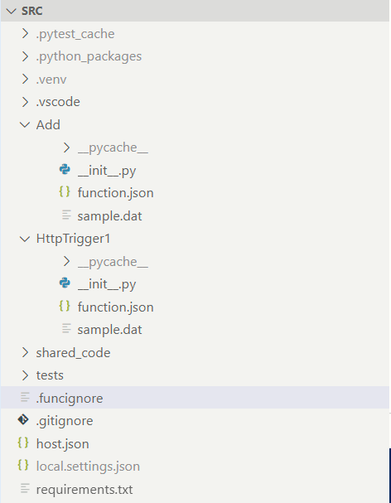
Behaviour of the end point (get, post, etc. security)
Http end points
Folders ignored during Azure publishing
Runtime config, logging, etc.
Re-usable classes
Unit tests
Python venv PIP modules
Environment variables used during local debugging

Slide 4
Start
Create a new resource group
Create a new Function App Plan
Deploy source files to function app
Create a new Function App
Configure App settings
End

Slide 5
