Slide 3
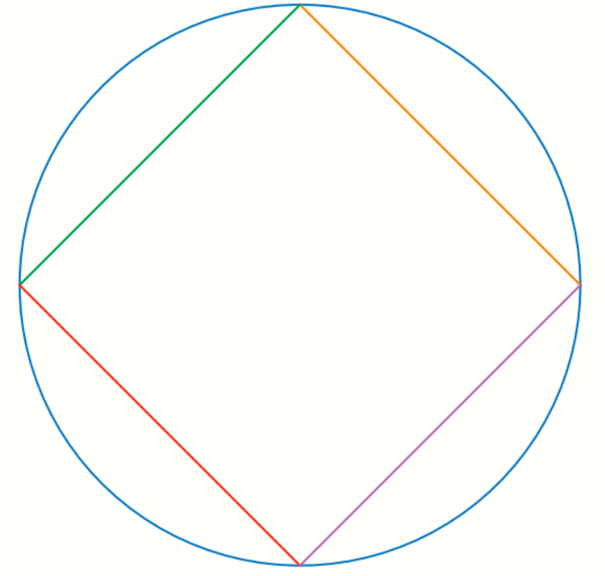

Slide 4
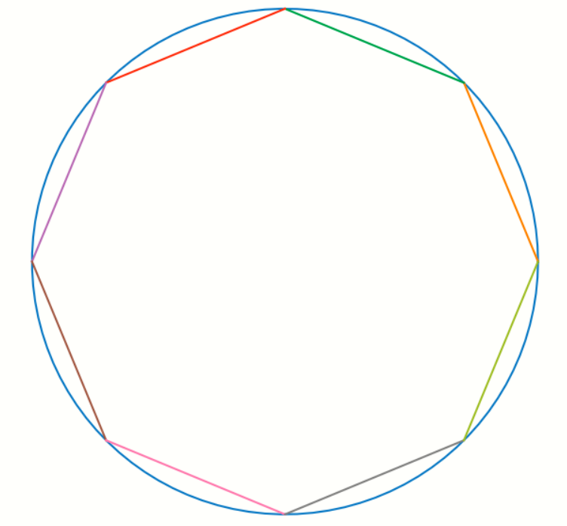
Notes:
8-sides

Slide 5


Slide 6




r
s
(${2s)}^{2}=r^{2}+r^{2}$
90
$${4s}^{2}={2r}^{2}$$
s
r
$$s= \frac{r}{\sqrt{2}}$$
2s
$$perimeter=4 ∗2s=8∗\frac{r}{\sqrt{2}}$$

Slide 7
Square of side 2*S0
r
r
2S1
S0
From 4 to 8 sides
90
90
S0
r
r
Octagon of side 2* S1
2S0
Can we come up a formula that gives us the value of given S1 given S0
Notes:
4-to-8-sides.png

Slide 8


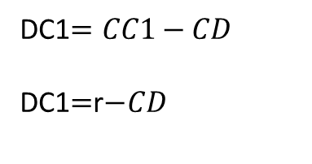





1. D bisects AB
AC is the radius r
AC=CB =r
AB is known from previous calculation and this is 2S0
The segment CC1 bisects AB
CC1=r=AC=BC
What do we want to find?
Find AC1 also denoted as 2S1
Why are we doing this?
If we can find a formula that gives us AC1 from AB then we can recursively sub-divide AC1 into smaller segments.
AD$=AB/2$ $=$ S0
2.Using Pythagoras theorem
A
$${CD}^{2}+{AD}^{2}=r^{2}$$
r
$${DC1}^{2}+{AD}^{2}={AC1}^{2}$$
AB/2=S0
C
D
C1
3.D splits the radius CC1
DC1$=CC1−CD$
DC1$=$r$−CD$
B
4. Combining the above equations
2S0
AD$=AB/2$ $=$ S0
${CD}^{2}=$ $r^{2}−{AD}^{2}$
DC1 $=$r$− CD$
${AC1}^{2}={DC1}^{2}+{AD}^{2}$ $={(2∗S1)}^{2}$
Notes:
4-to-8-sides-calculation.png

Slide 9
Iteration number (n) | Number of sides | Length of one side of the regular polygon | Perimeter
0 | 4 | S0 | 4*S0
1 | 8 | S1 | 8*S1
2 | 16 | S2 | 16*S2
Notes:
Summary-table.png

