Slide 1
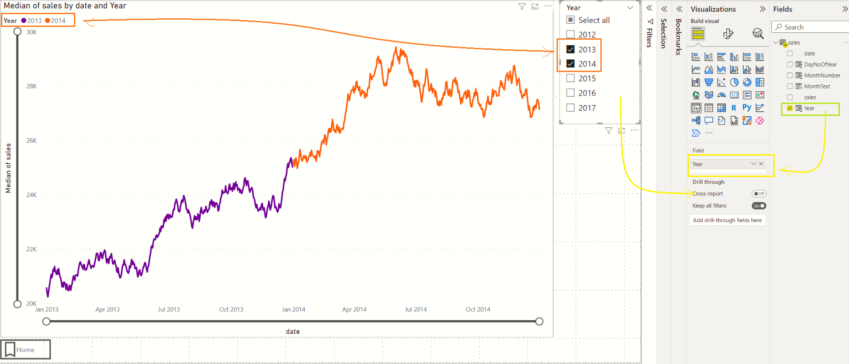
Year column.
Year is a Calculated column on the date field.

