Slide 1
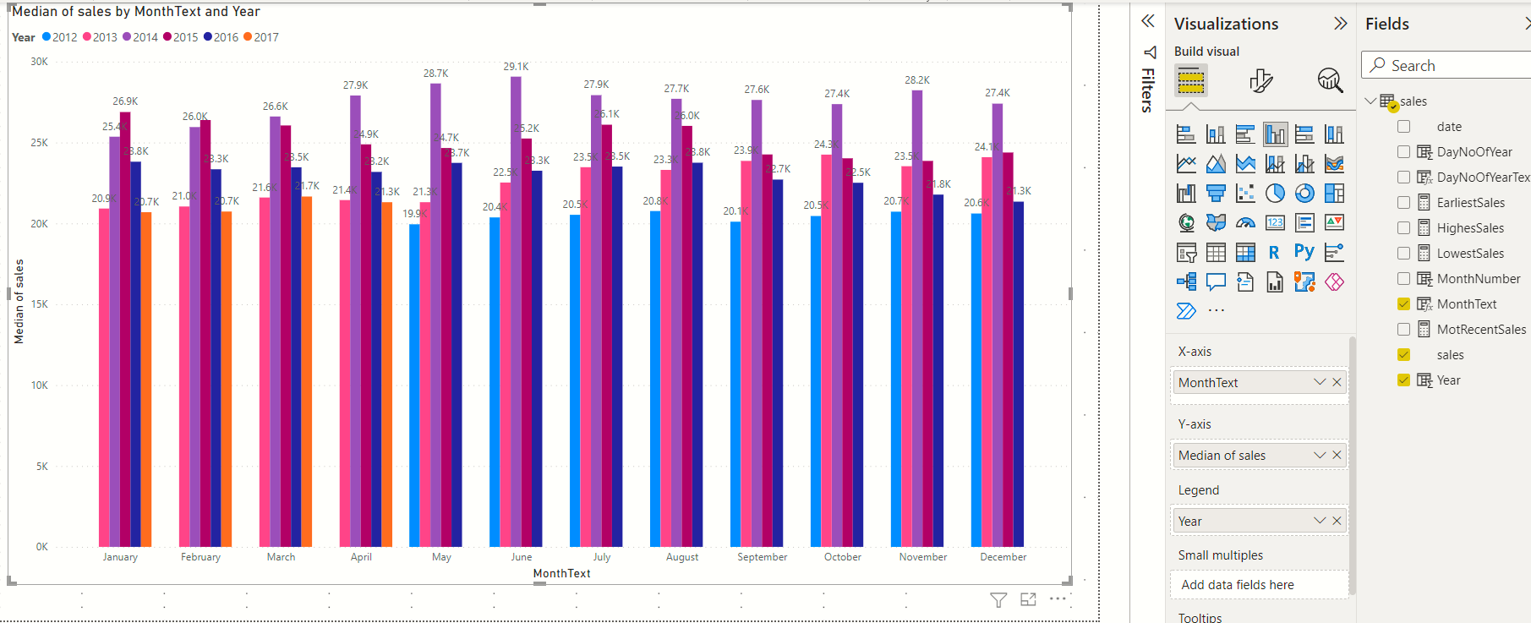
Clustered column chart
Legend => Year , this produces the vertical bars

