Slide 1
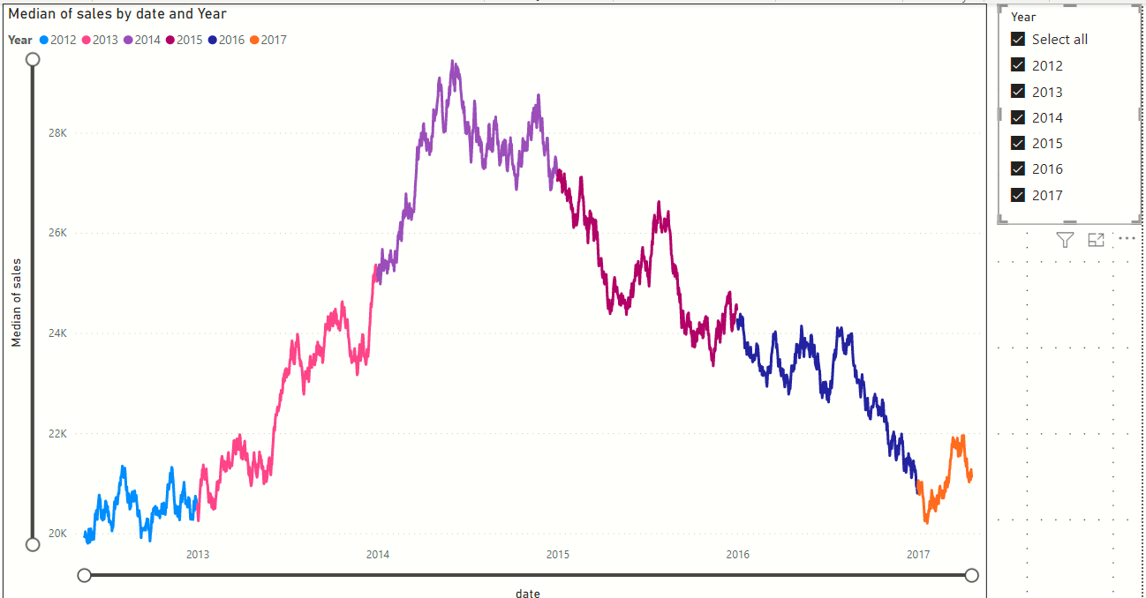
Y axis upper limit
Y axis lower limit
All years selected

