Slide 1
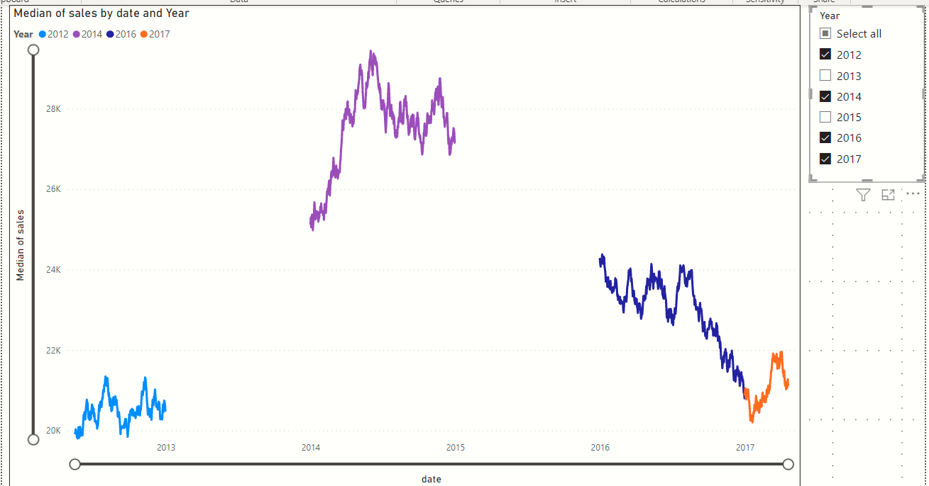
Y axis upper limit
Y axis lower limit
Select some of the years only
- Notice the Y and X axis limits. They remain unchanged!

