Slide 1
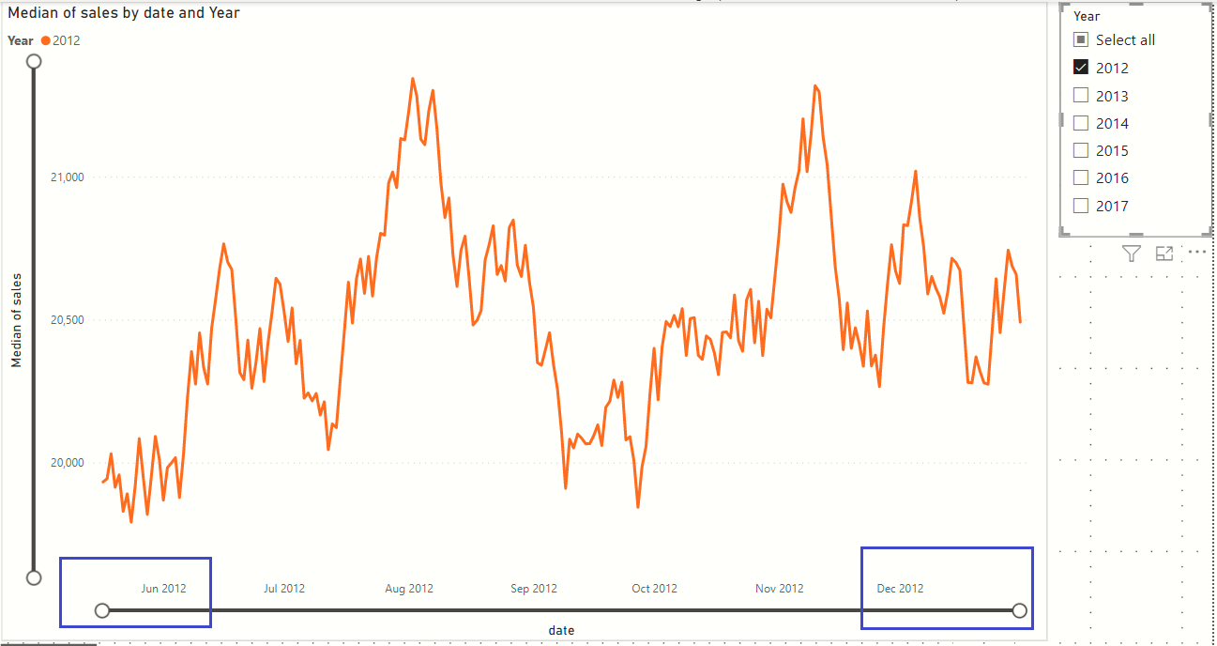
1. Change the selection of the Years
4. Y-axis limits will adjust to new peaks and troughts
2. X-axis upper limit will immediately change
3. X-axis lower limit will immediately change

