Slide 1
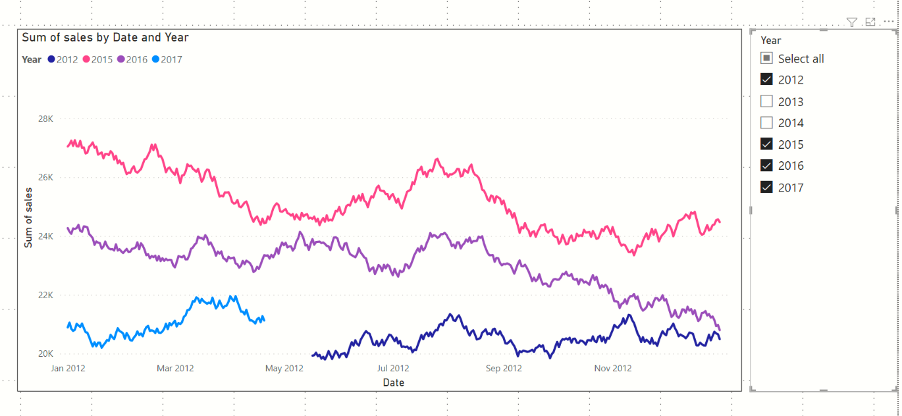
Slicer to select the year(s) that we want to analyse
The X axis only displays 1 year
Every year’s sales is on a separate curve

