Slide 1
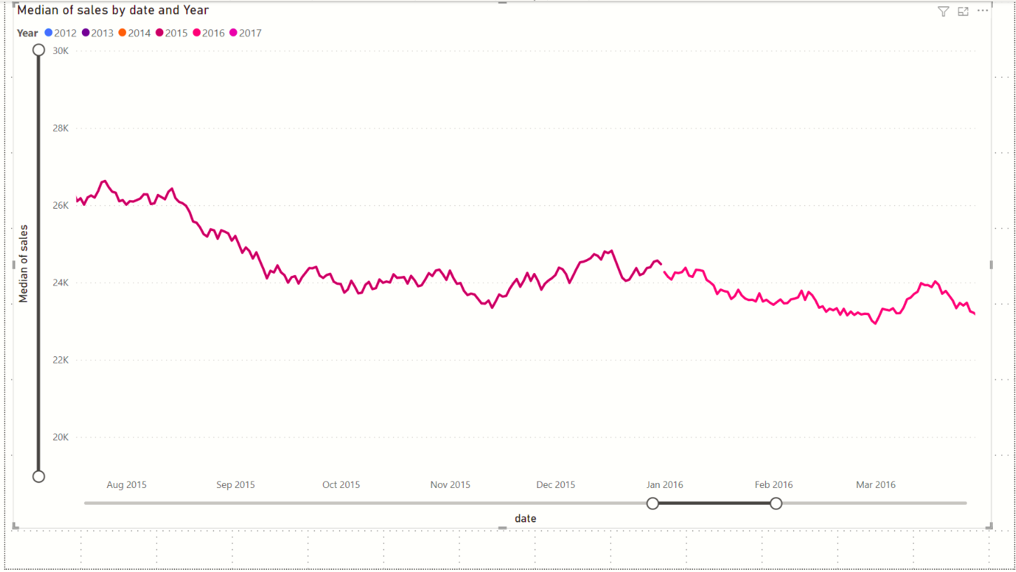
Uncheck this option to disable automatic creation of hierarchy
You will need to click and drag the Zoom sliders in either direction !!

