Slide 1
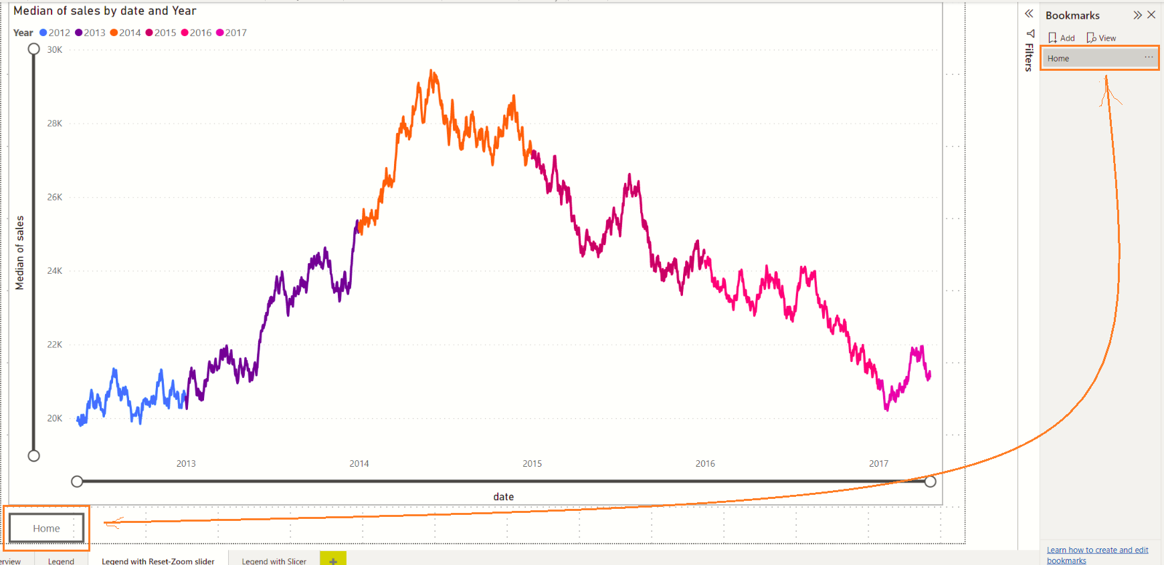
Bookmark captured with zoom sliders in default state
Uncheck this option to disable automatic creation of hierarchy
This is a Button wired to a Bookmark
You will need to click and drag the Zoom sliders in either direction !!

