Slide 1
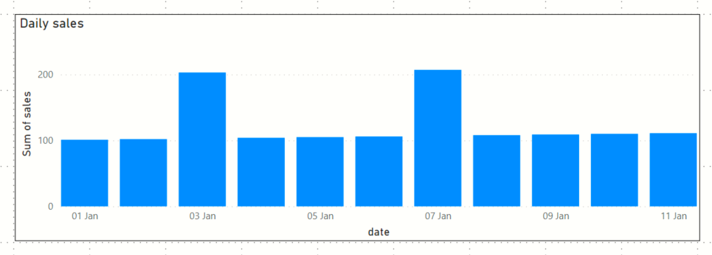
1-2 Jan
2-3 Jan
3-4 Jan
Δchange=(sales on current day – sales on previous day)
4-5 Jan

