Slide 2
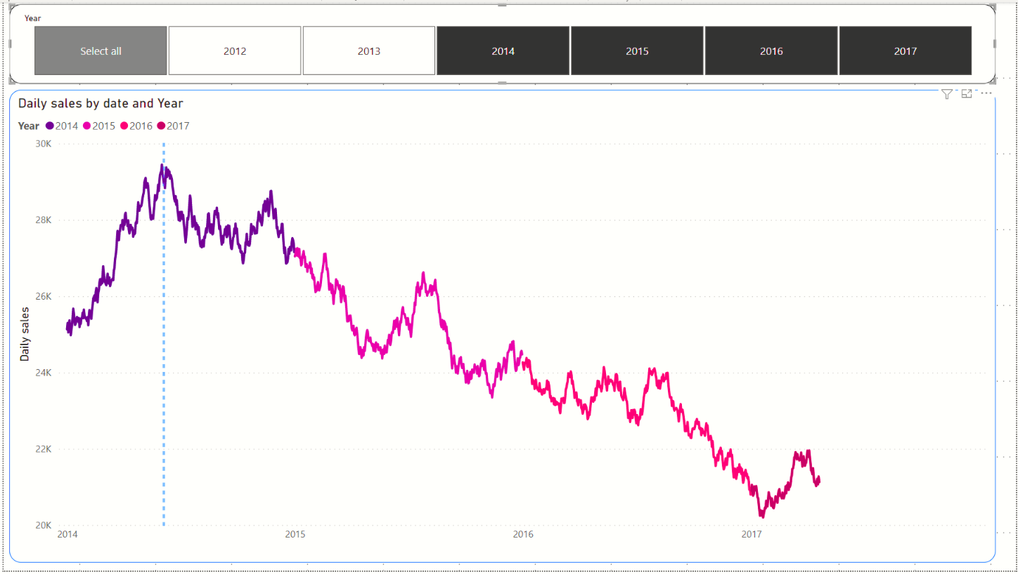
Sales amount along Y axis
Sales date along X axis

