Slide 1
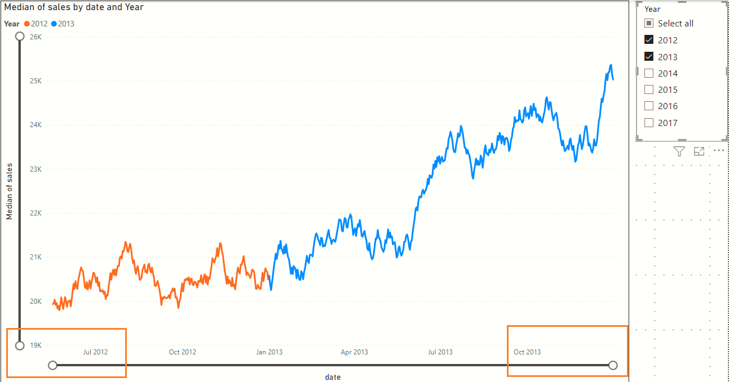
The X and Y axis limits fluctuate with changing slicer selection

