Slide 2
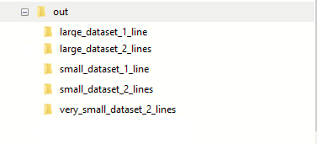
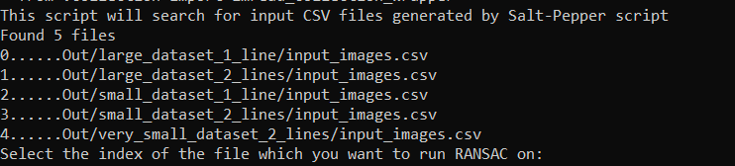
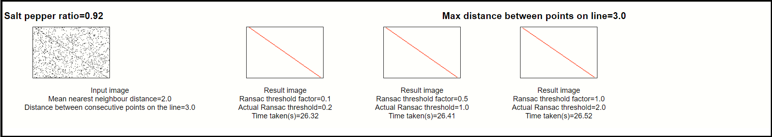
Start
Generate Noisy images
SaltPepperNoise.py
ExecuteRansac.py
Run RANSAC
PlotResultsSideBySide.py
End

