Slide 1
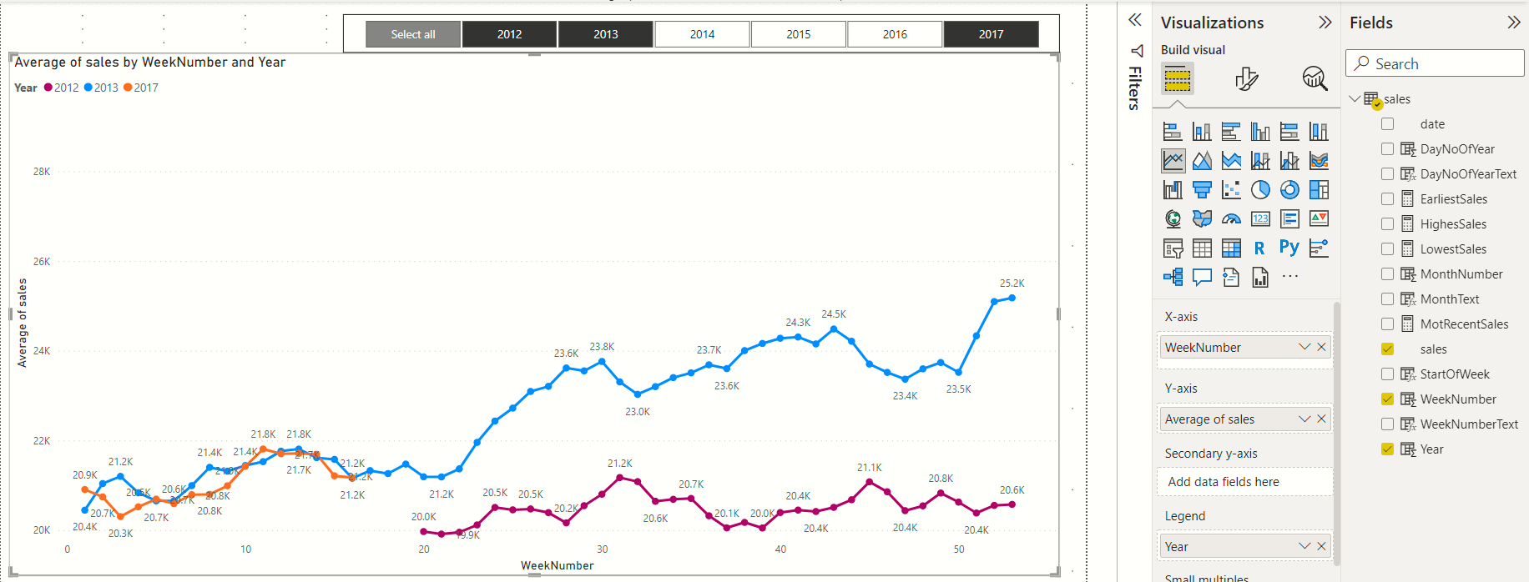
Slicer on Year calculated column

