Slide 1
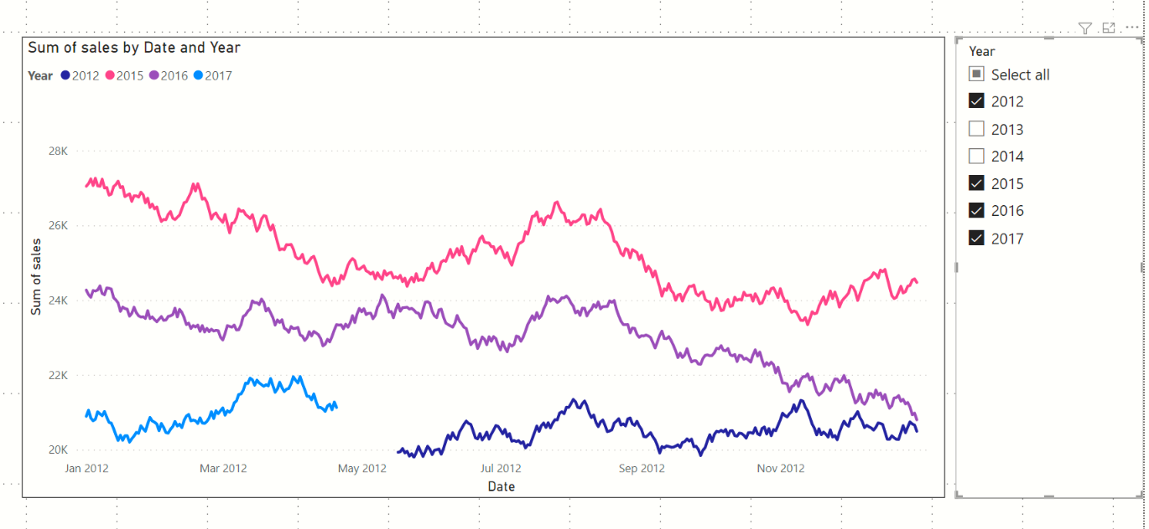
Slicer to select the year(s) that we want to analyse
The X axis only displays 1 year
Every year’s sales is on a separate curve

Slide 2
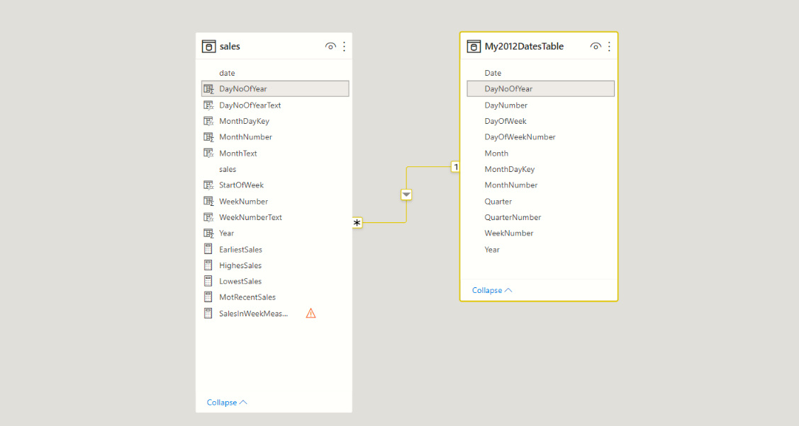
New Date table with 1 year of dates (any leap year will do)
Relationship using the column DayNoOfYear column

Slide 3
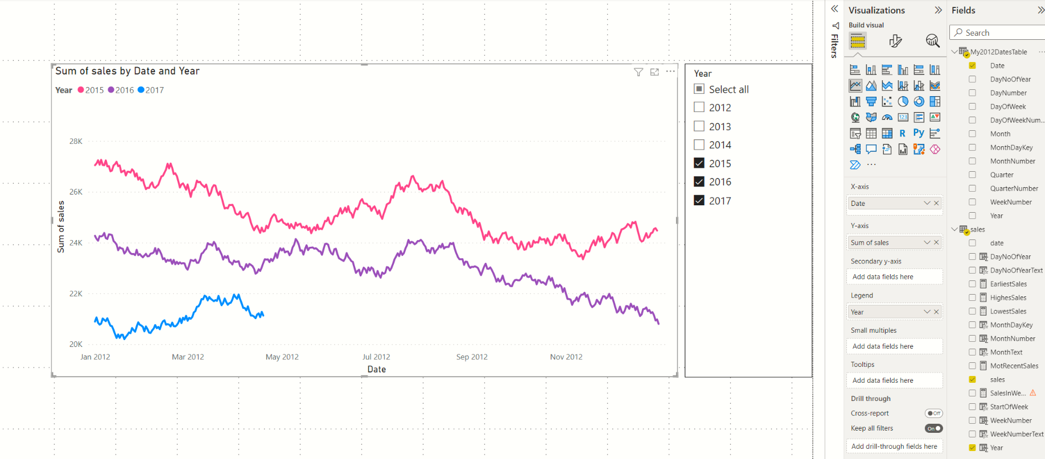
Slicer on Sales->Year column
X axis: My2012DatesTable>Date column
Y axis: Sales>sales column
Legend: Sales>year column

Slide 4
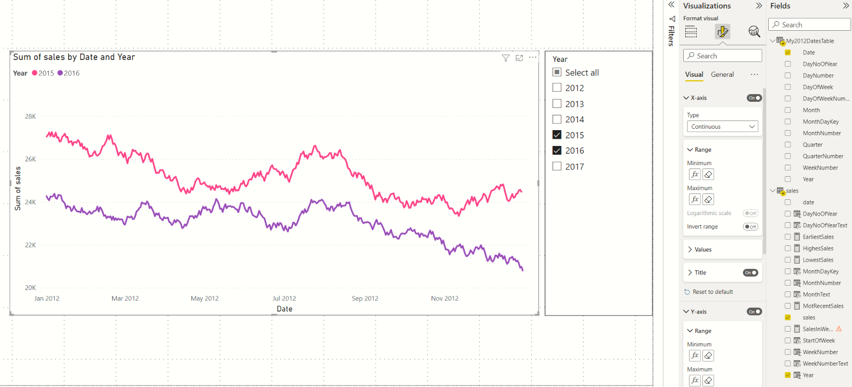
Use the EARLIEST and LATEST values from the My2012DatesTable

Slide 5
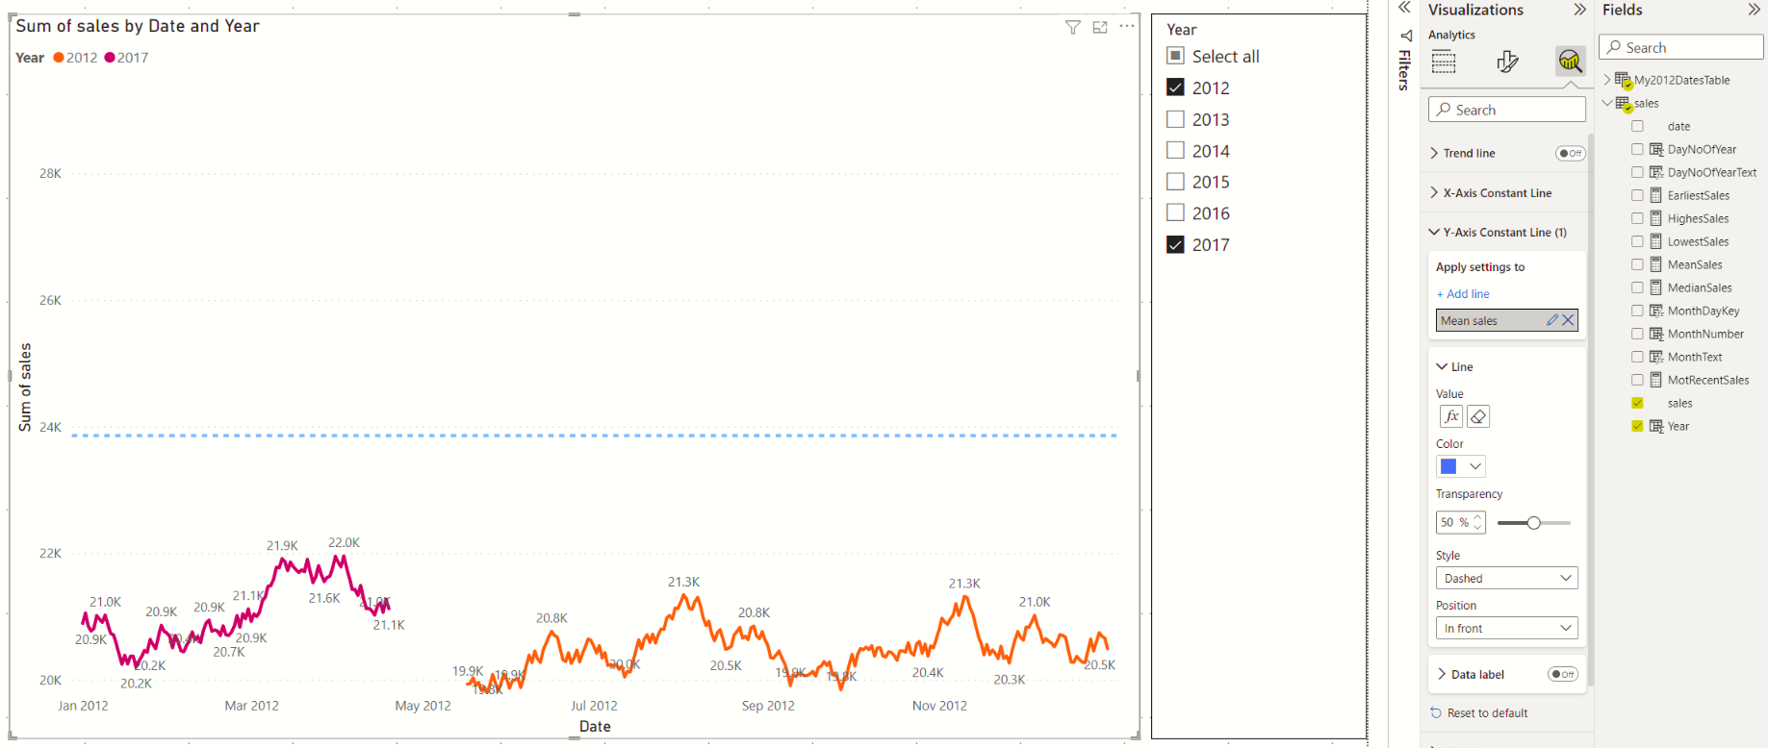
Constant line to indicate mean sales
DAX measure to give mean sales

