Slide 1
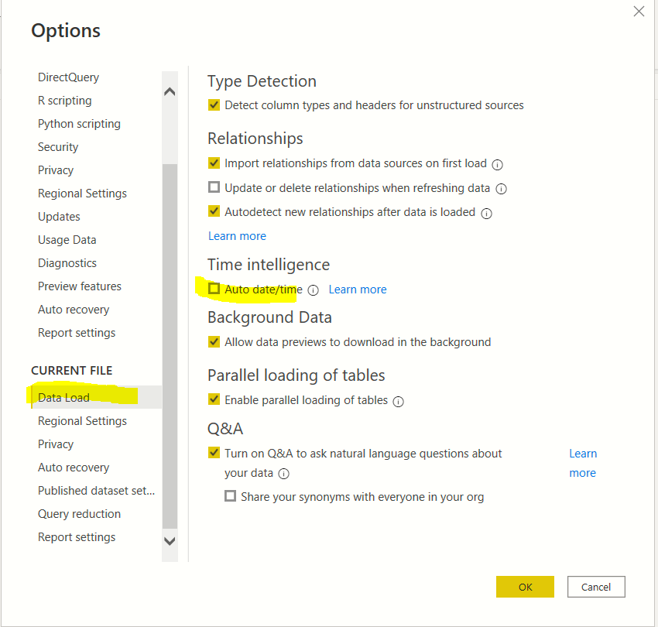
Uncheck this option to disable automatic creation of hierarchy

