Slide 1
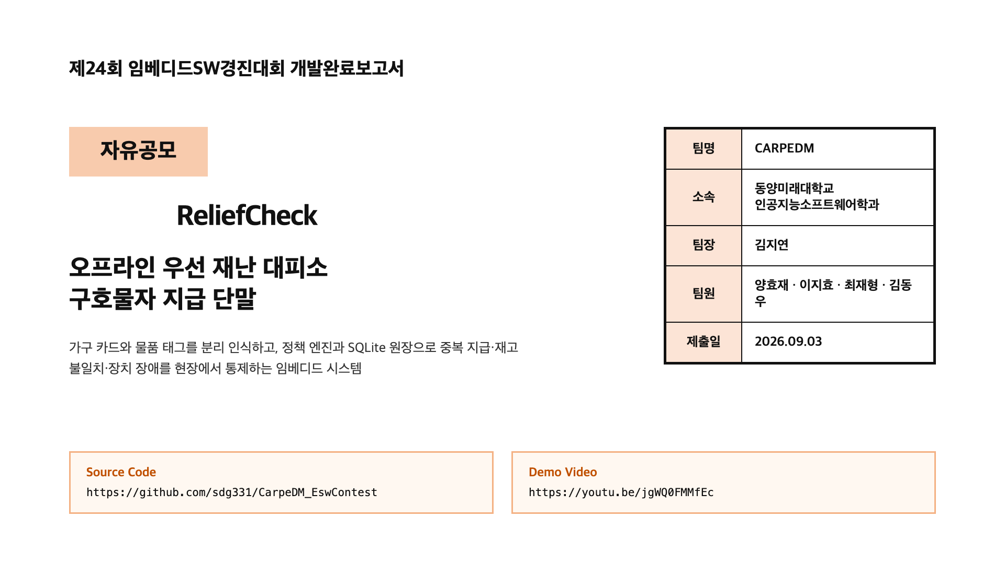
Notes:
[Sources] Sources: guide PDF, application XLSX, user-supplied video URL.
Generated as a full-slide raster page to match the guide style and preserve PDF layout.

Slide 2
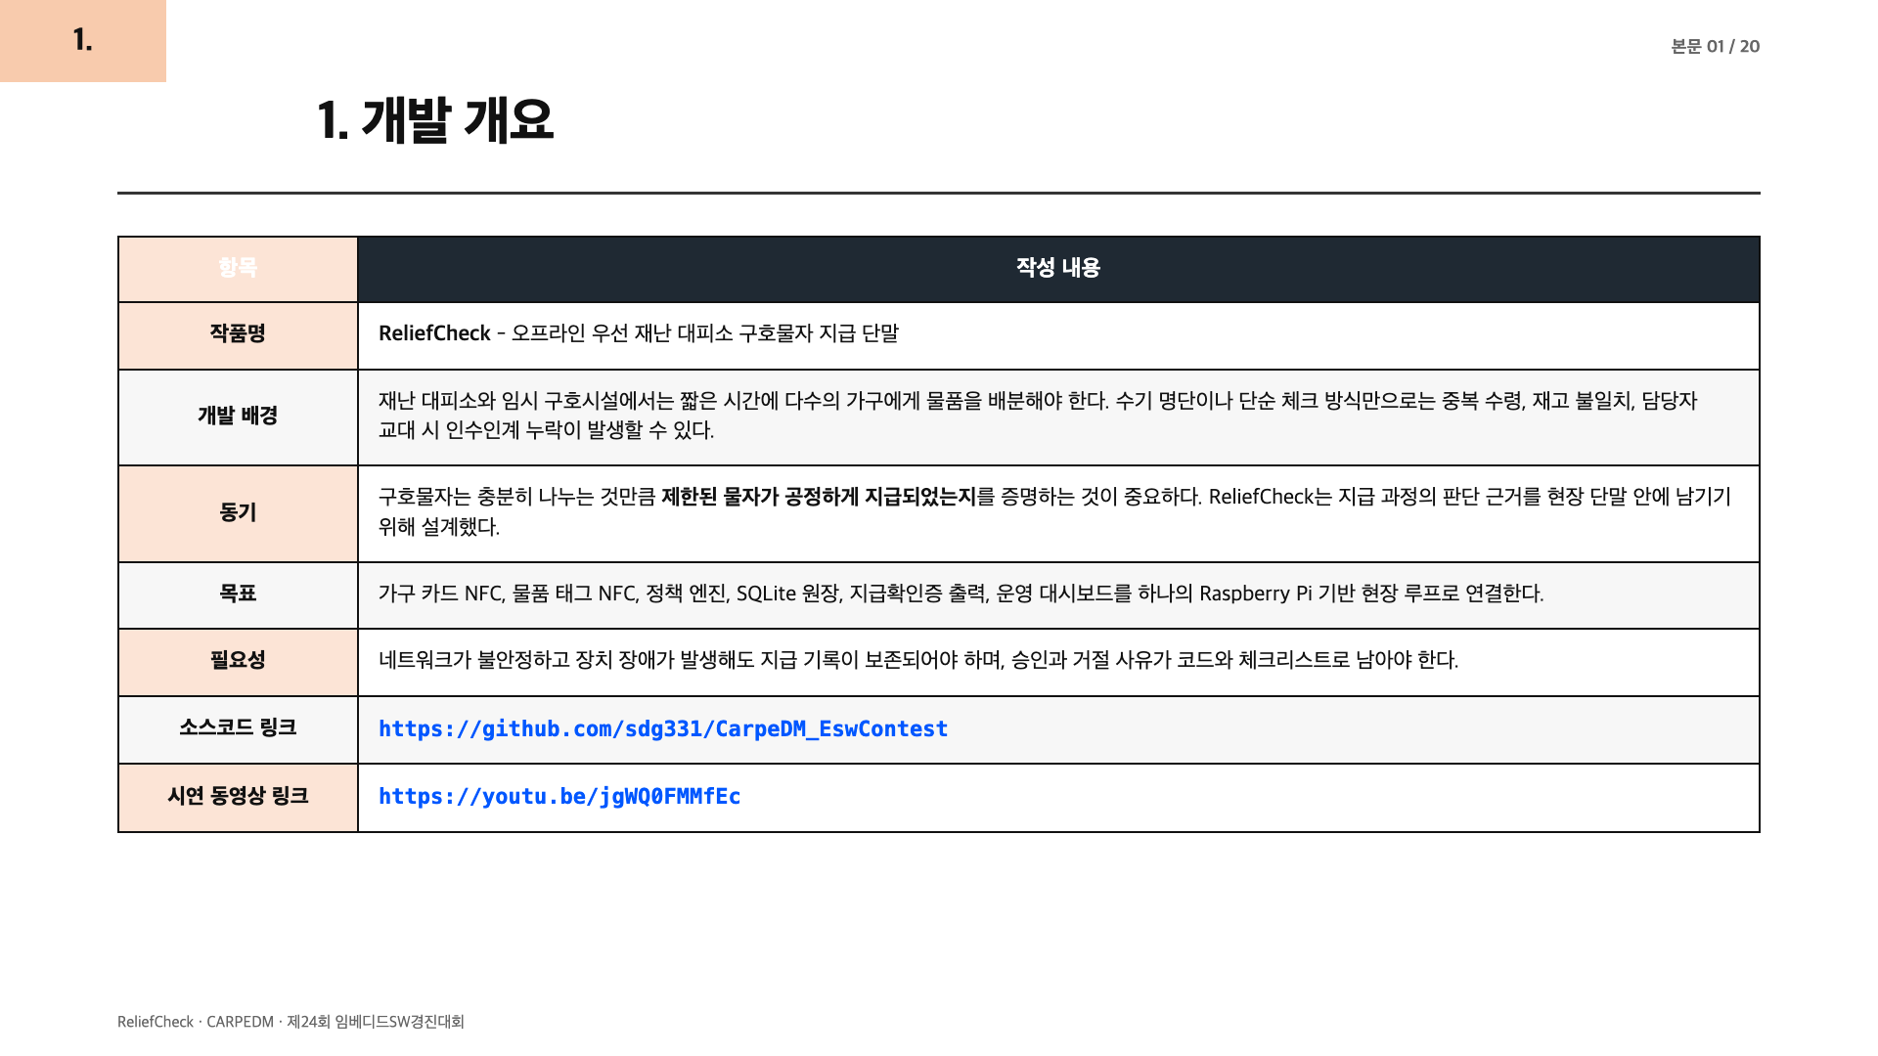
Notes:
[Sources] Sources: guide PDF section 4 item 1; README.md problem and demo flow; user-supplied source/video links.
Generated as a full-slide raster page to match the guide style and preserve PDF layout.

Slide 3
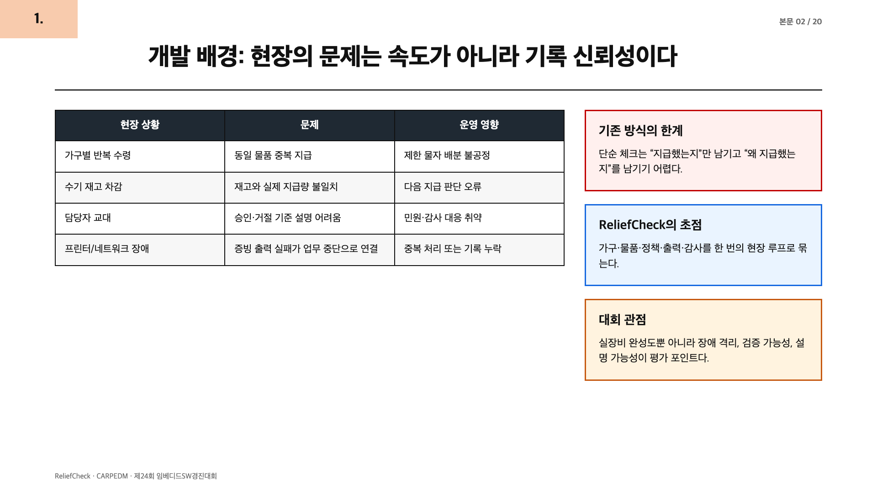
Notes:
[Sources] Sources: README.md problem definition; docs/07-competition-readiness.md first-five-second judging points.
Generated as a full-slide raster page to match the guide style and preserve PDF layout.

Slide 4
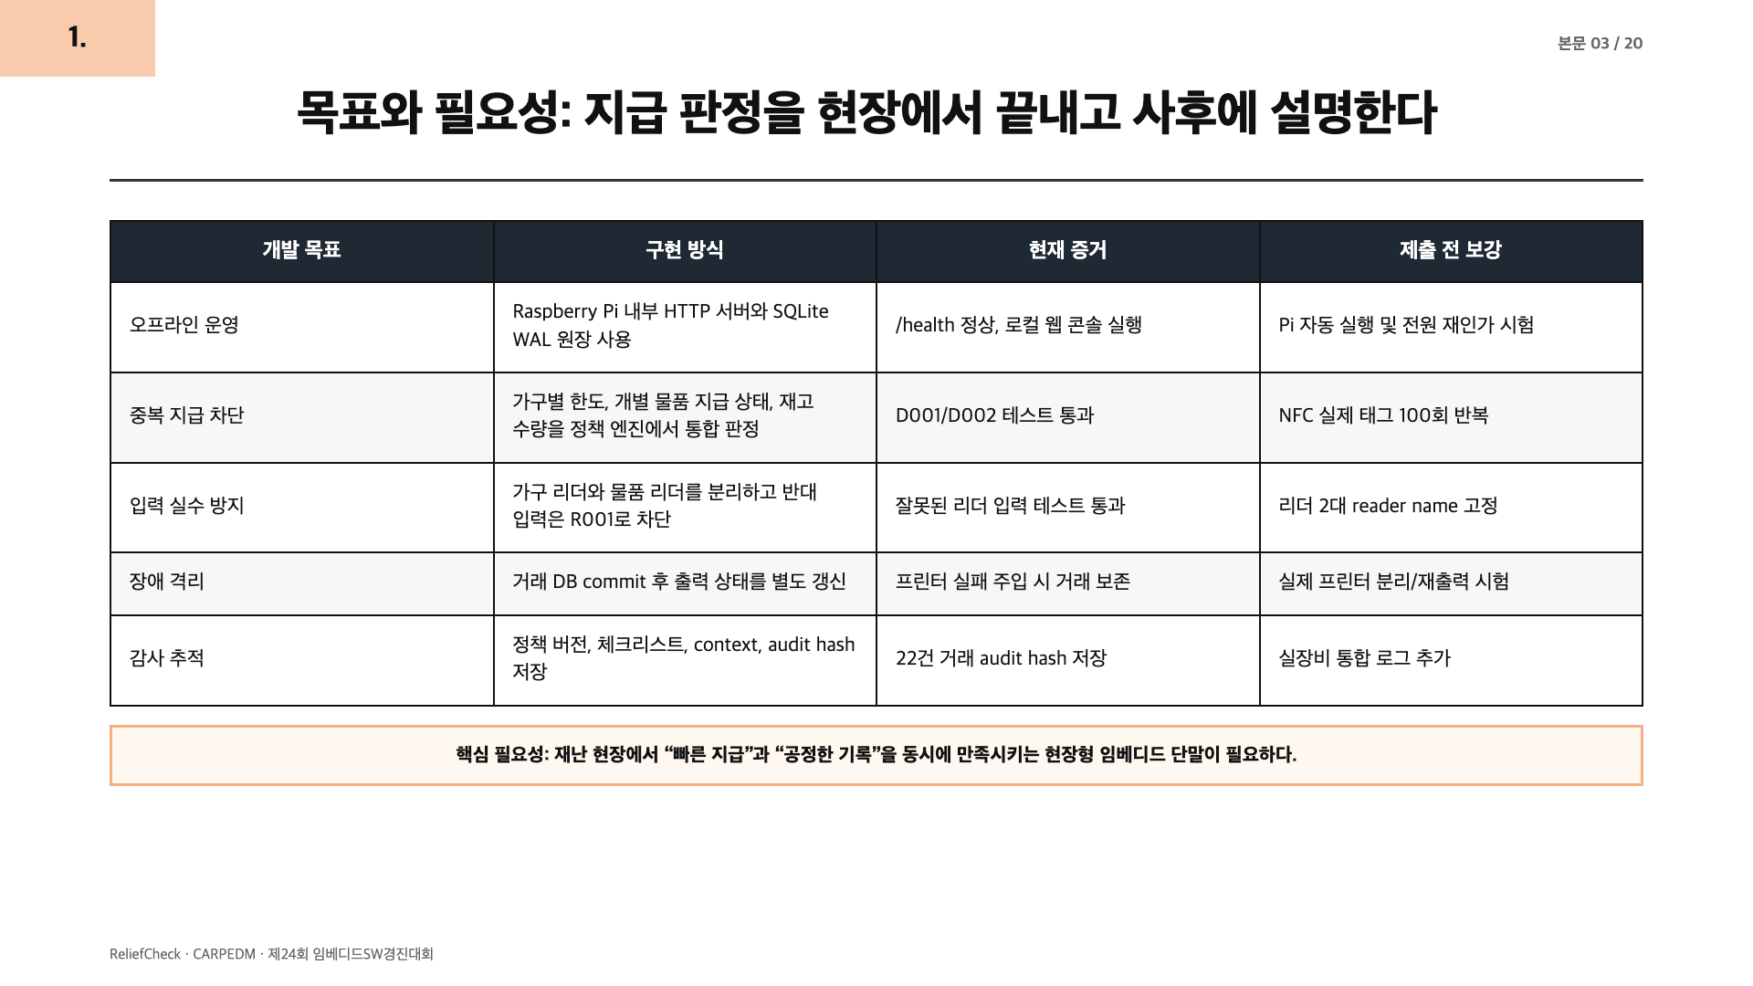
Notes:
[Sources] Sources: reports/sw-evidence-summary.md; reports/experiment-summary.md; README.md current implementation table.
Generated as a full-slide raster page to match the guide style and preserve PDF layout.

Slide 5
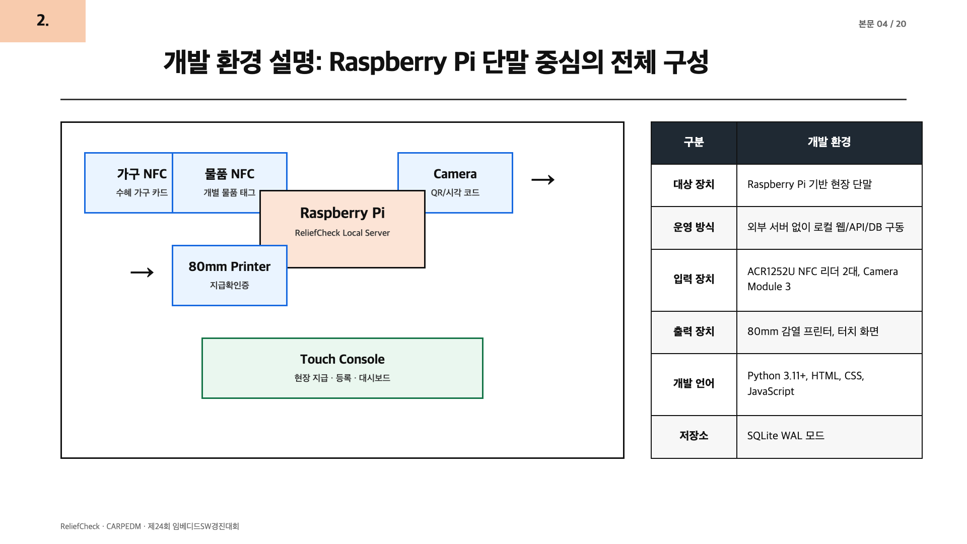
Notes:
[Sources] Sources: README.md current implementation; docs/01-mvp-architecture.md; docs/08-hardware-bringup-session.md.
Generated as a full-slide raster page to match the guide style and preserve PDF layout.

Slide 6
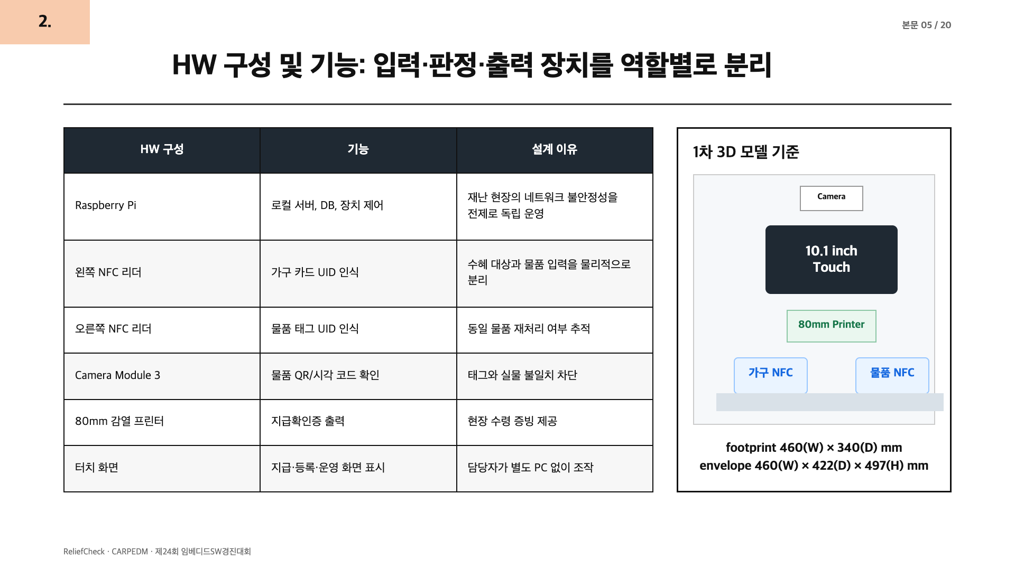
Notes:
[Sources] Sources: docs/10-3d-model-v1.md; models/reliefcheck-kiosk-v1.json; README.md hardware table.
Generated as a full-slide raster page to match the guide style and preserve PDF layout.

Slide 7
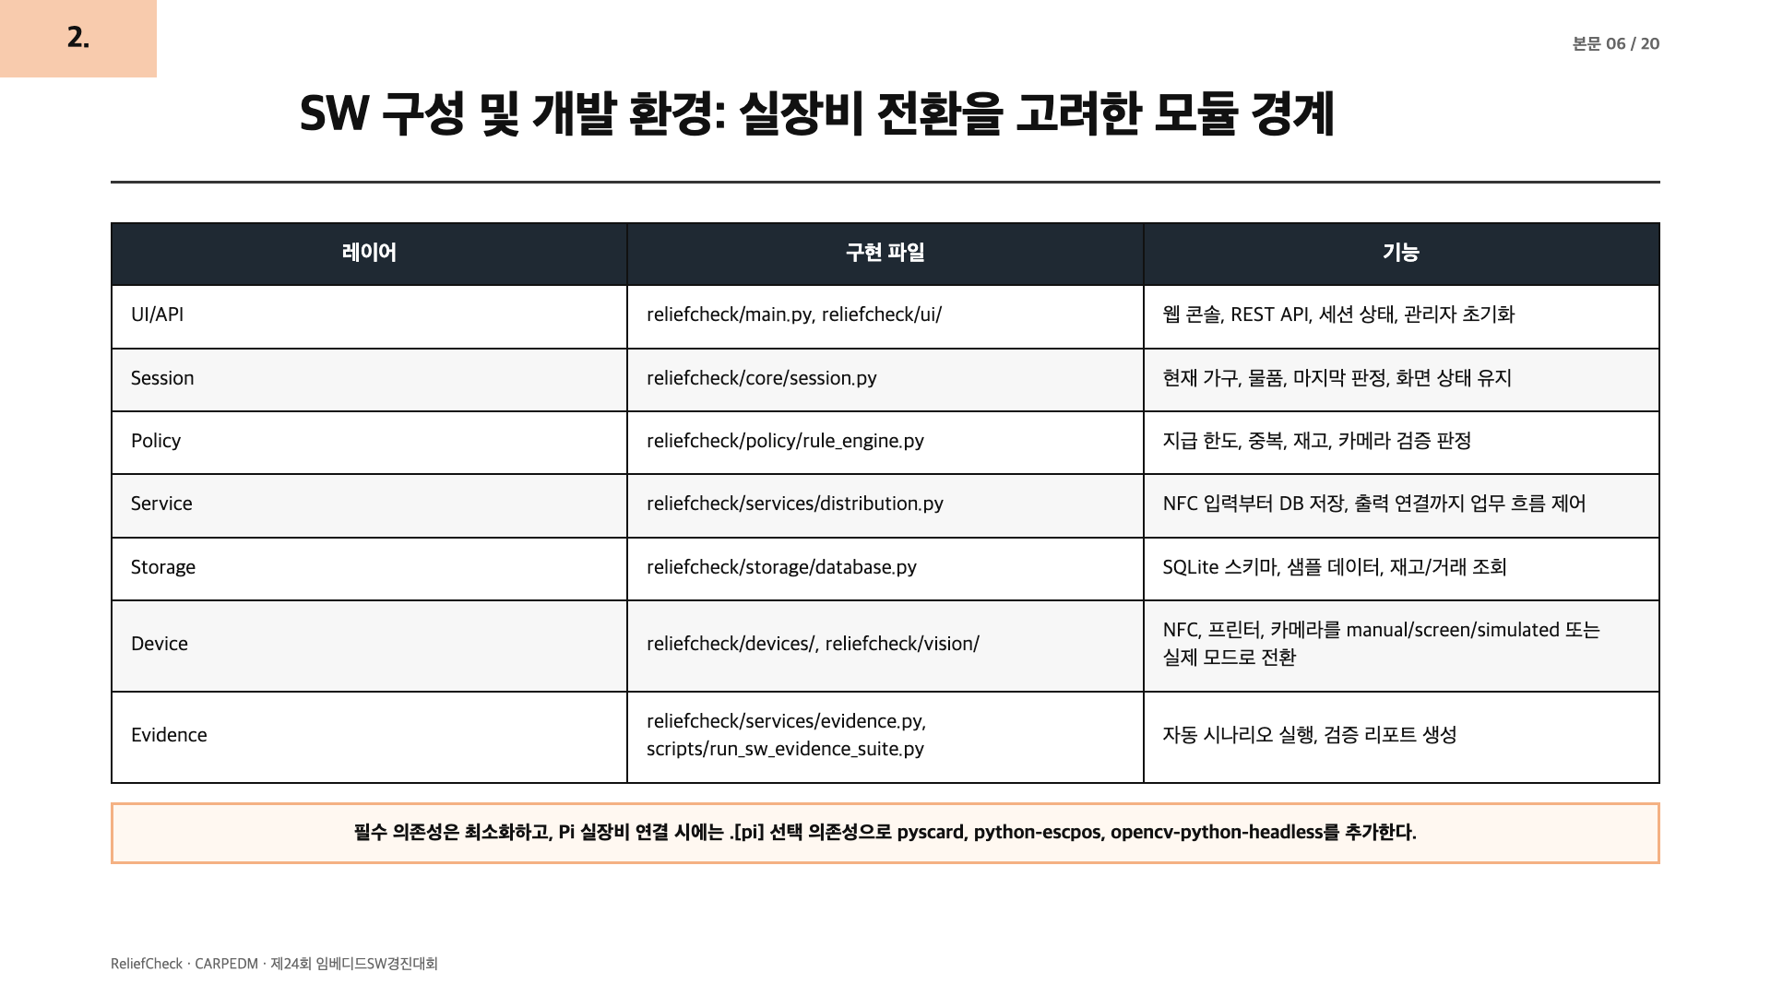
Notes:
[Sources] Sources: docs/01-mvp-architecture.md; pyproject.toml; rg function/class inspection.
Generated as a full-slide raster page to match the guide style and preserve PDF layout.

Slide 8
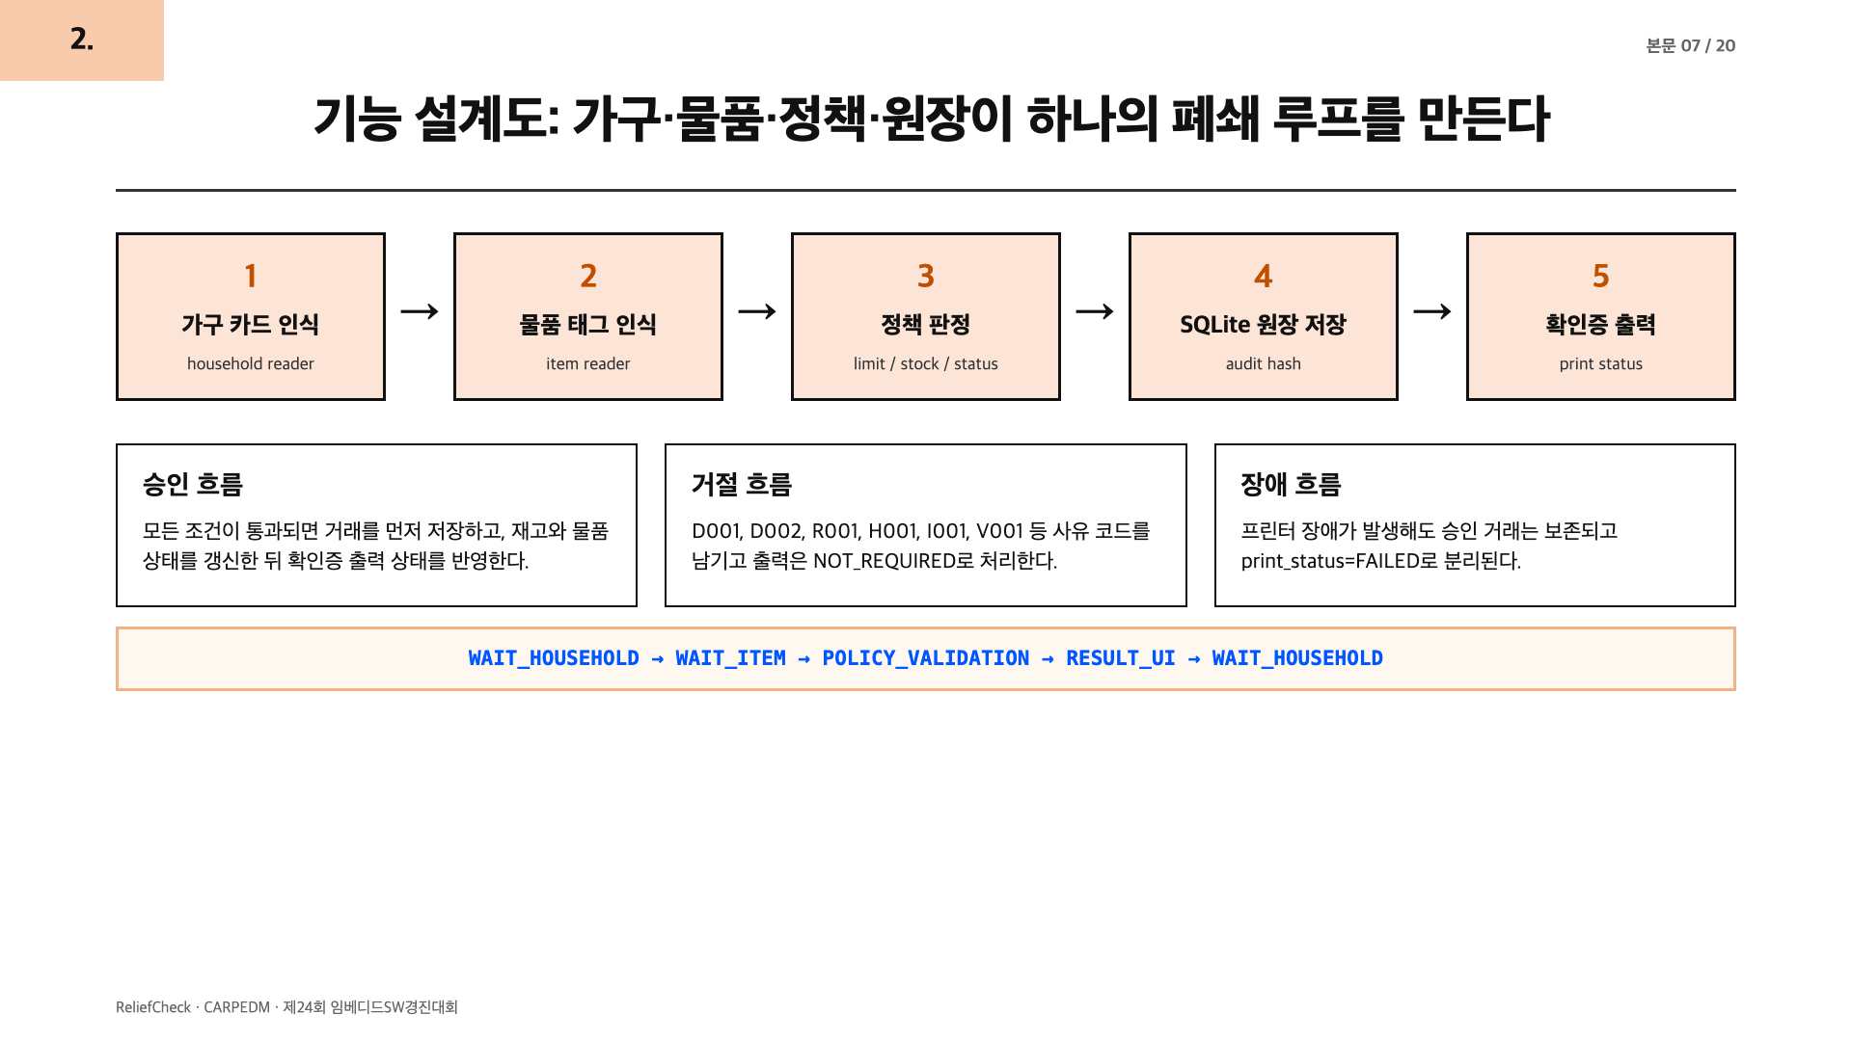
Notes:
[Sources] Sources: README.md demo flow; docs/01-mvp-architecture.md MVP state flow; reports/sw-evidence-summary.md.
Generated as a full-slide raster page to match the guide style and preserve PDF layout.

Slide 9
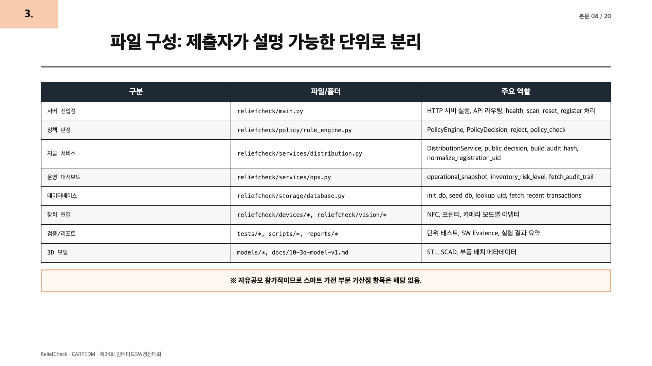
Notes:
[Sources] Sources: rg --files; rg function/class inspection; README.md 주요 파일.
Generated as a full-slide raster page to match the guide style and preserve PDF layout.

Slide 10
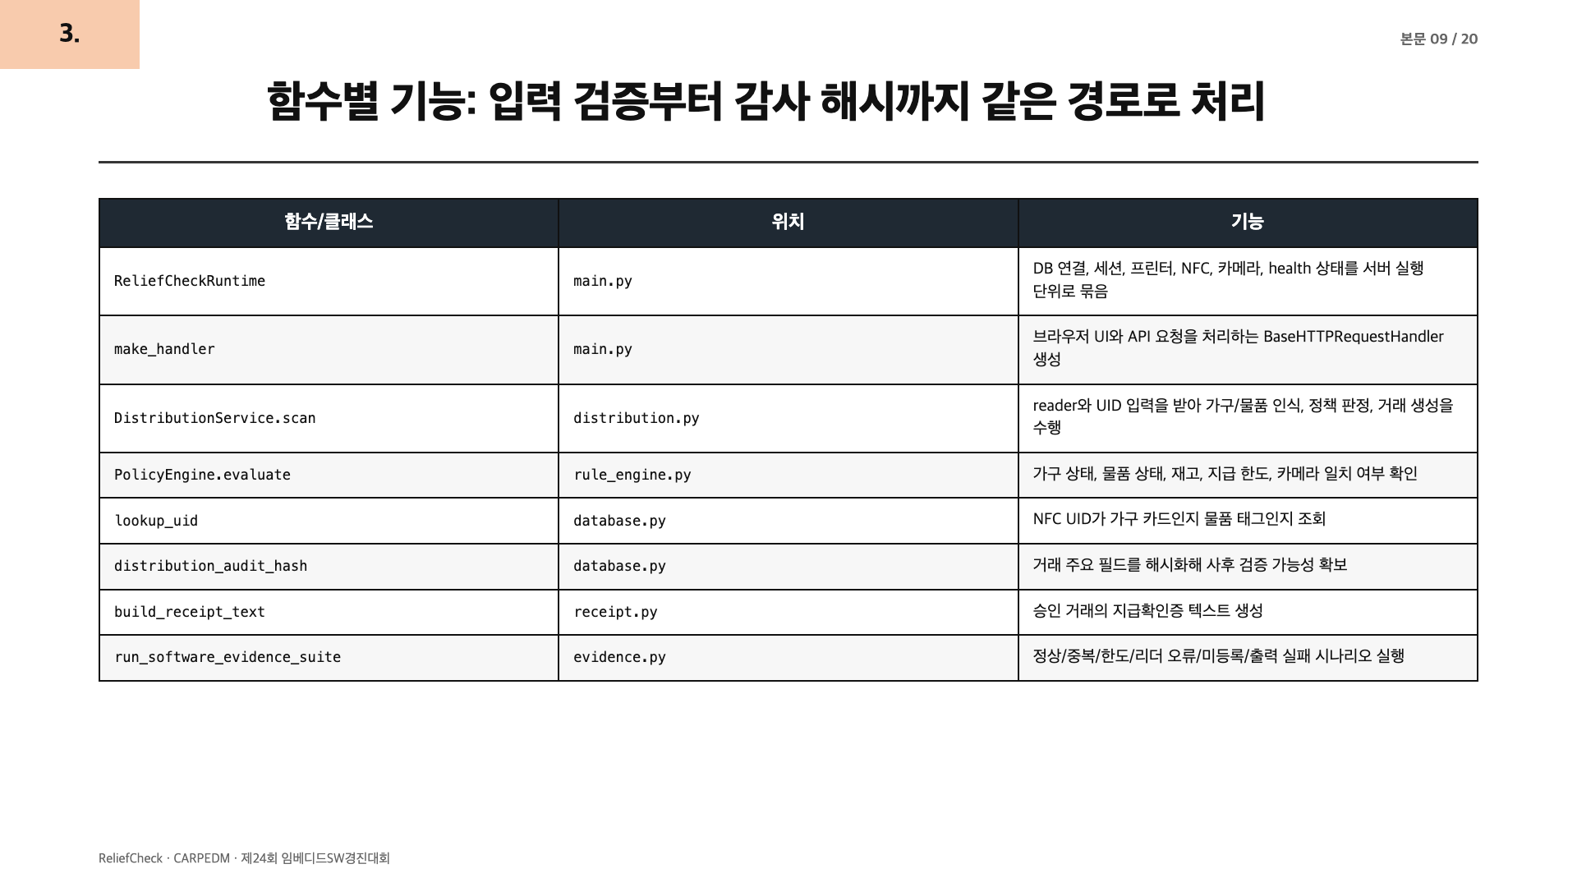
Notes:
[Sources] Sources: rg function/class inspection; reliefcheck source files.
Generated as a full-slide raster page to match the guide style and preserve PDF layout.

Slide 11
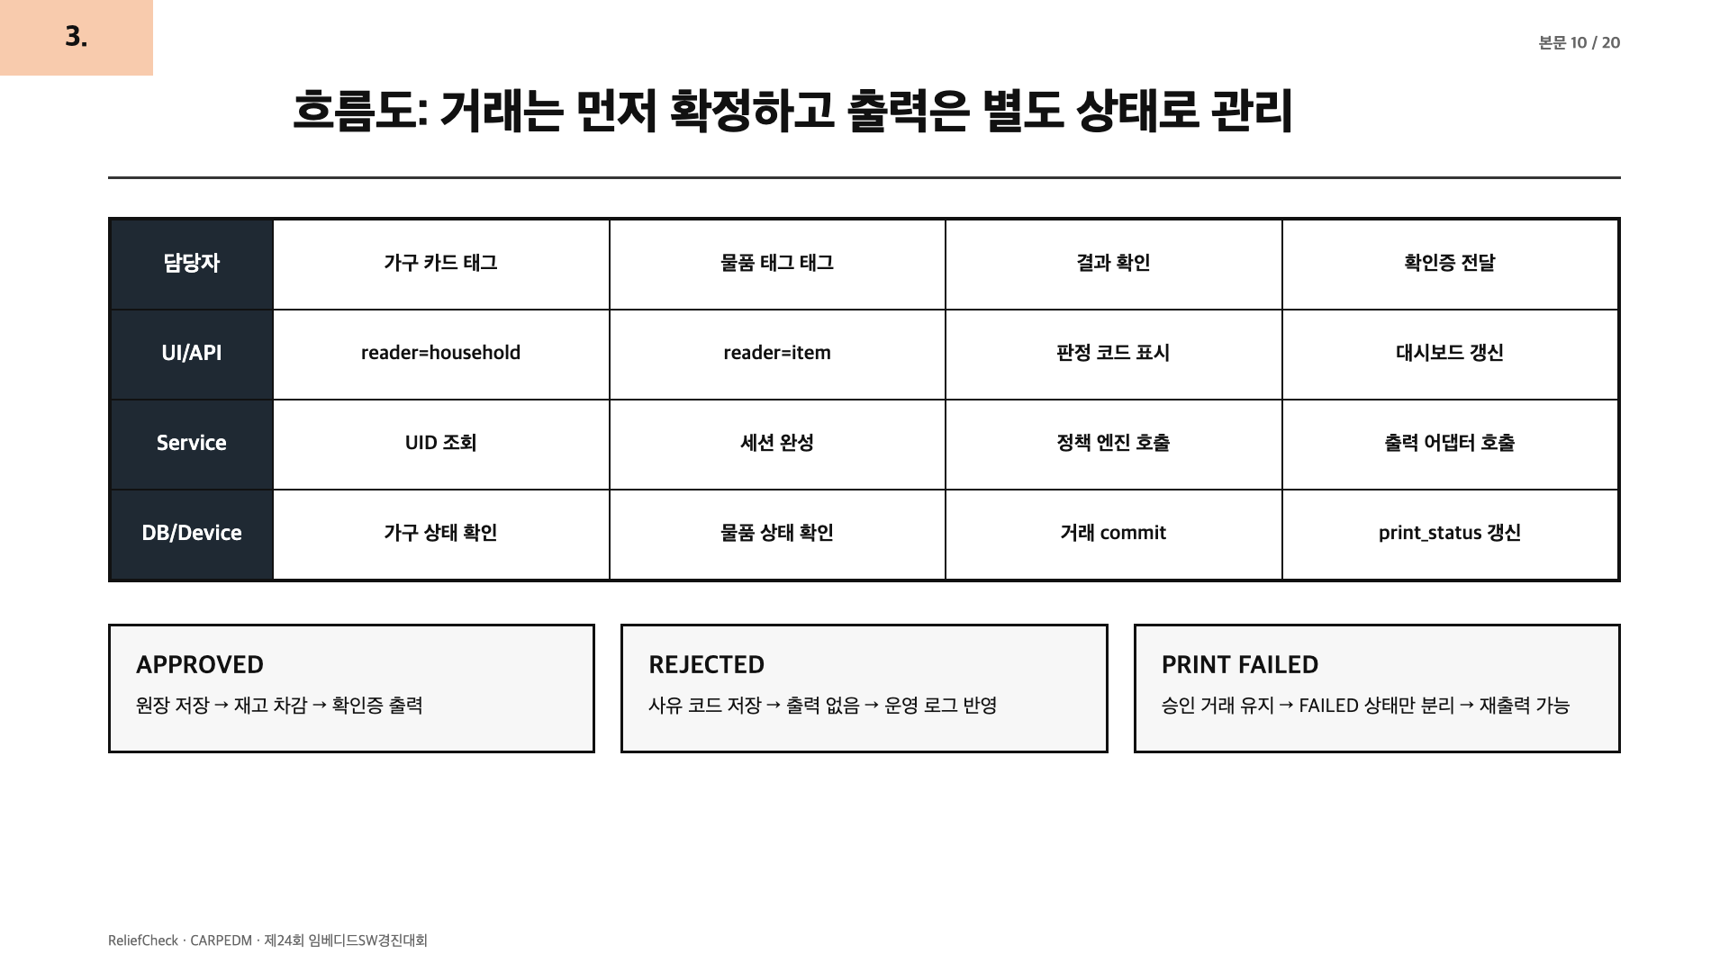
Notes:
[Sources] Sources: README.md system structure; services/distribution.py; reports/sw-evidence-summary.md PRINT_FAILURE scenario.
Generated as a full-slide raster page to match the guide style and preserve PDF layout.

Slide 12
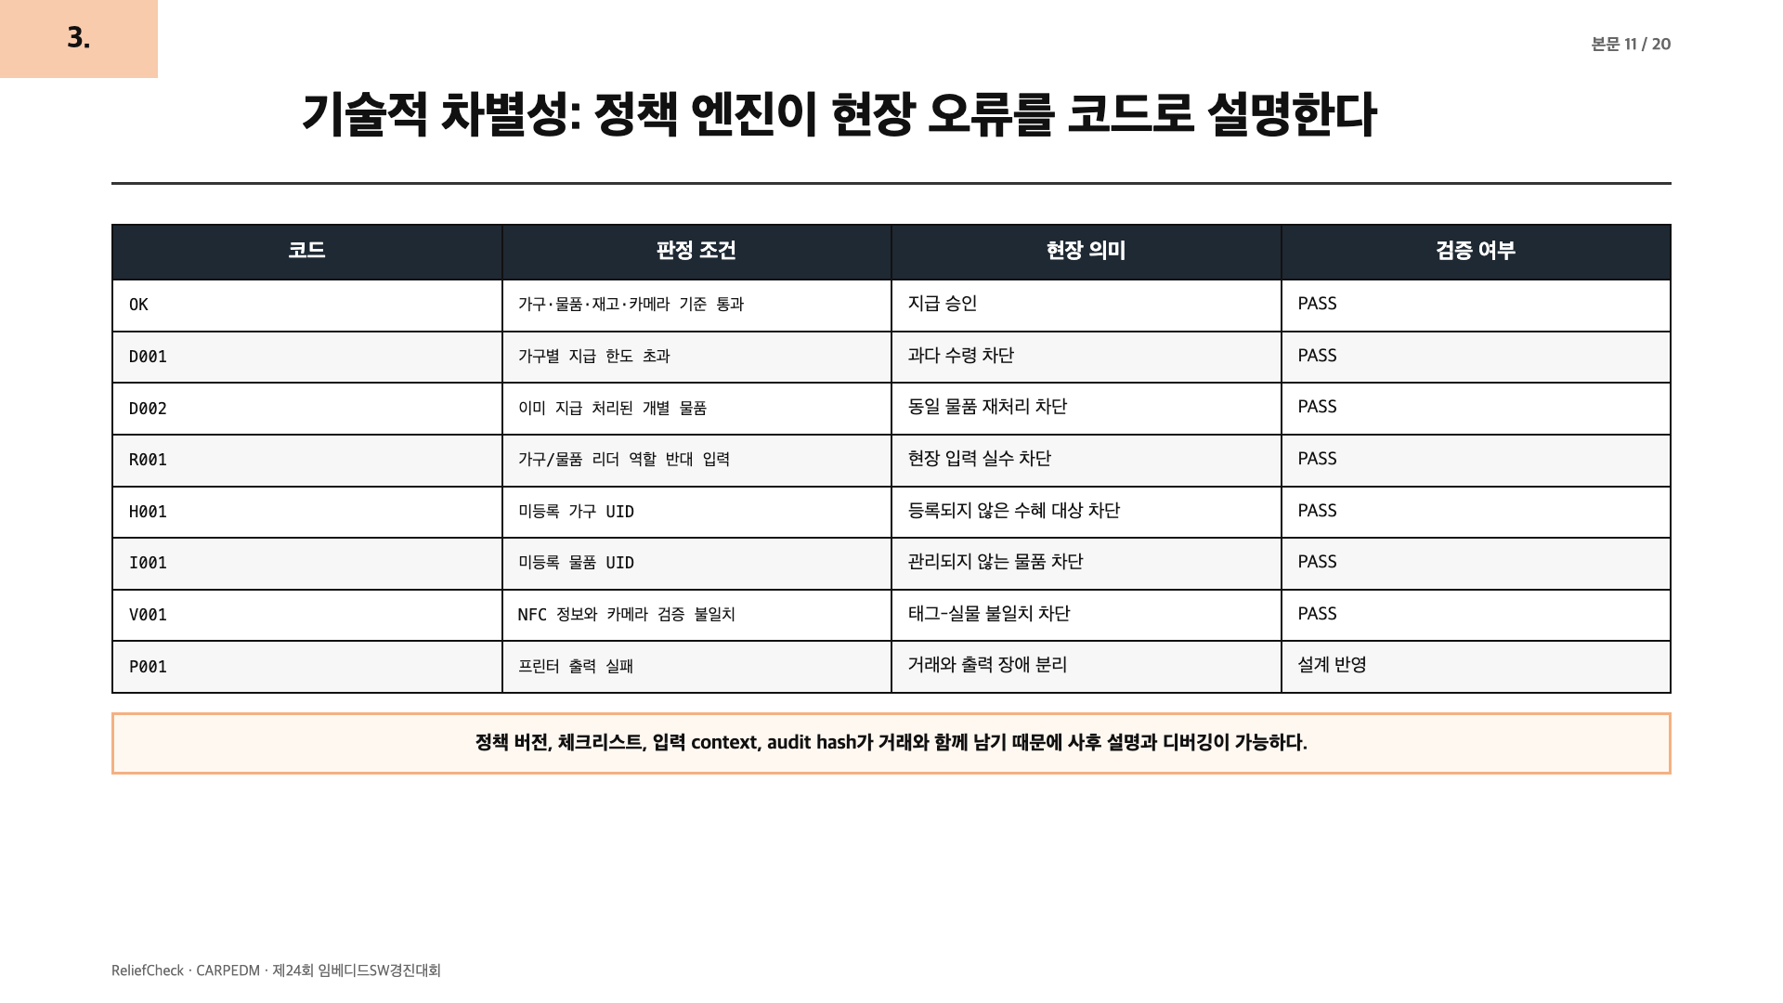
Notes:
[Sources] Sources: reports/sw-evidence-summary.md scenario result; README.md reason codes.
Generated as a full-slide raster page to match the guide style and preserve PDF layout.

Slide 13
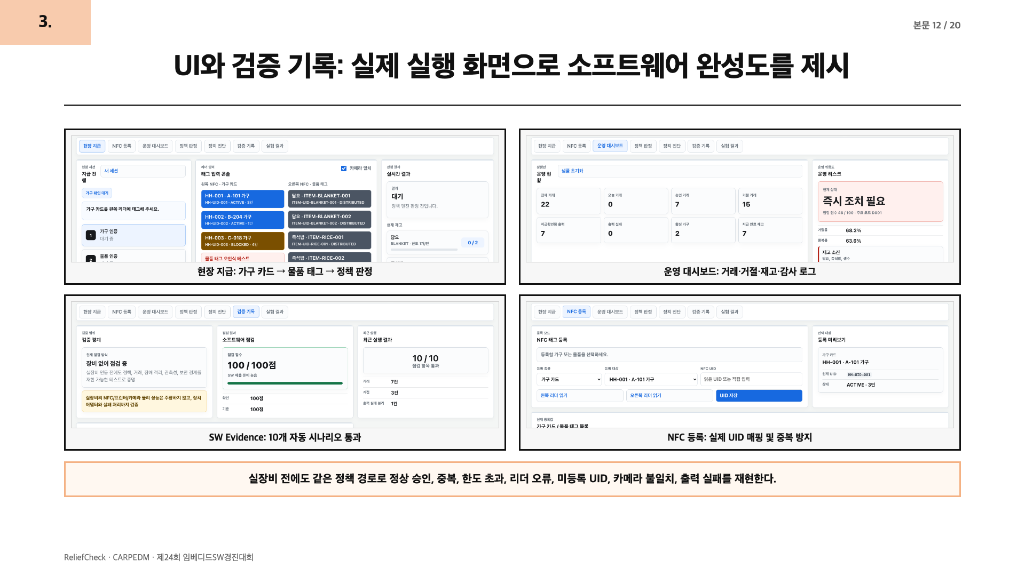
Notes:
[Sources] Sources: local ReliefCheck UI screenshots; reports/sw-evidence-summary.md.
Generated as a full-slide raster page to match the guide style and preserve PDF layout.

Slide 14
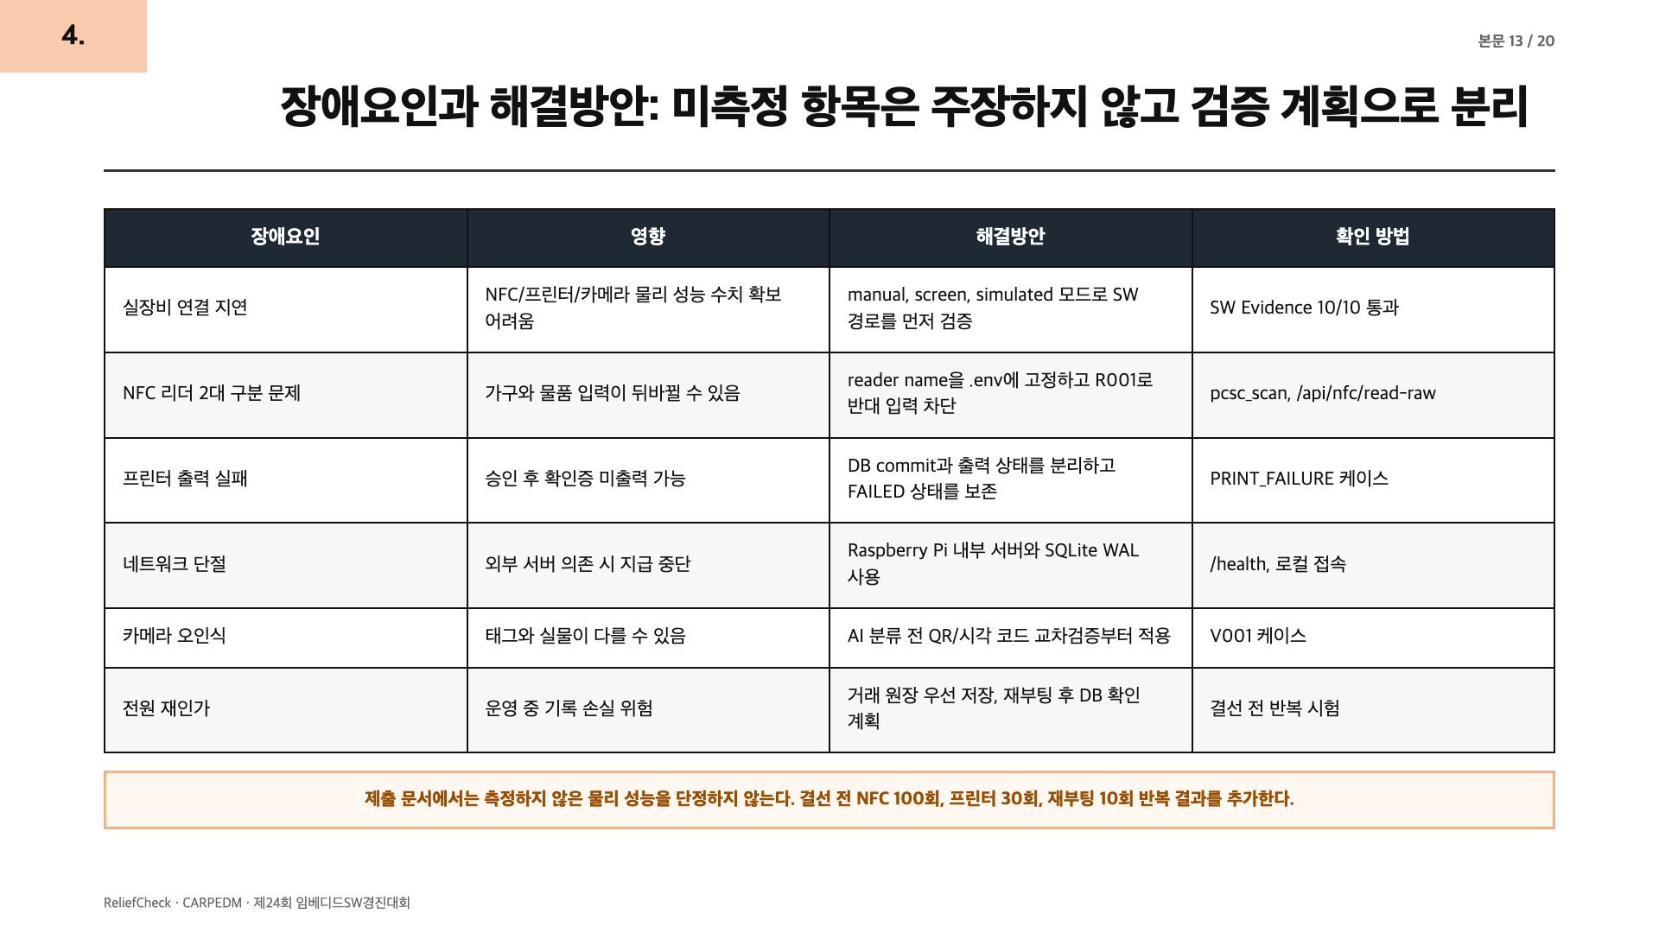
Notes:
[Sources] Sources: docs/08-hardware-bringup-session.md; docs/09-one-hour-pi-bringup.md; docs/07-competition-readiness.md.
Generated as a full-slide raster page to match the guide style and preserve PDF layout.

Slide 15
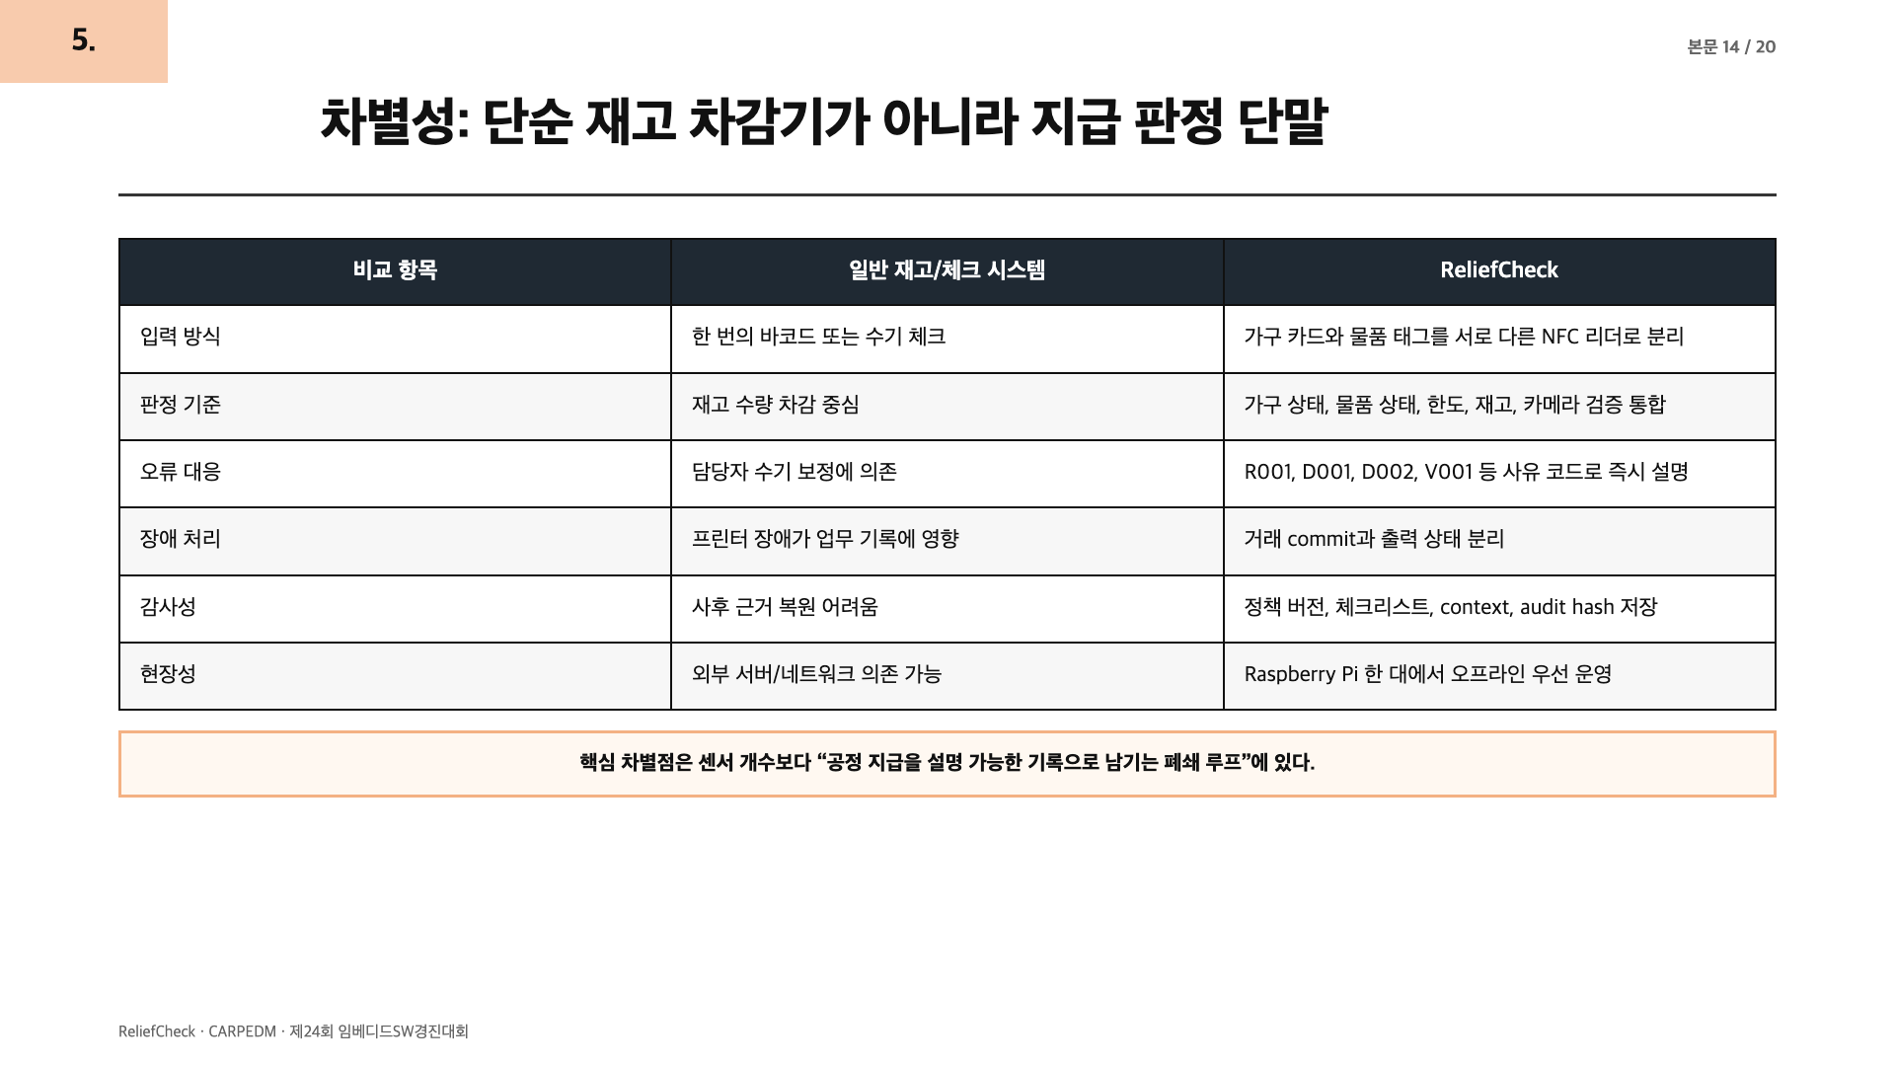
Notes:
[Sources] Sources: README.md problem definition; reports/sw-evidence-summary.md; docs/07-competition-readiness.md.
Generated as a full-slide raster page to match the guide style and preserve PDF layout.

Slide 16
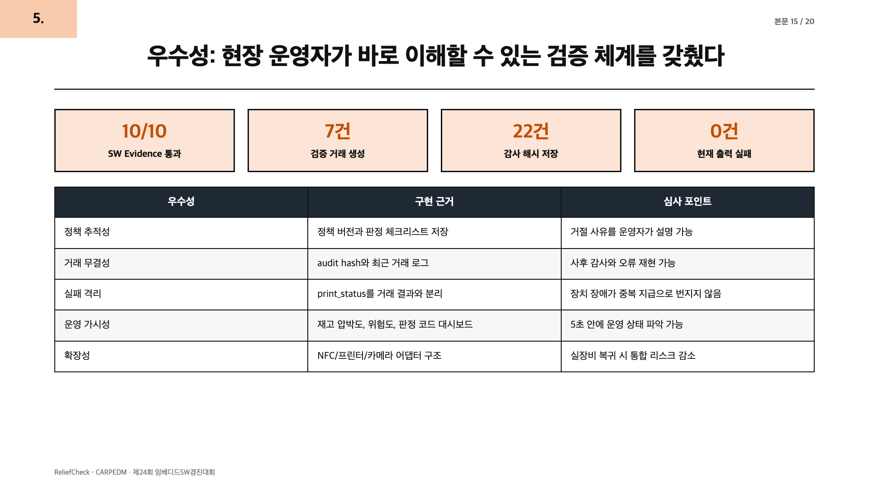
Notes:
[Sources] Sources: reports/sw-evidence-summary.md; reports/experiment-summary.md; local UI screenshots.
Generated as a full-slide raster page to match the guide style and preserve PDF layout.

Slide 17
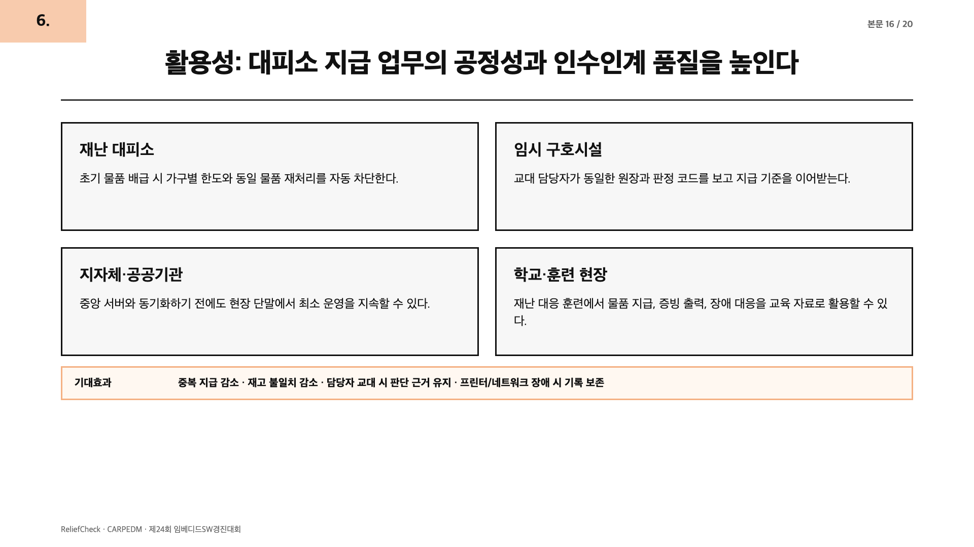
Notes:
[Sources] Sources: README.md problem and next steps; docs/03-test-plan.md.
Generated as a full-slide raster page to match the guide style and preserve PDF layout.

Slide 18
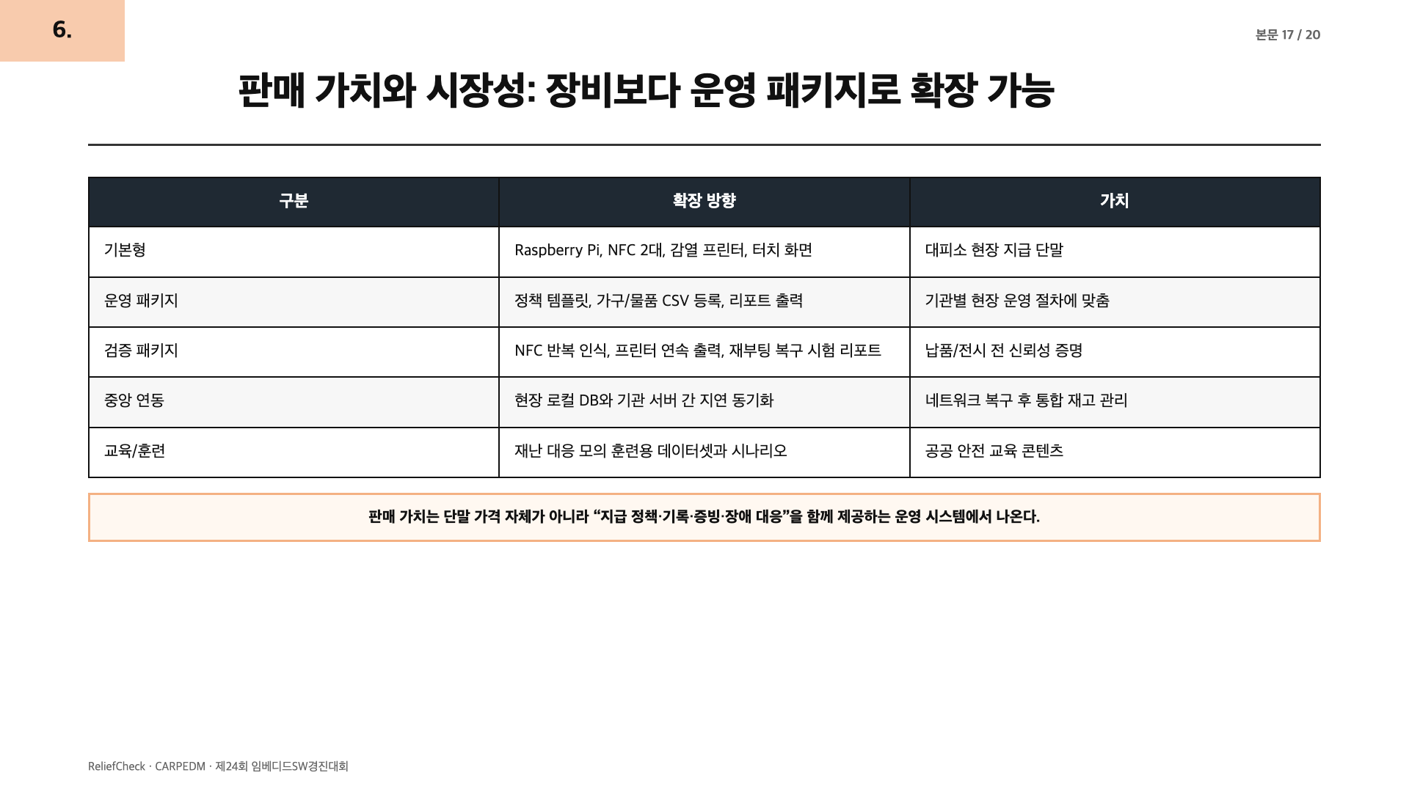
Notes:
[Sources] Sources: docs/07-competition-readiness.md; docs/03-test-plan.md; README.md 실장비 확인 범위.
Generated as a full-slide raster page to match the guide style and preserve PDF layout.

Slide 19
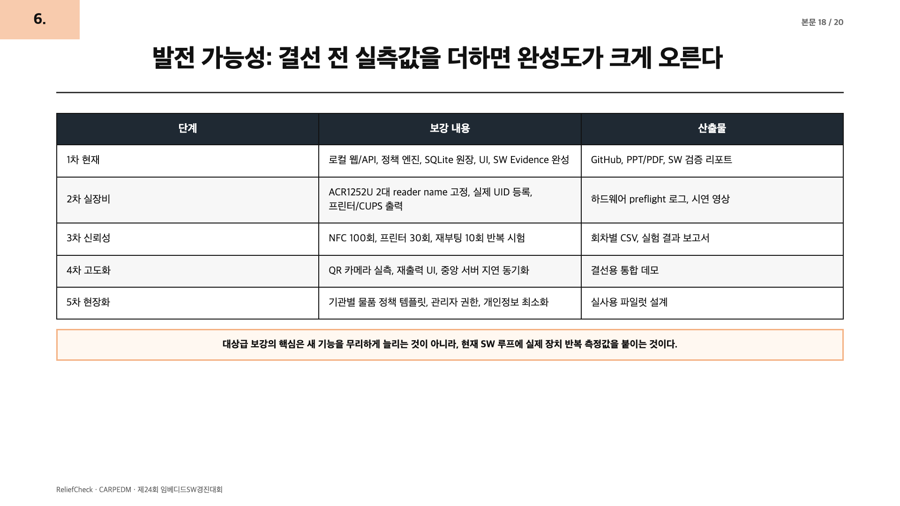
Notes:
[Sources] Sources: docs/08-hardware-bringup-session.md; docs/09-one-hour-pi-bringup.md; docs/07-competition-readiness.md.
Generated as a full-slide raster page to match the guide style and preserve PDF layout.

Slide 20
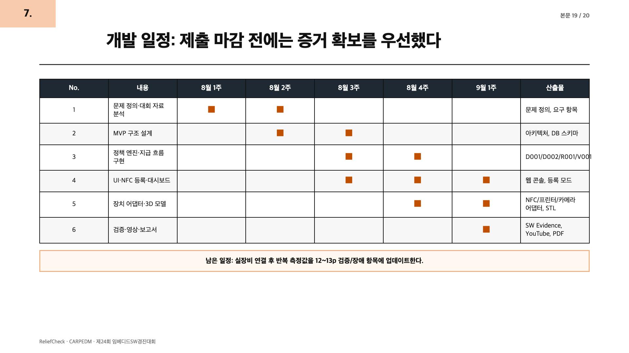
Notes:
[Sources] Sources: guide PDF item 7; repository docs and reports generated by current project.
Generated as a full-slide raster page to match the guide style and preserve PDF layout.

Slide 21
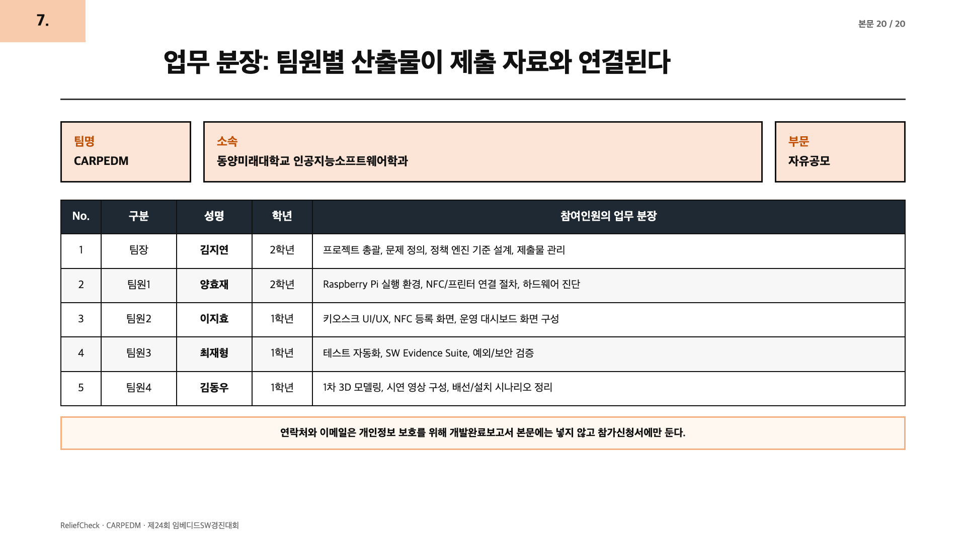
Notes:
[Sources] Sources: application XLSX team data; guide PDF item 7.
Generated as a full-slide raster page to match the guide style and preserve PDF layout.

