Slide 1
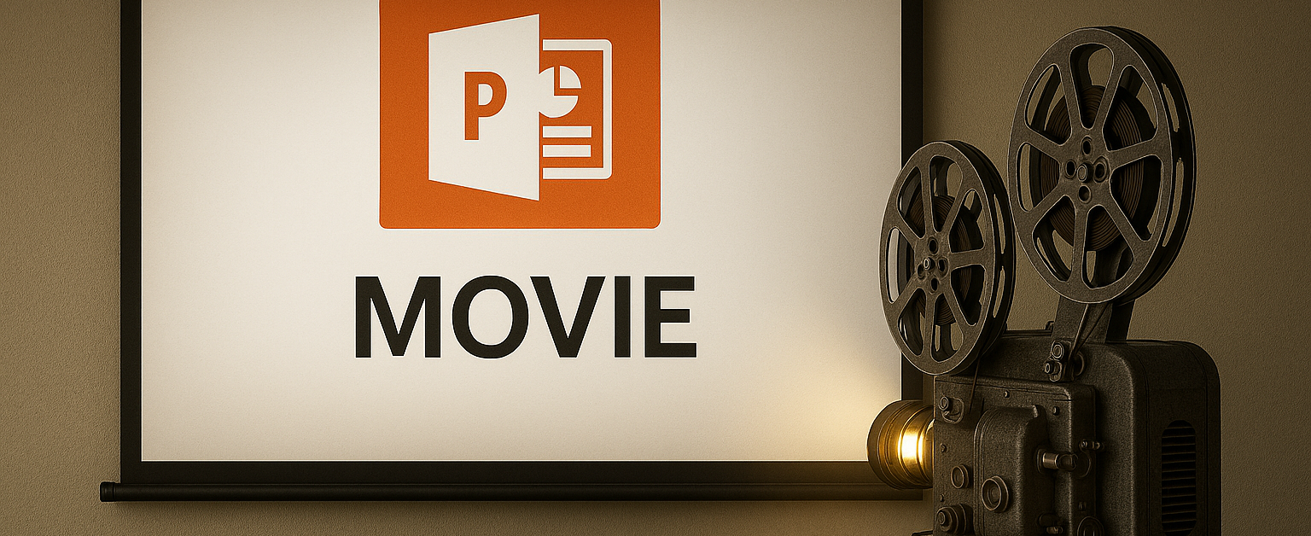
Your First Movie
Notes:
Here’s a test slide to create your first movie.

