Slide 1
CS 410 Team SDK Final Project
Shyam Sridharan (shyams4), Kaung Yang (kaungky2), Dion Hiananto(hianant2)

Slide 2
Project Overview
Features of WikiFinder:
Allow for Question Answering local to page information
Generate Summary for page
Scrape images within page

Slide 3
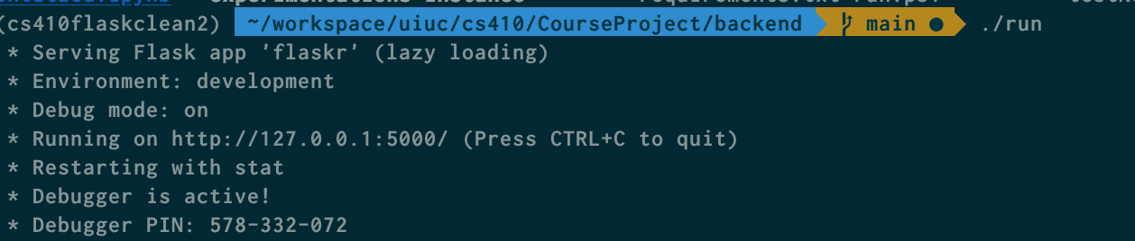
Make sure you have python 3.8 setup (you can use conda to have multiple versions of python running in your computer https://docs.conda.io/projects/conda/en/latest/commands/install.html )
Clone the repository listed in github https://github.com/sdgs72/CourseProject
Go to the backend folder and run the following command (pip3 install -r requirements.txt) also see below image
Installing scikit might be problematic since it depends on any OS version and some other global python packages you might have, please use google to find out on how to fix it
Run the python setup script to install nltk data packages using (python3 setup.py)
In windows you might just use python instead of python3, but make sure that you are using the same python 3.8 environment that is running as in the previous step
Run the run script (./run). (This will run on port 5000, make sure that it port 5000 is not used by anything else)
Please use windows powershell if you are in windows to run the run script
Setup - Backend

Slide 4
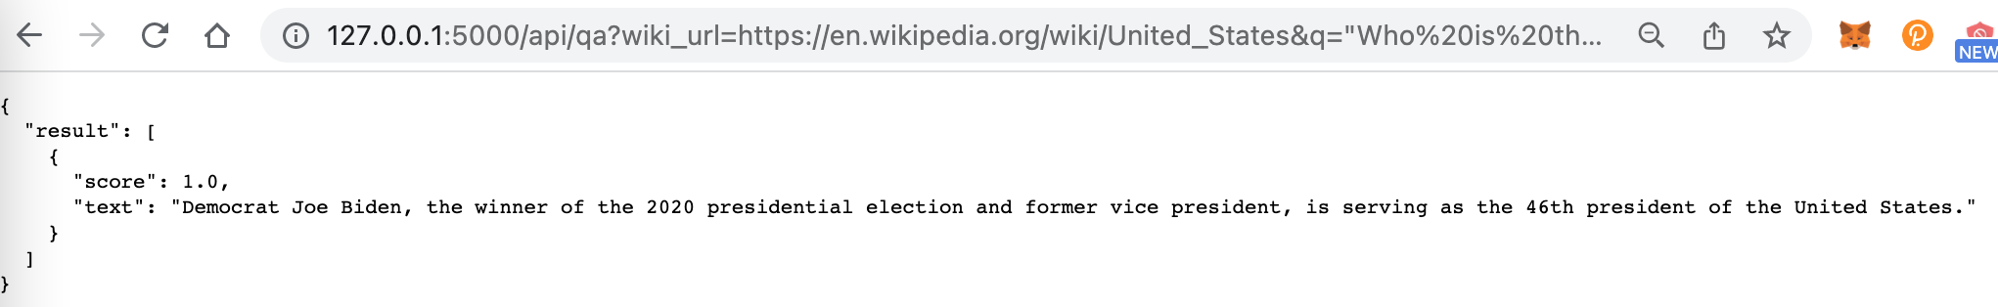
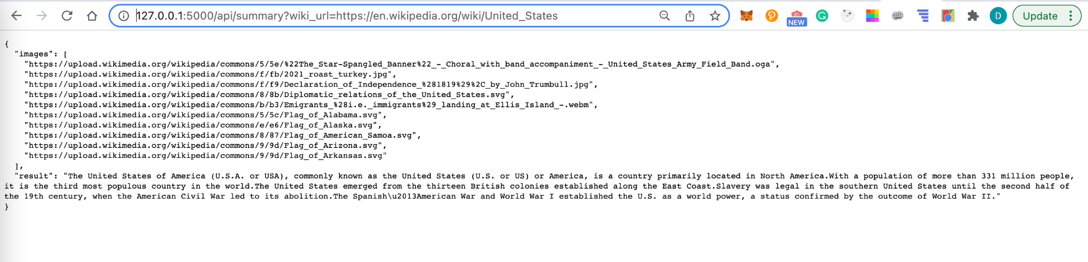
Wait for a few minute after running it and you can test out the API for QA using the following GET request http://127.0.0.1:5000/api/qa?wiki_url=https://en.wikipedia.org/wiki/United_States&q=%22Who%20is%20the%20president%22 . (The wiki_url parameter is the wiki link and q parameter is the question)
You can also try out the summary API using this URL (http://127.0.0.1:5000/api/summary?wiki_url=https://en.wikipedia.org/wiki/United_States use wiki_url as the wikipedia URL)
API - Backend

Slide 5
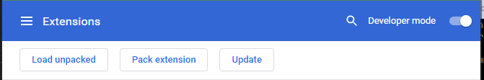
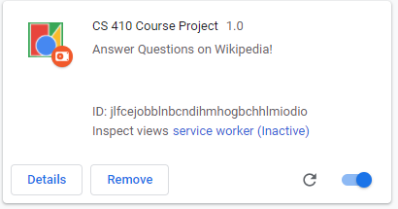
Install google chrome on your computer if you have none
Open the Extension Management page by navigating to chrome://extensions in your chrome browser. You will then be brought up to a window containing chrome extensions.
Make sure that the Developer mode option is enabled (located in the top right)
Click the load unpacked button and select the path to our project’s extension folder. (IE …../CourseProject/extension )
The plugin should be loaded at this point ( it should show CS410: CourseProject)
Setup - Frontend

Slide 6
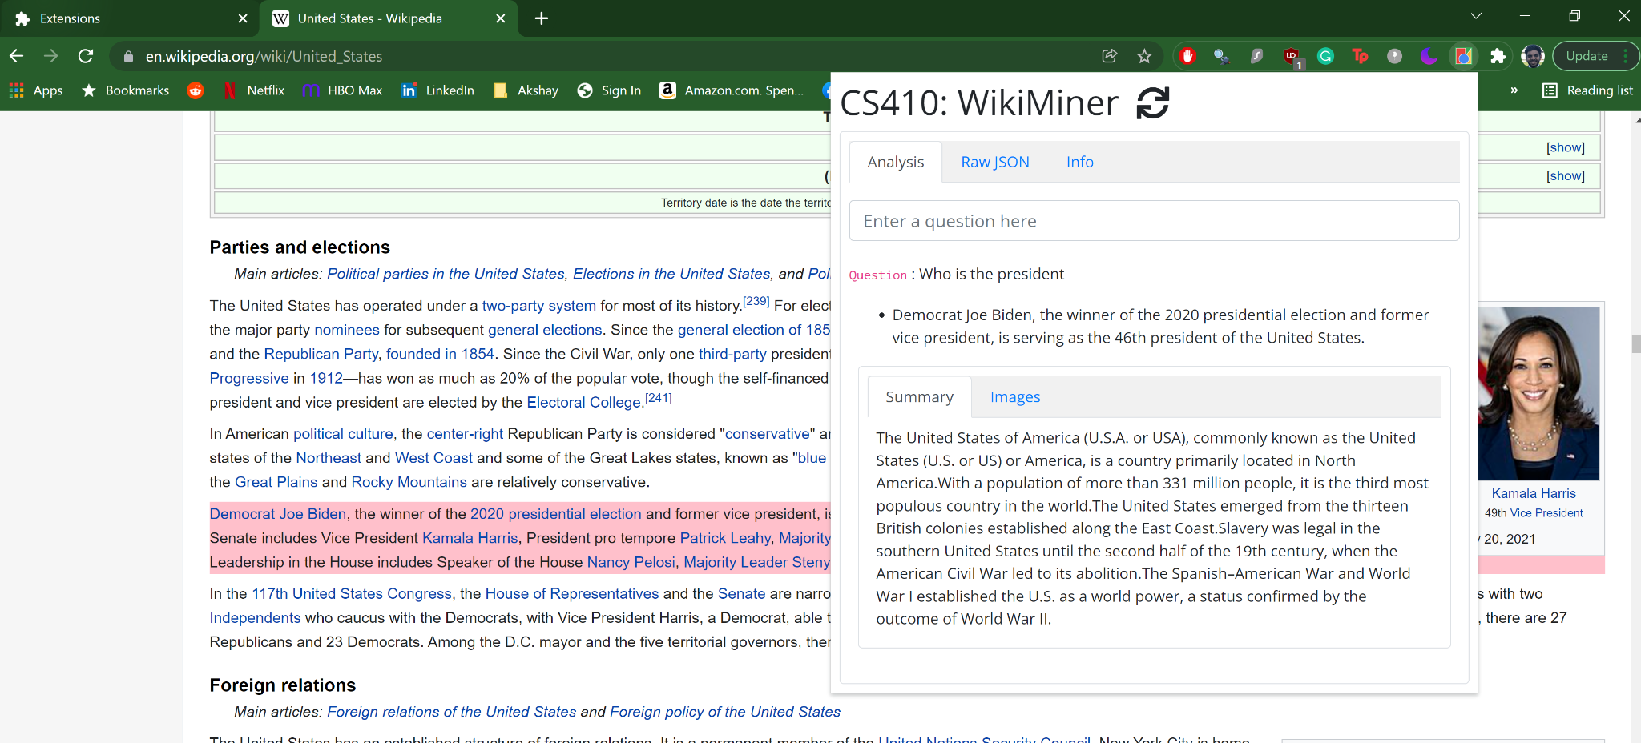
Demo

