Slide 1

Two Jug Problem- How To Run(1/2)
Prerequisite
  Make sure that Java 7 (or) later installed on your machine
  On Windows
  If Java is not there, simple go here
    http://www.oracle.com/technetwork/java/javase/downloads/jdk7-downloads-1880260.html

Slide 2
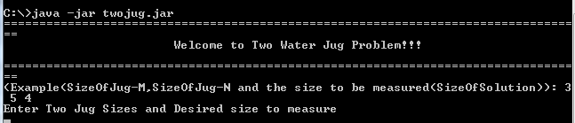
Two Jug Problem – How To Run(2/2)
Download the twojug.zip and unzip
  For example, I have downloaded to C:\
Execute
  java -jar twojug.jar
  Ex:

