Slide 1


The Battle of Neighborhoods
Capstone Project

Slide 2
Business Problem
compare the Neighbourhoods of New York and Toronto for the availability of
sports classes (gyms)
The problem: to determine similarity and (or) dissimilarity.
I will:
retrieve the top 100 venues that are in the Neighbourhoods of a city within a radius of 1000 meter;
explore, analyse and cluster the Neighbourhoods of the two cities;
use and compare the top ten venues around the Neighbourhood

Slide 3
DATA
For Toronto:
https://en.wikipedia.org/wiki/List_of_postal_codes_of_Canada:_M, - dataset containing the Borough, Neighbourhood with Latitude and Longitude for Toronto
For New York:
https://geo.nyu.edu/catalog/nyu_2451_34572 - dataset containing the Borough, Neighbourhood with Latitude and Longitude coordinates for New York city
For both - Foursquare API

Slide 4
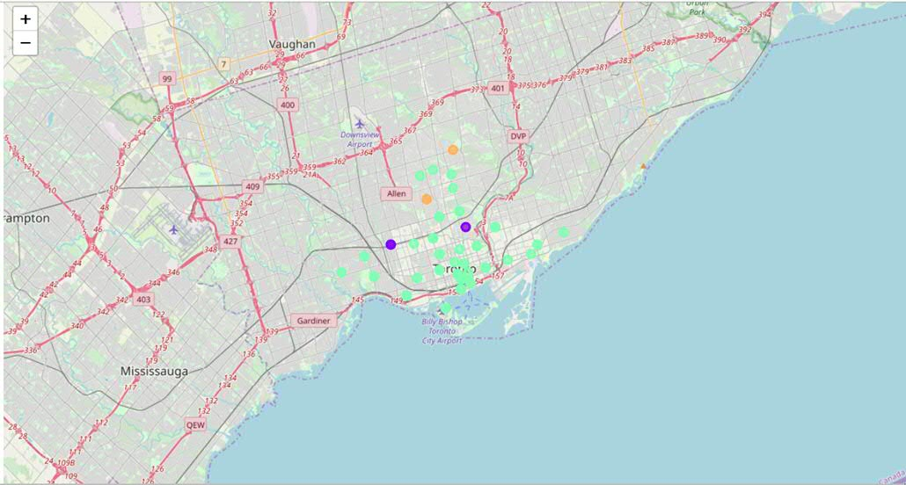
TORONTO

Slide 5
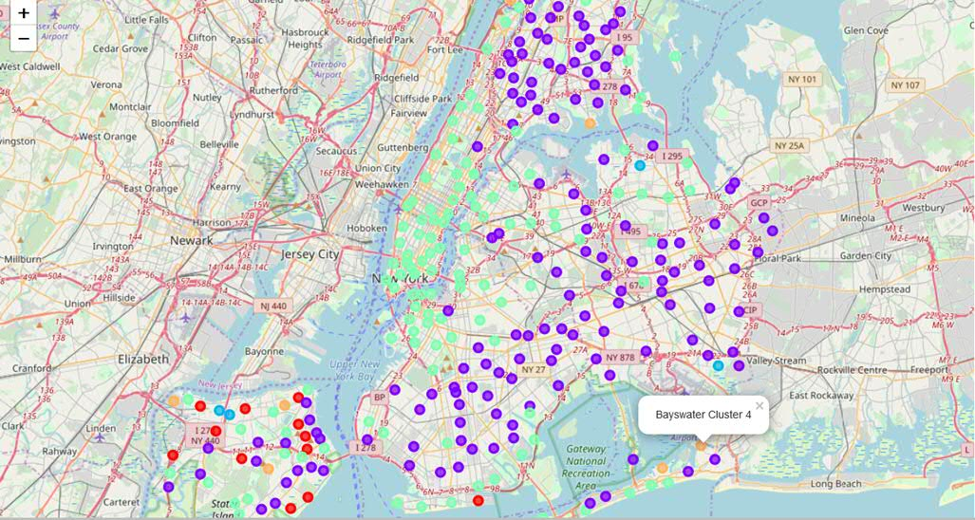
NEW YORK

Slide 6
FINDINGS
Similarities: Both the cities are on waterfronts. Neighbourhoods have proximity to Restaurants with all types of cuisine, Bars, Parks, Culture Centers. Very ethnically diverse. Both the cities propose a lot of opportunities for training and sport activities
Dissimilarities: New York neighbourhoods have more gyms for sports activities compared to Toronto.

Slide 7
CONCLUSION
The stakeholders can use this approach to compare Neighbourhoods effectively.

