Slide 1
Digital Portfolio
STUDENT NAME: Dhanuja Sivakumar
REGISTER NO AND NM-ID:546C1AB8E0EECF8B68544C2A91F646C7
DEPARTMENT: B.C.A - 2nd year
COLLEGE: M.R.K – Collage of arts and science
(Affilatted to Annamalai University)

Slide 2
PROJECTTITLE : Portfolio Creation

Slide 3


AGENDA
Problem Statement
Project Overview
End Users
Tools and Technologies
Portfolio design and Layout
Features and Functionality
Results and Screenshots
Conclusion
Github Link
3/21/2024 Annual Review

Slide 4

PROBLEM STATEMENT
Many students find it difficult to showcase their skills and projects
in a professional way. A personal portfolio website helps by
presenting information in a structured, attractive, and accessible
format that can be shared with recruiters, faculty, and peers.

Slide 5

PROJECT OVERVIEW
This project is a personal portfolio website designed with a
dark theme and responsive layout. It showcases my technical
and creative skills, highlights my projects, and provides contact
links for networking. The portfolio acts as a digital resume that
represents my academic and career readiness.

Slide 6

WHO ARE THE END USERS?
• Students (for project submission & self-branding)
• Recruiters and Employers
• Faculty and Evaluators
• Professional Network and Peers

Slide 7

TOOLS AND TECHNIQUES
• HTML – Structure of the portfolio website
• CSS – Styling and dark theme design
• JavaScript – Interactivity and smooth scrolling
• Tailwind CSS – Utility-first styling framework
• GitHub Pages – Hosting the live portfolio website

Slide 8
POTFOLIO DESIGN AND LAYOUT
• Dark themed, modern responsive design
• Smooth scrolling navigation
• Skills section with glow effects
• Project cards with Live Demo & Code links
• Contact section with quick links
<number>

Slide 9
FEATURES AND FUNCTIONALITY
• About Me section (Introduction & background)
• Skills showcase (Technical + Creative)
• Projects with live demo and GitHub links
• Contact details with quick connect options
• Responsive design for desktop & mobile

Slide 10
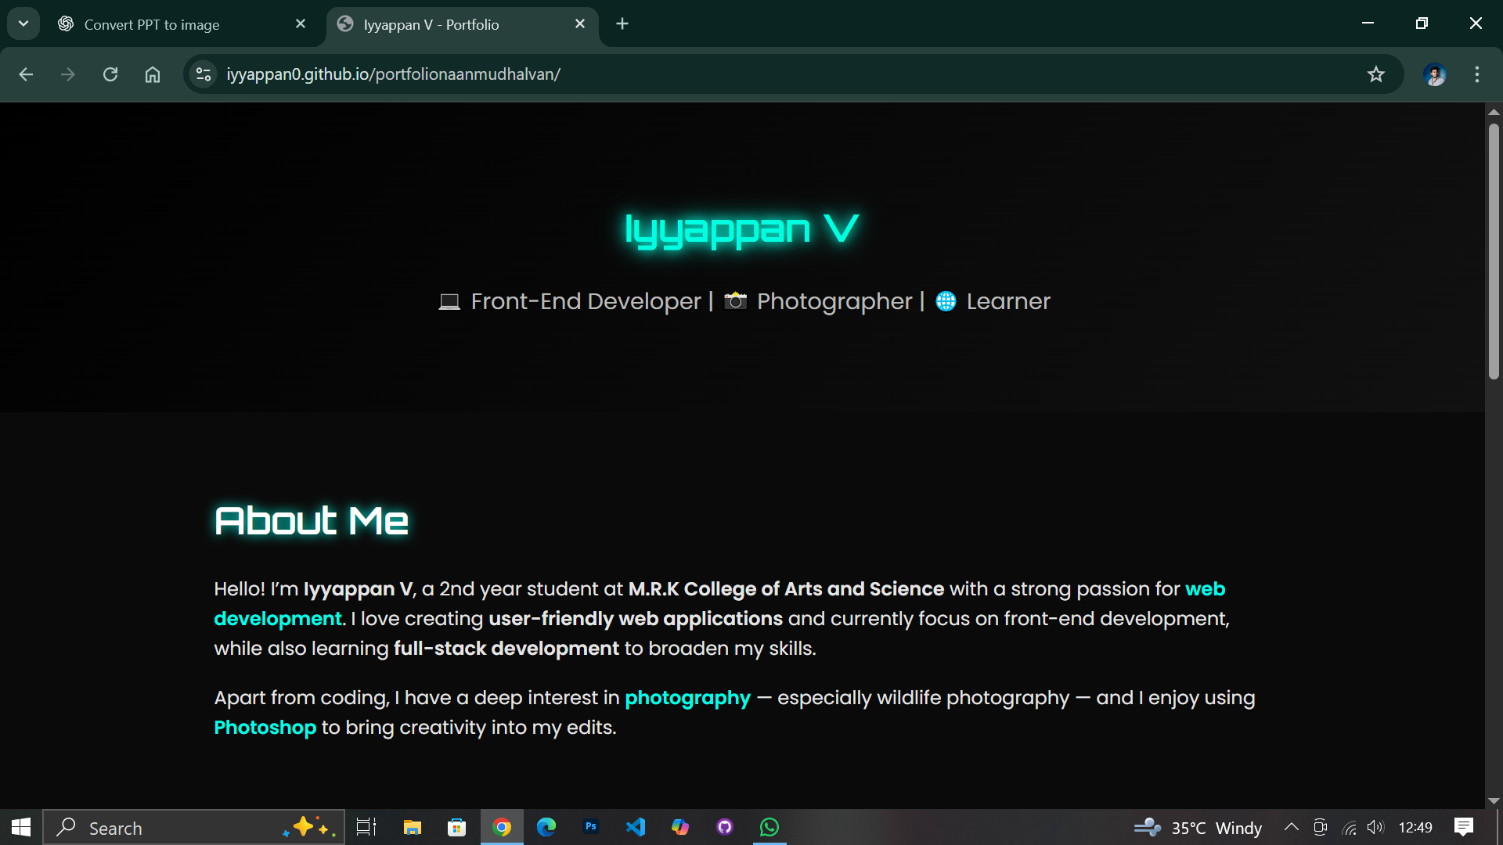
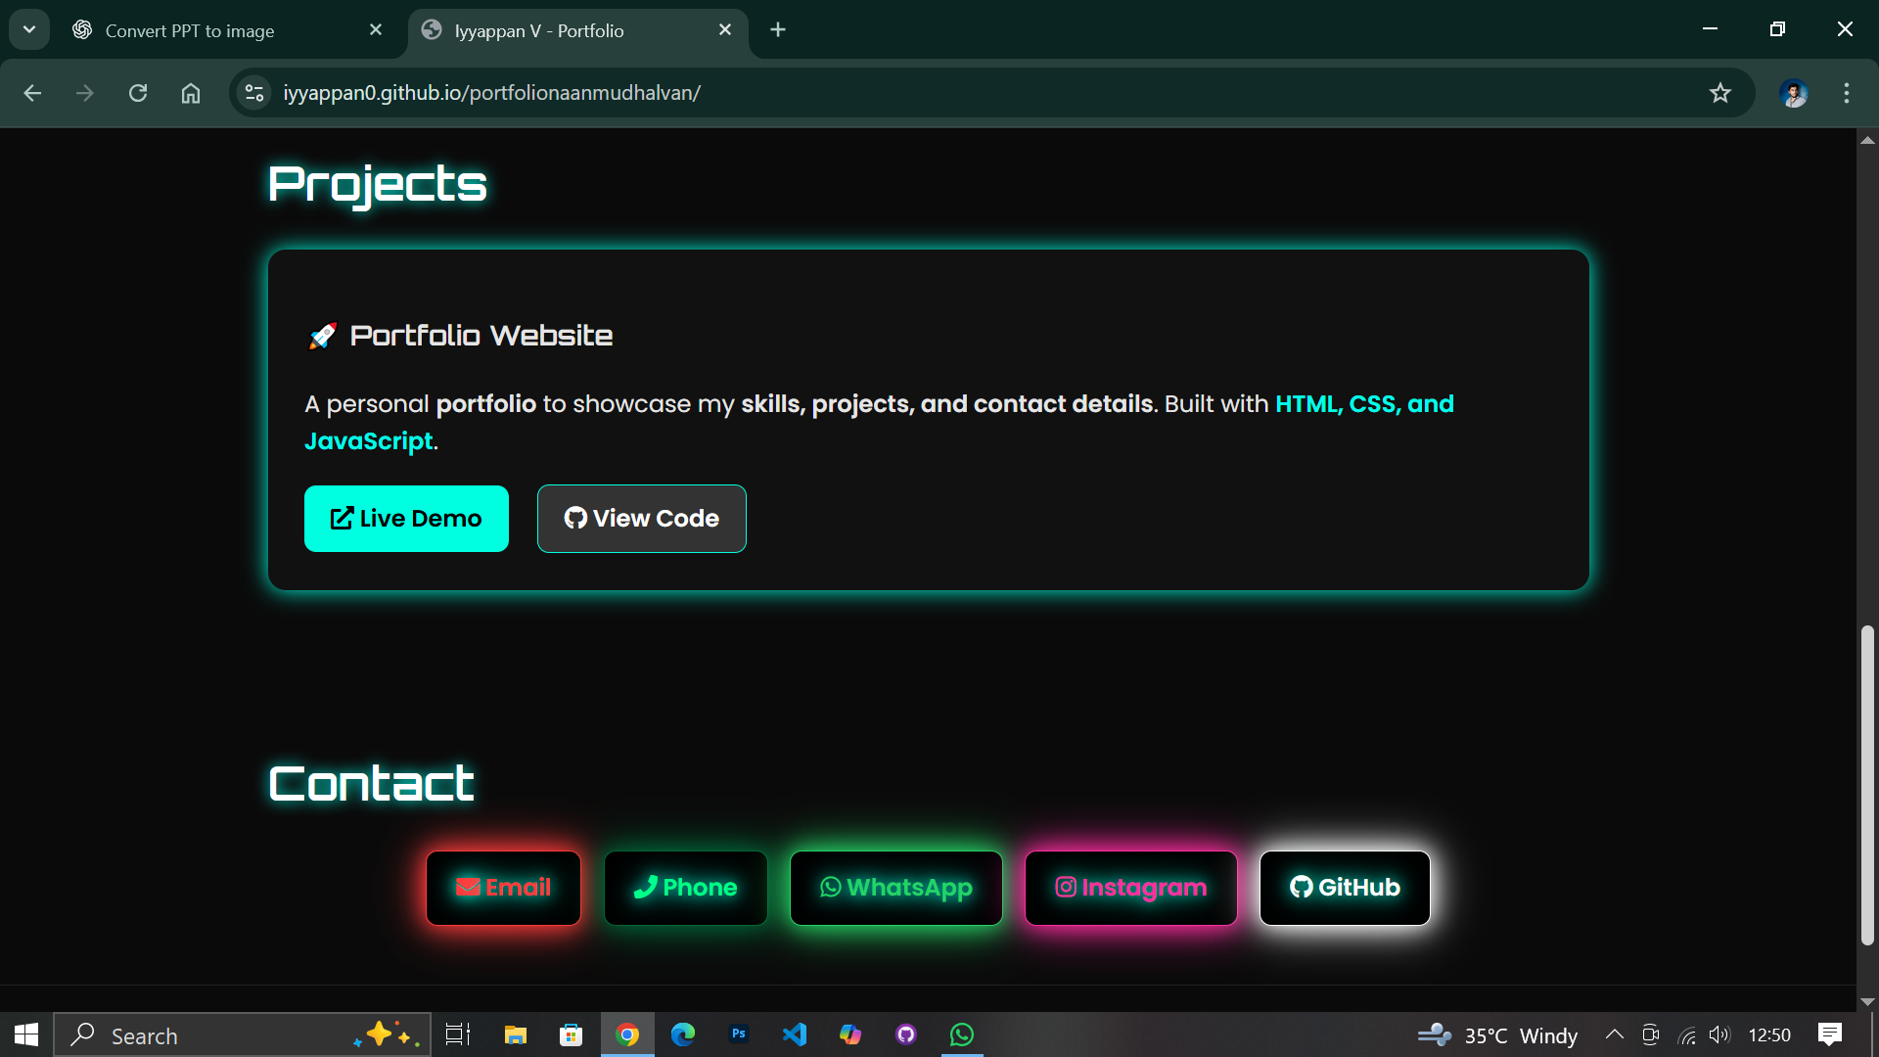

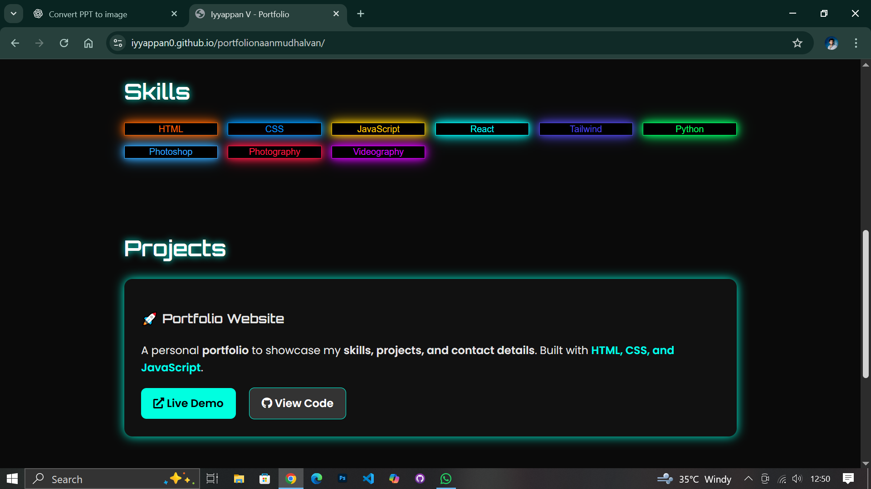
RESULTS AND SCREENSHOTS
Simple
3/21/2024 Annual Review
<number>

Slide 11
CONCLUSION
This portfolio project demonstrates my web development
skills and creativity. It serves as a professional digital identity
that highlights my abilities and prepares me for academic and
career opportunities.
GitHub Repository:
https://sdhanuja516-sys.github.io/my-portfolio/
<number>

