Slide 1
Type Ia Supernovae: Near Infrared Studies
Suhail Dhawan
Supervisor: Dr. Bruno Leibundgut
Collaborators: J. Spyromilio, K. Maguire (ESO), S.Blondin (LAM)

Slide 2
Outline
Background on Type Ia supernovae (SNIa)
Advantage of Near Infrared (NIR) wavelengths
Describe the study
Results
Interpretation

Slide 3
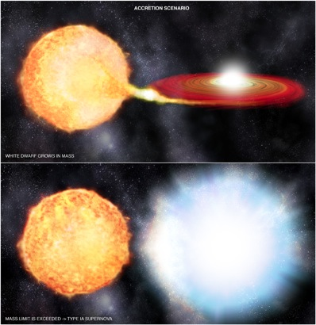
SNIa diversity
Different Progenitor Channels
Single degenerate
Double degenerate
Various Explosion Mechanisms
Detonations
Deflagarations
Delayed Detonations etc.
Range of observed Nickel mass
Diverse peak luminosity

Slide 4
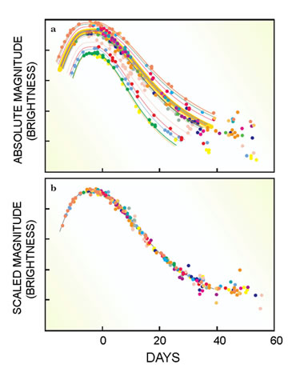
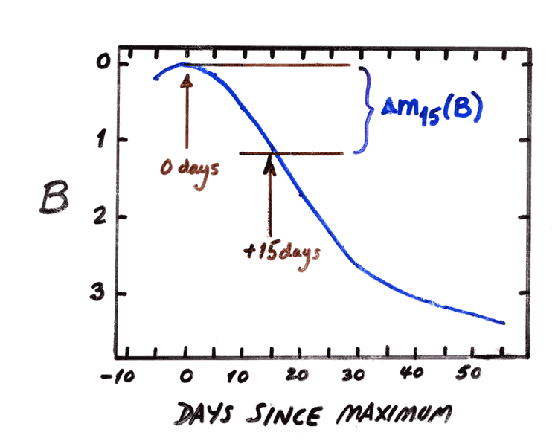
Standardize Peak Luminosity
Reduced scatter => better cosmology
Width-luminosity relation(Phillips 1993)
Fig: (Left) Corrections after applying the Phillips relation
(Right) Δm15 definition
Fig: (left) CTIO/CfA SN sample. (Top): Decline rate parameter (M.Phillips circa 1995 )

Slide 5
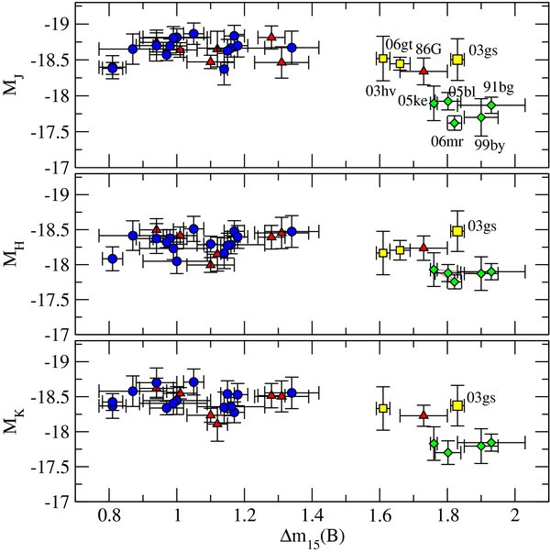
The Promise of the IR
Lower dust extinction
Uniform peak luminosity ~ 0.15 mag
Weak dependence on Δm15. No correction needed
Fig: peak magnitude versus Δm15(Krisciunas et al. [2009])

Slide 6
This Study
Y (1 μ m) J (1.2 μ m ) H (1.6 μ m) light curves
Near-maximum properties
Late-time behaviour
Based on literature data
Mostly Carnegie Supernova Project (CSP) data
Dedicated NIR follow-up
Observations at late epochs
Uniform photometric system

Slide 7
NIR light curves
Well Sampled SNe
Visible increase of scatter
Uniform late decline
Fig: Objects with well
sampled light curves

Slide 8
Complete sample
Uniform at first peak
Uniform near minimum
Diverse at late phases
Fig: light curves for the SN in our sample. CSP objects are in blue and non-CSP objects in green. (plotted J band only for visibility)

Slide 9
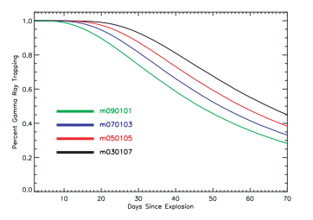
Late Decline
Slope between +40 and +90 days
Late Decline uniform
Top: Γ ray escape fraction (Woosley et al. 2007)
Right: Late time decline rates for SNIa in YJH band (Dhawan et al. 2014)

Slide 10
Correlation with optical properties
Strong correlation
Scatter ~2 days Y, J; ~3 days in H
Fig: t₂ (YJH) versus Δm15 (Dhawan et al. 2015)

Slide 11
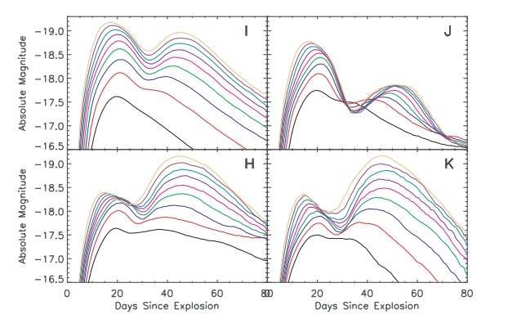
Emerging Physical Picture
Ionization transition
Increased emissivity
t₂ depends on synthesized nickel mass
Fig: Model light curves for different nickel mass (Kasen 2006)

Slide 12
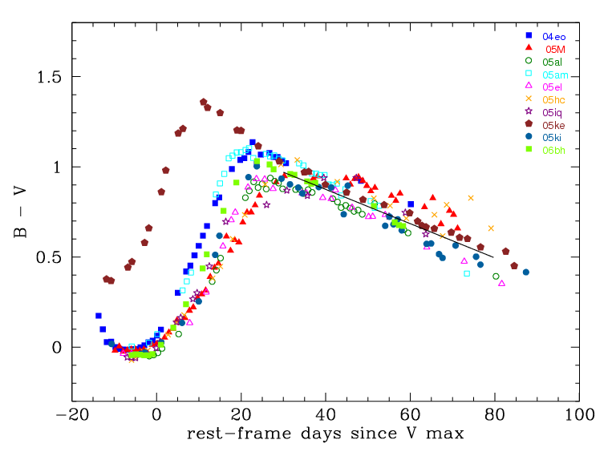
Lira law epoch
Uniform late colour evolution
Optically faint objects redden earlier
Models show early Fe/Co line appearance (Kasen & Woosley 2007)
Fig: B-V colour curves for objects
observed in CSP (Folatelli et al. [2010])

Slide 13
Relation to NIR second maximum
t_{L} correlates with t₂
Y, J identical
H: 3 days earlier
Fig:t₂ versus t, the epoch of entering constant colour evolution (Dhawan et al. 2014)

Slide 14
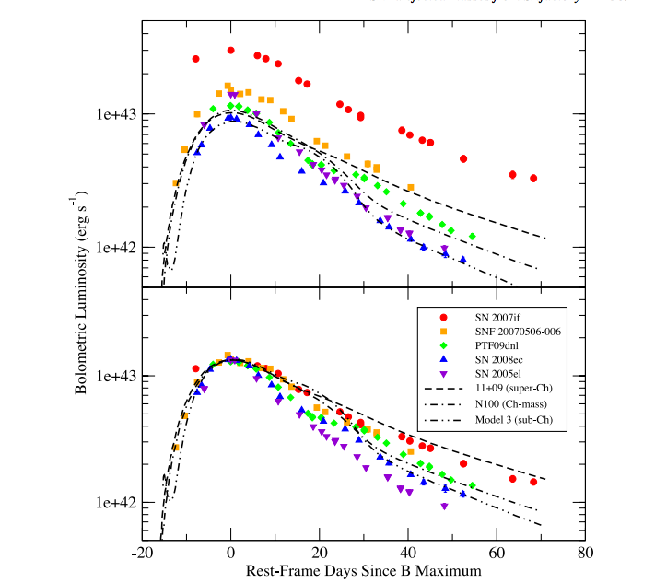
Measuring Nickel Mass
Arnett’s rule
Luminosity at peak == instantaneous decay rate
Requires distance and reddening correction
Figure: Bolometric light curves from Scalzo et al. [2014]

Slide 15
Correlation with NIR properties
Low reddening SNe
Ultraviolet to NIR flux
Peak corresponds to Nickel synthesized (Arnett 1982)
Correlates with t₂
Fig: Bolometric luminosity versus timing of second maximum (Dhawan et al. in prep)

Slide 16
Conclusions
Confirm low luminosity scatter
Diverse second maximum
Uniform late decline slope
Nickel mass driving optical/NIR appearance of SNIa
(t₂, Δm₁₅, t_{L}, M|₅₅)
Fig: Matrix representing important correlations

Slide 17
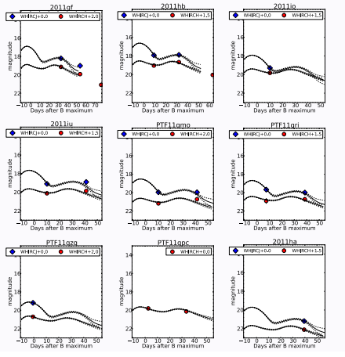
Working with Few Observations
1-3 points per light curve
More objects in sample
Pilot study concluded
Figure: subset of light curves from Weyant et al. [2014]

Slide 18
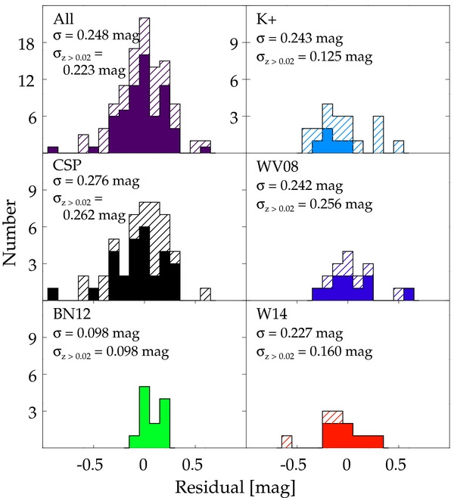
Studies so far
Scatter of peak luminosity < 0.2 mag
Large, uniform samples
Distances to < 6% (Kattner et al. 2012)
Fig: H band peak distribution for different samples (Weyant et al. [2014])

Slide 19
Timing parameters
t₁ (~1d ) t₀ (~2.5d) t₂ (~5d)

Slide 20
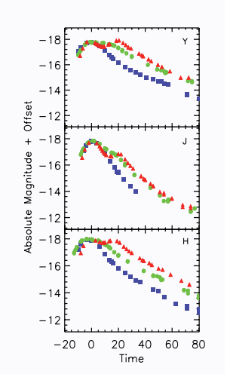
Peculiar Type Ia SNe
Faint SNe; No second max
First maximum is after B_{max}
Some SN have second ‘bump’
Similar late decline
Used for subclassification
Figure: light curves of 3 fast declining (faint SNe). Kattner et al. [2012]

Slide 21
Conclusions thus far
Uniform behaviour confirmed
t₂ correlates with Δm15
t₂ correlates with t_{L}
Nickel mass driving correlations

Slide 22
(Far right): M|₅₅ versus t₂ in YJH bands. (Right): Light curves showing M|₅₅
Comparison of late time properties
Y brightest; followed by H and J
Strong correlation

Slide 23
Follow Up Investigations
Direct Nickel mass measurement
Infer Nickel mass indirectly
Analyse range of Nickel distribution
Compare with existing methods

Slide 24
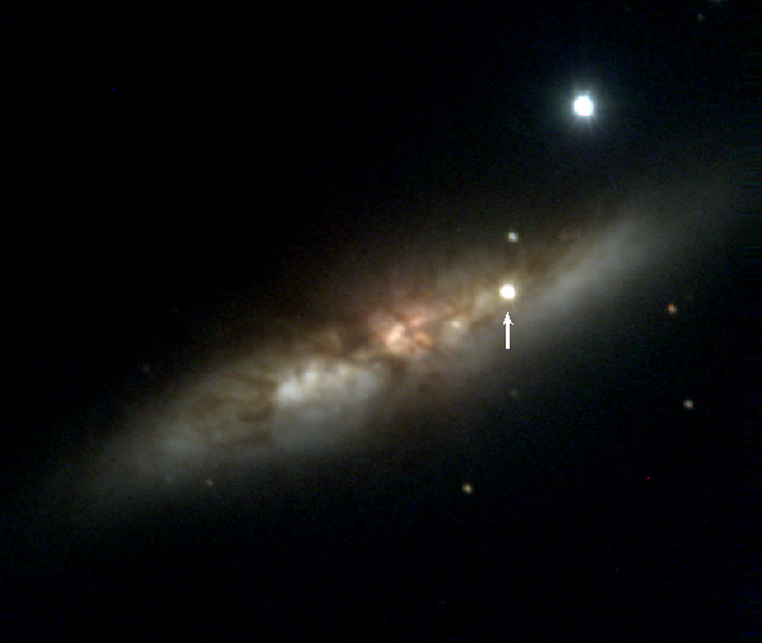
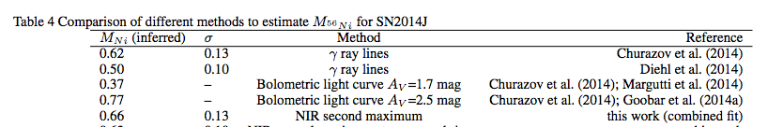
SN2014J: Inferring Nickel Mass
Use t₂ to get L_{max}
Derive Nickel mass (Arnett’s rule)
Fig: SN2014J in M82.(ref: astrobob) Table: Different estimates for nickel mass (Dhawan et al. in prep)

Slide 25
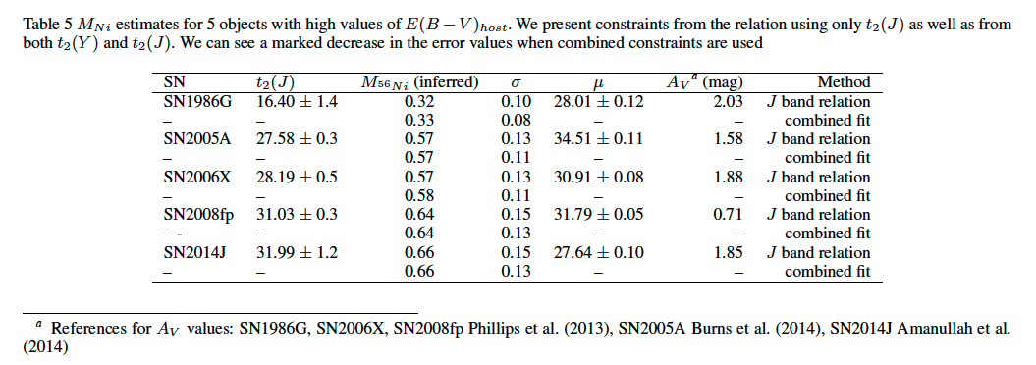
Other Reddened SNe
Apply method to larger sample
Estimated value for SN2006X from Wang+2008 of 0.5 with error of 0.1 solar mass

Slide 26
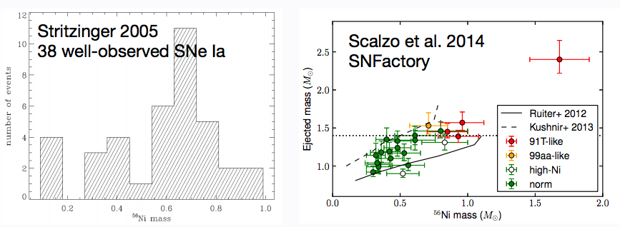
Nickel Mass Studies
Well-observed SNe
Studies require reddening correction
Large diversity in Nickel mass values

Slide 27
Nickel Mass Distribution
Range of ⁵⁶Ni mass
Estimated from t2
Fig: Distribution of Ni mass from t₂ (Dhawan et al. in prep)

Slide 28
H₀ from NIR observations
More precise than optical
Measured using SN2002fk (Cartier et al. 2014)
Zero Point of Hubble Diagram
Distance from Cepheids, Tully-Fisher
H₀ values from Cartier et al. (2014) using SN2002fk

Slide 29
Aim of Investigation
Reduce error in H₀
Use NIR standard behaviour
M_{max} from theoretical models
Circumvent distance uncertainty

Slide 30
Future Work
t₂ as a standardization parameter
NIR for photometric classification
NIR for characterizing peculiar Ia’s

Slide 31
IR correlations
Weak trend between t₀ and t₂
Trend between M₀ and M₂
Strong inter-filter correlations
Fig:t2 and M₂ in different IR filters

Slide 32
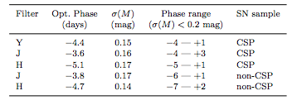
Improved Distances?
Uniformity in first peak
Weak correlation with t₂
Only slight improvement in J and H, none in Y
Fig: M₁ versus t₂ in YJH bands. (Top): Table with scatter values for the sample

Slide 33
M₂ versus Δm15 in YJH bands

Slide 34
Improving Distances Further
Colour correlations (Tripp 1998)
Spectral features (Wang et al. 2009, Bailey et al. 2009, Blondin et al. 2011)
Host galaxy properties (Sullivan et al. 2006, 2010)
Others: Late decline rate (Wang et al. 2008)
Scatter ~ 0.15 mag (reduced from ~0.5 mag)

Slide 35
The Connection

Slide 36
Infrared Colours
Interpolated with SN(oo)Py
Uniform near first max
Trough in J-H
Fig: IR colour curves (left) Y-J (right) J-H

