Slide 1
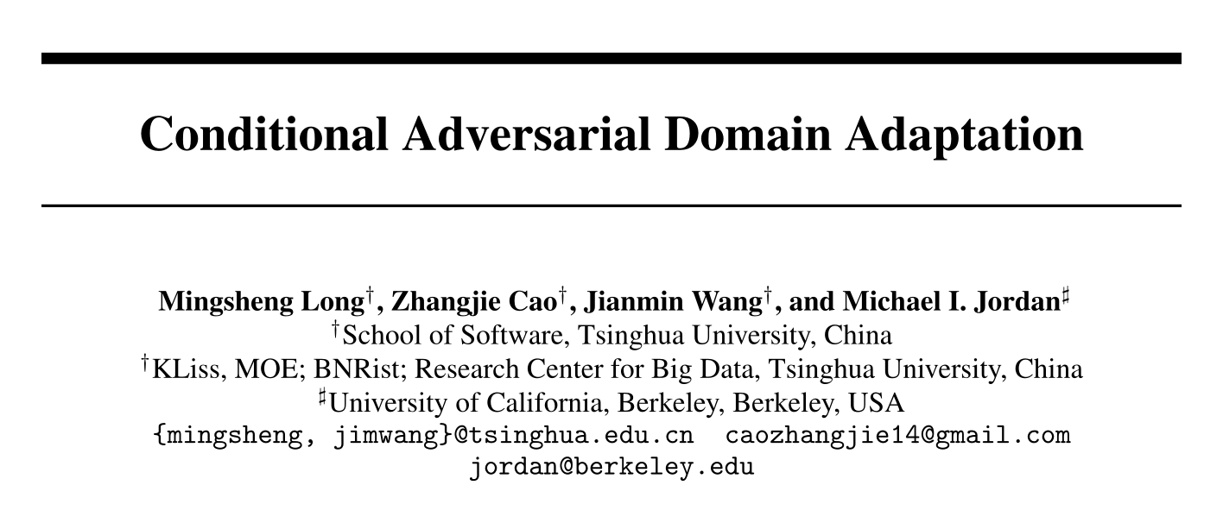
2021-03-30

Slide 2
Outline
Motivation
Explanation
Multimodel distribution
Tensor product
Specific task
Methods
Conditional discriminator
Multilinear conditioning
Entropy conditioning
Generalization error analysis
Experiments

Slide 3
Introduction
Learning a model that reduces the dataset shift between training and testing distributions is known as domain adaptation .It finds wide applications in computer vision and natural language processing .
recent research on deep domain adaptation further embeds adaptation modules in deep networks using two main technologies for distribution matching: moment matching and adversarial training.

Slide 4
Motivation
First, when the joint distributions of feature and class, i.e. P(xs,ys) and Q(xt,yt), are non-identical across domains, adapting only the feature representation f may be insufficient.
Second, when the feature distribution is multimodal, which is a real scenario due to the nature of multi-class classification, adapting only the feature representation may be challenging for adversarial networks.

Slide 5
CGAN
CGANs disclose that the distributions of real and generated images can be made similar by conditioning the generator and discriminator on discriminative information.
Conditional GANs generate globally coherent images from datasets with high variability and multimodal distributions.
Motivated by conditional GANs,in adversarial domain adaptation:
The classifier prediction g conveys discriminative information potentially revealing the multimodal structures. So,feature representation f and classifier prediction g can be modeled simultaneously

Slide 6
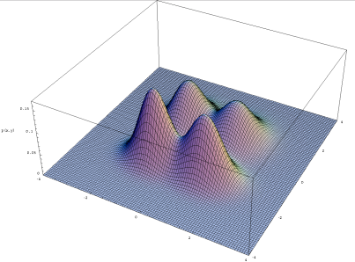
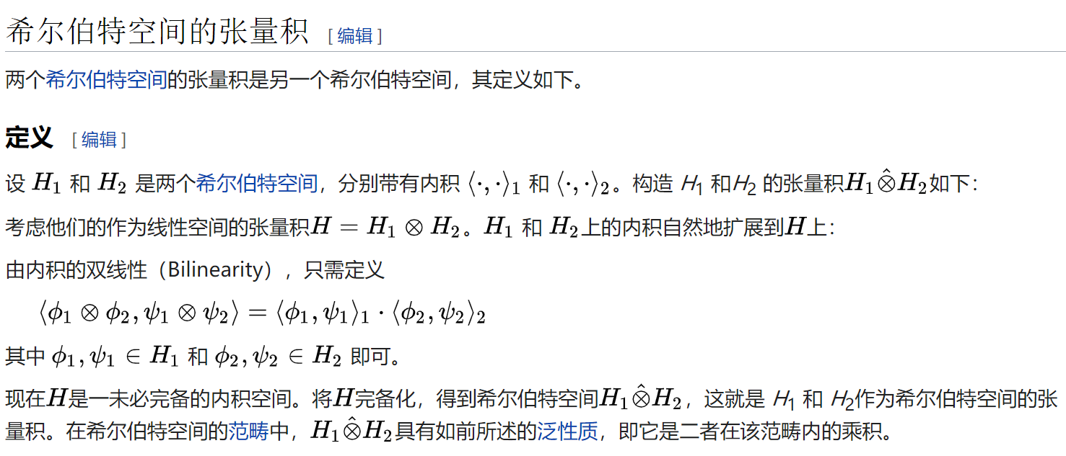
Explanation
Multimodel distribution – multiple peaks
Tensor product

Slide 7
Conditional Adversarial Domain Adaptation
The key to the CDAN models is a novel conditional domain discriminator conditioned on the cross-covariance of domain-specific feature representations and classifier predictions.
Two novel conditioning strategies are designed to capture the cross-covariance dependency between the feature representations and class predictions while controlling the uncertainty of classifier predictions.

Slide 8
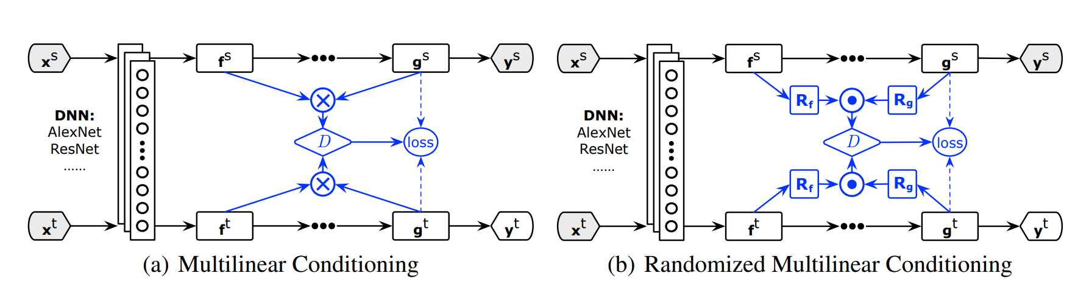
Conditional discriminator
Architectures of Conditional Domain Adversarial Networks (CDAN) for domain adaptation,where domain-specific feature representation f and classifier prediction g embody the cross-domain gap to be reduced jointly by the conditional domain discriminatorD.

Slide 9
Multilinear conditioning
⊕is widely adopted by existing conditional GANs,but f and g are independent on each other, thus failing to fully capture multiplicative interactions between feature representation and classifier prediction
the multilinear map is defined as the outer product of multiple random vectors. It has been successfully applied to embed joint distribution or conditional distribution into reproducing kernel Hilbert spaces
Given two random vectors x and y, the joint distribution P(x,y) can be modeled by the cross-covariance Exy[φ(x) ⊗ φ(y)]
fully capture the multimodal structures behind complex data distributions

Slide 10
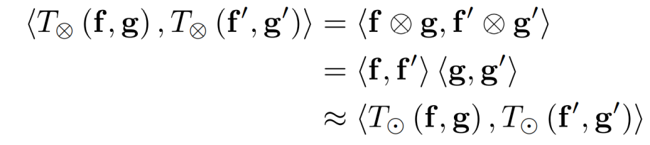
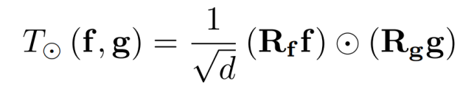
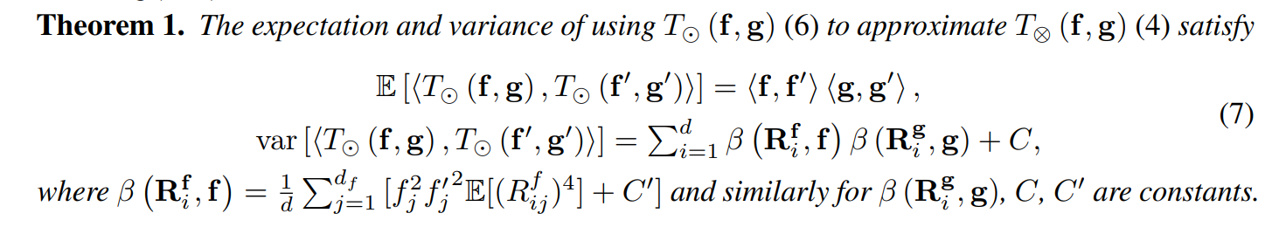

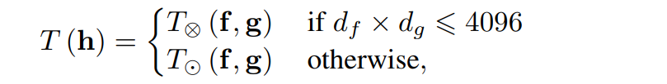
Dimension explosion
the inner-product on T⊗ can be accurately approximated by the inner-product on T
4096 is the largest number of units in typical deep networks (e.g. AlexNet)

Slide 11
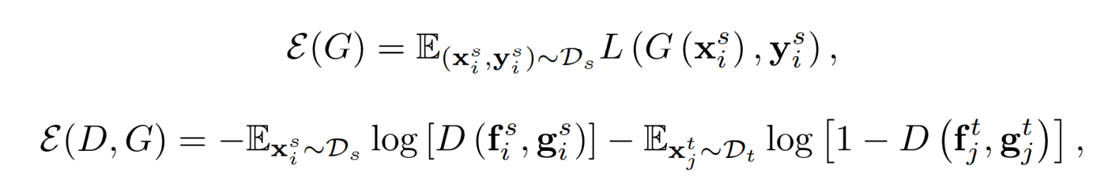
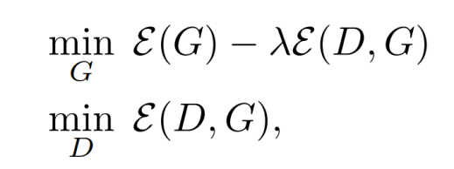
CDAN is a minimax optimization problem
The first one is minimized to guarantee lower source risk;
The second one is minimized over D but maximized over(f,g)
Totally,the minimax game of conditional domain adversarial network (CDAN) is:
λ is a hyper-parameter between the two objectives to tradeoff source risk and domain adversary

Slide 12
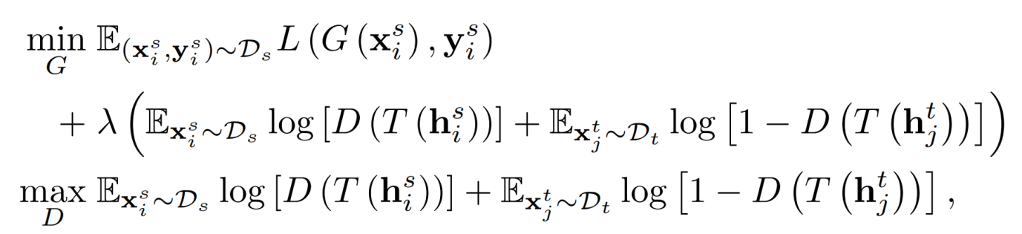
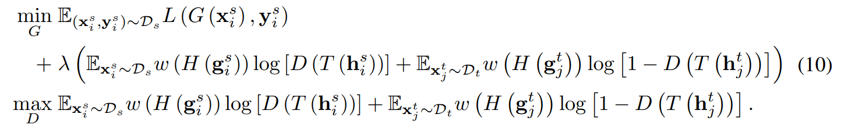

CDAN(CDAN+E)
Towards safe transfer, we quantify the uncertainty of classifier predictions by the entropy criterion$H\left(g\right)=−\sum_{c=1}^{C}{g_{c}logg_{c}}$
$$weight=1+e^{−H(g)}$$

Slide 13
Generalization Error Analysis
Denotation:
Bound

Slide 14
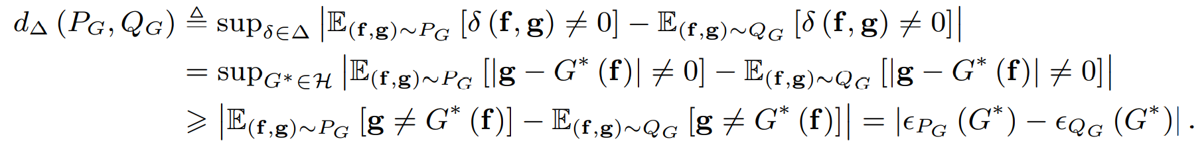
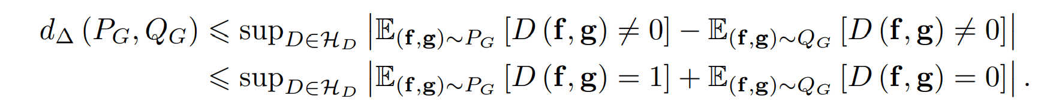
Generalization Error Analysis
Define a (loss) difference hypothesis space ∆ , {δ = |g − G∗ (f)| : G∗ ∈ H} over the joint variable (f, g), where δ : (f, g) 7→ {0, 1} outputs the loss of G∗ ∈ H.
domain discriminator D is related to d∆(PG, QG):

Slide 15
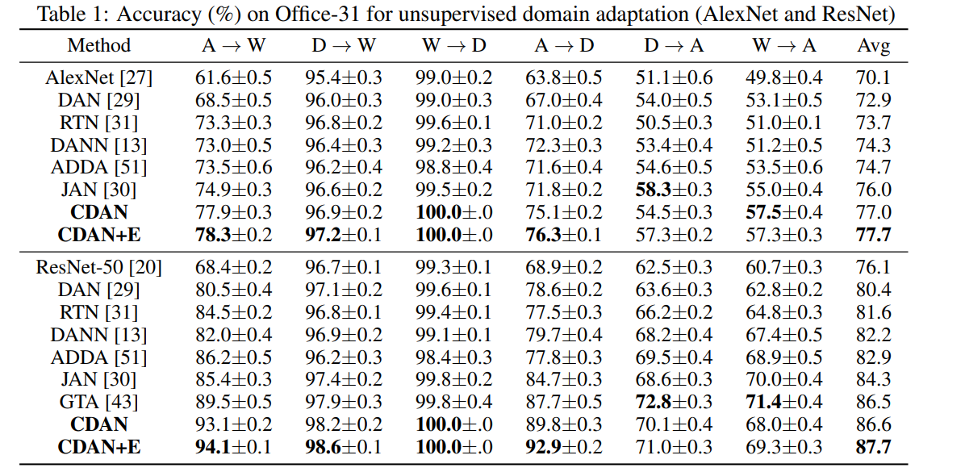
Experiments
Network | dataset | model | A-W | W-A | W-D | D-W | A-D | D-A
ResNet50 | Office | DANN | 72.05% | 24.65% | 92.17% | 94.30% | 75.36% | 35.90%
 |  | CDAN | 77.36% | 26.27% | 94.18% | 96.60% | 82.53% | 40.32%
 |  | CDAN+E | 76.10% | 39.19% | 97.39% | 93.45% | 85.54% | 41.16%

Slide 16
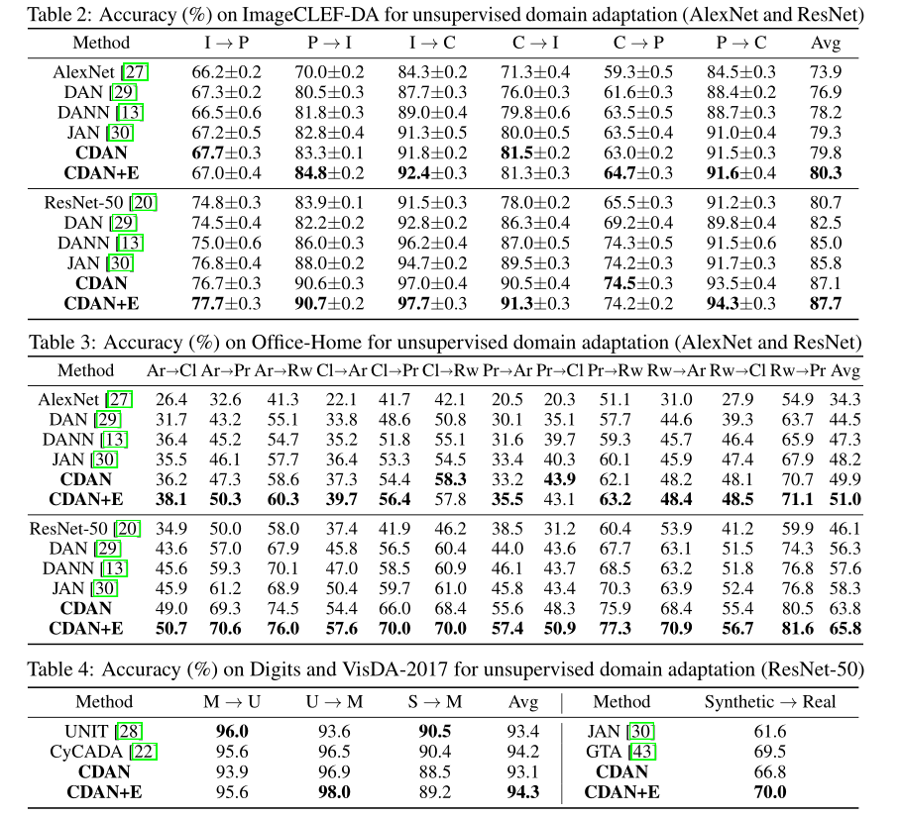
Experiments

Slide 17
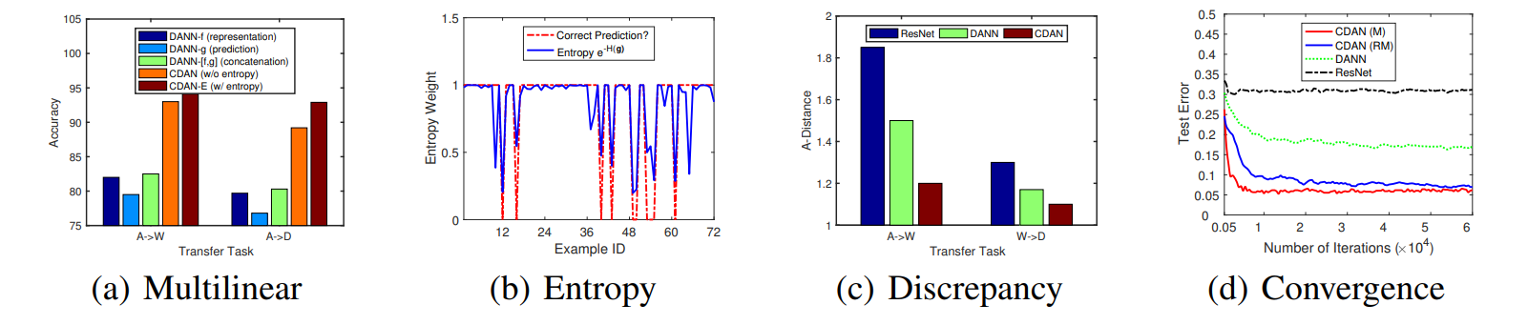
Experiments

Slide 18
Thanks

Slide 19
