Slide 1
Domain-Adversarial Training of Neural Networks
2021-03-12

Slide 2

Domain Adaptation
Learning a discriminative classifier or other predictor in the presence of a shift between training and test distributions is known as domain adaptation (DA).
Assumption:different domains,single task
Different domains:feature spaces different OR feature spaces same but probality distribution different
the obtained feed-forward network can be applicable to the target domain without being hindered by the shift between the two domains.
many previous papers on domain adaptation that worked with fixed feature representations, We thus focus on learning features that combine (i) discriminativeness (无法区分来自源域还是目标域)and (ii) domain-invariance(完成图像分类任务)
The goal of the learning algorithm isto build a classifier η : X → Y with a low target risk

Slide 3
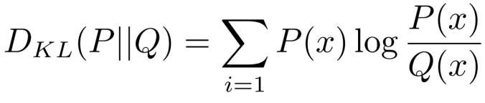
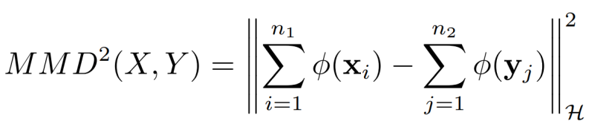
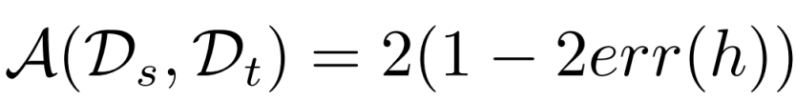
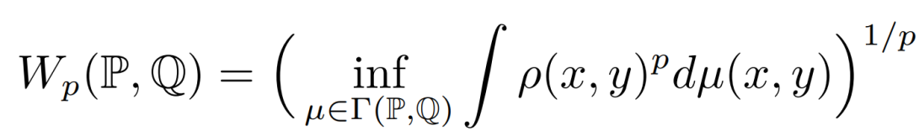
Domain Divergence
To tackle the challenging domain adaptation task, many approaches bound the target error by the sum of the source error and a notion of distance between the source and the target distributions.
Assumption: the source risk is expected to be a good indicator of the target risk when both distributions are similar.
Several notions of distance have been proposed for domain adaptation

Slide 4
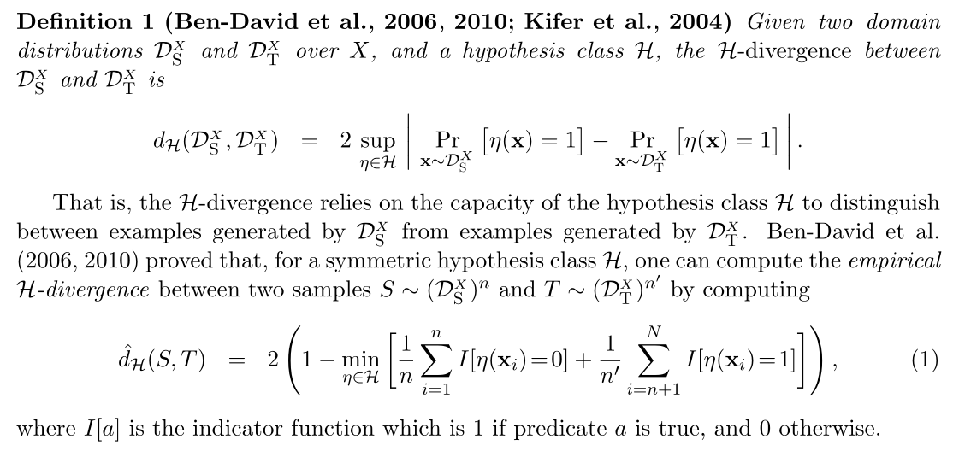
Domain Divergence

Slide 5
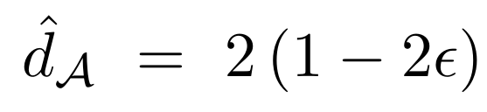
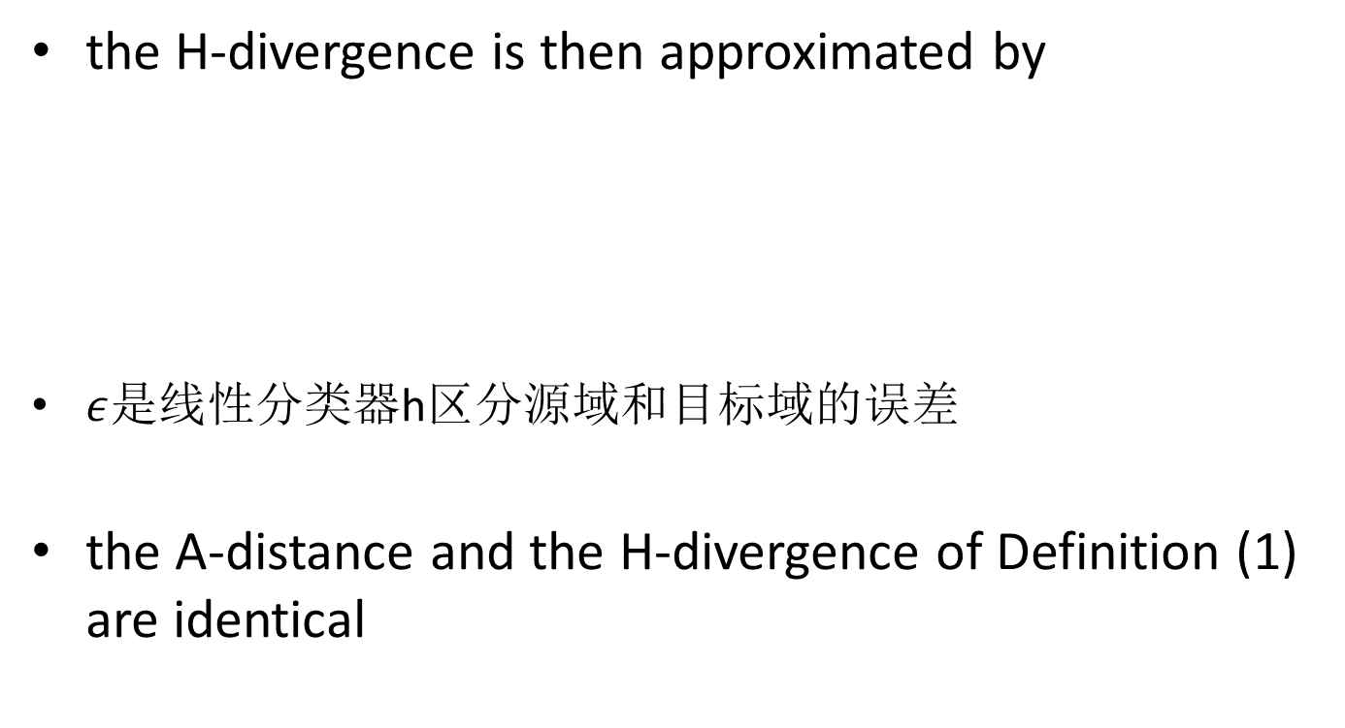
Proxy Distance
the H-divergence is then approximated by
$ε$是线性分类器h区分源域和目标域的误差
the A-distance and the H-divergence of Definition (1) are identical

Slide 6
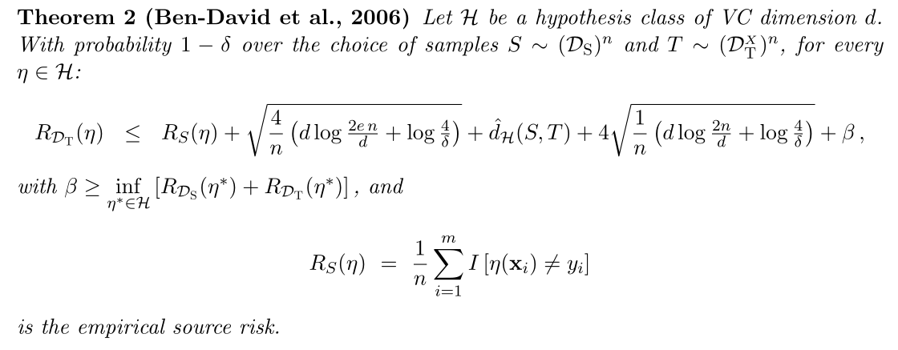
Generalization Bound on the Target Risk
H-divergence dH(DXS,DXT)is upper bounded by its empirical estimateˆdH(S, T) plus a constant complexity term that depends on the VC dimension of H and the size of samples S and T.

Slide 7
Generalization Bound on the Target Risk
to find a classifier with a small RDT(η) in a given class of fixed VC dimension,the learning algorithm should minimize a trade-off between the source risk RS(η) and the empirical H-divergenceˆdH(S, T).
a strategy to control the H-divergence is to find a representation of the examples where both the source and the target domain are as indistinguishable as possible.

Slide 8
DANN
all three training processes can be embedded into an appropriately composed deep feed-forward network, called domain-adversarial neural network(DANN)
The goal of DANN is to predict the classification label of the input image in the target domain
The approach is generic(通用) as a DANN version can be created for almost any existing feed-forward architecture that is trainable by backpropagation.

Slide 9
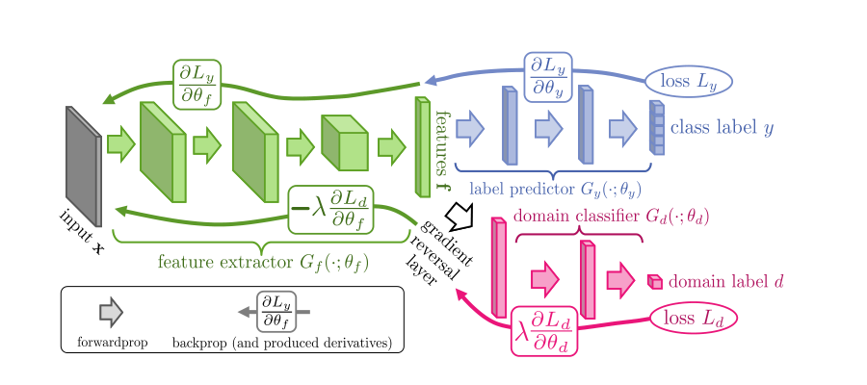
minimize
the loss of the label classifier and to maximize the loss of the domain classifier
minimize
the loss of the label classifier
minimize the loss of the domain classifier
forward:transformation
backpropagation:multiplies it by −1

Slide 10

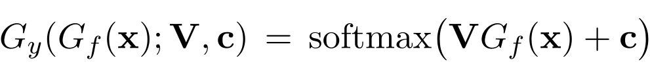
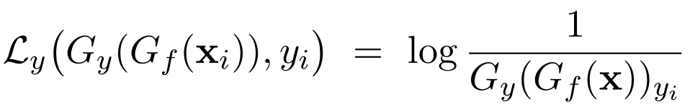
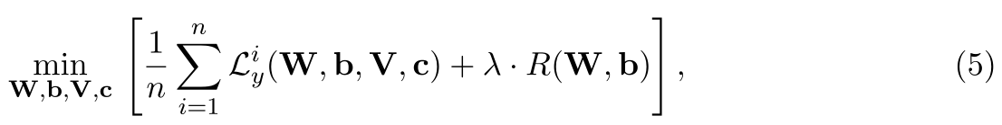
以单隐层为例，对于特征提取器就是一层简单的神经元（复杂的任务中就是用多层，或者使用卷积层）：
对于类别预测器（复杂任务中需要换成更深的网络进行映射和分类）：
类别预测器损失函数：
源域上，训练的优化目标是：

Slide 11
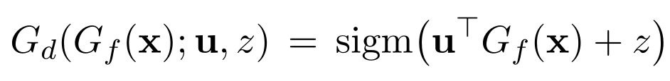
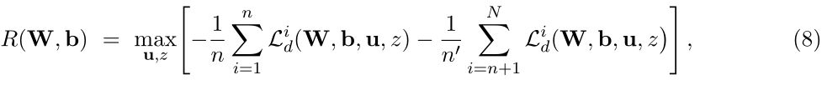
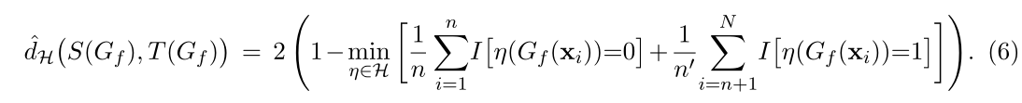
对于域分类器
域分类器损失函数(H散度)：
此时，域分类器的目标函数为：
This regularizer seeks to approximate the H-divergence of Equation (6), as 2(1−R(W,b)) is a surrogate(代替) for ˆdH(S(Gf), T(Gf))

Slide 12
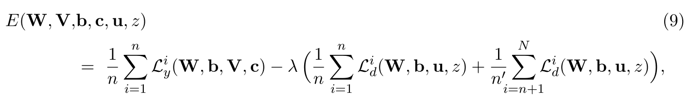
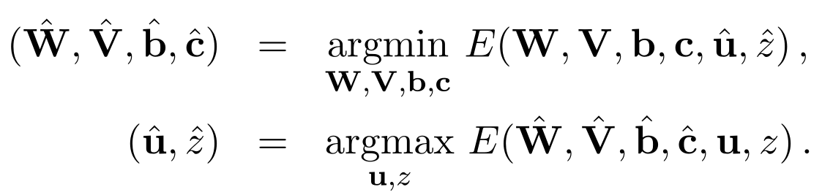
DANN
总目标函数((5)+(8))
迭代时,最小化目标函数来更新标签预测器的参数，最大化目标函数来更新域判别器的参数：

Slide 13
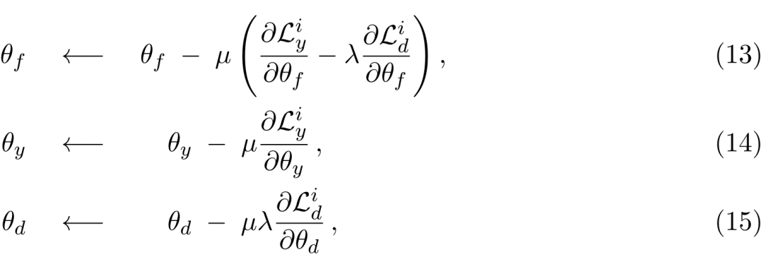
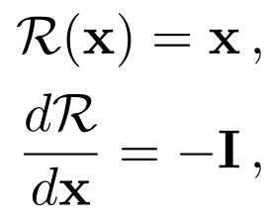
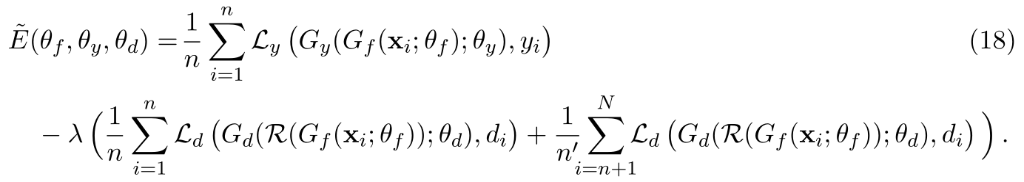
DANN
若使用SGD算法进行优化DANN的模型参数，DANN模型参数的梯度更新公式如下式所示
然而，特征提取器在进行参数更新时，域分类损失的梯度与图像分类损失梯度方向相反。本文提出了梯度反转层（Gradient Reversal Layer, GRL）, 使得在反向传播过程中梯度方向自动取反，在前向传播过程中实现恒等变换，相关数学表示如下式所示：

Slide 14
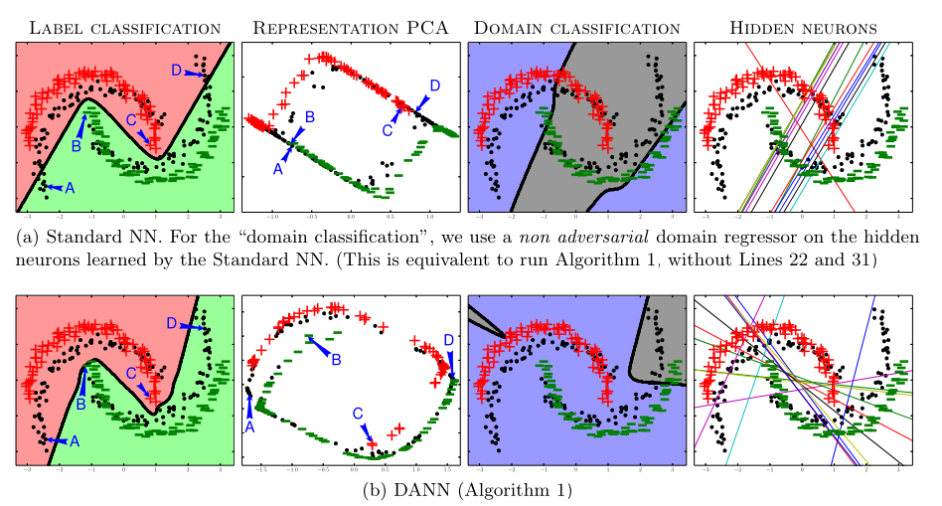
Experiments

Slide 15
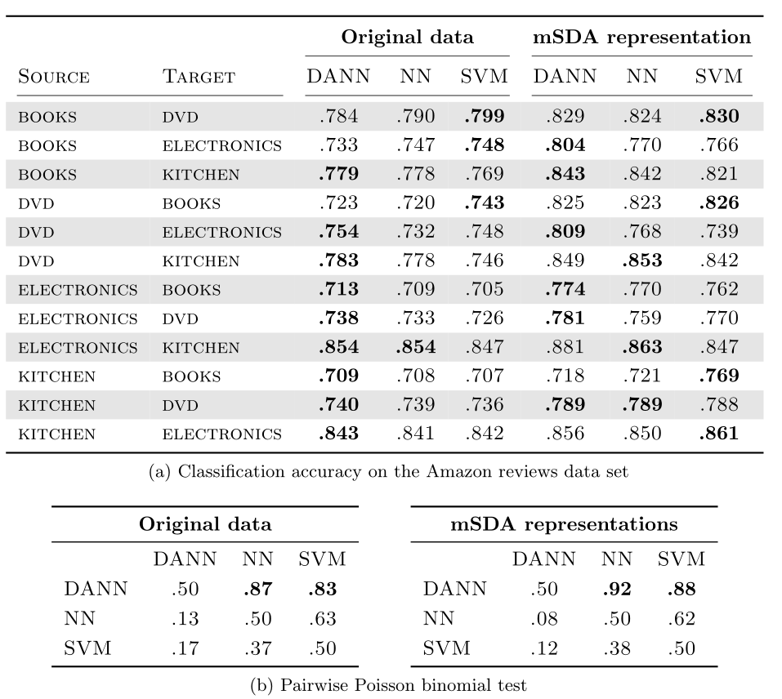
Experiments

Slide 16
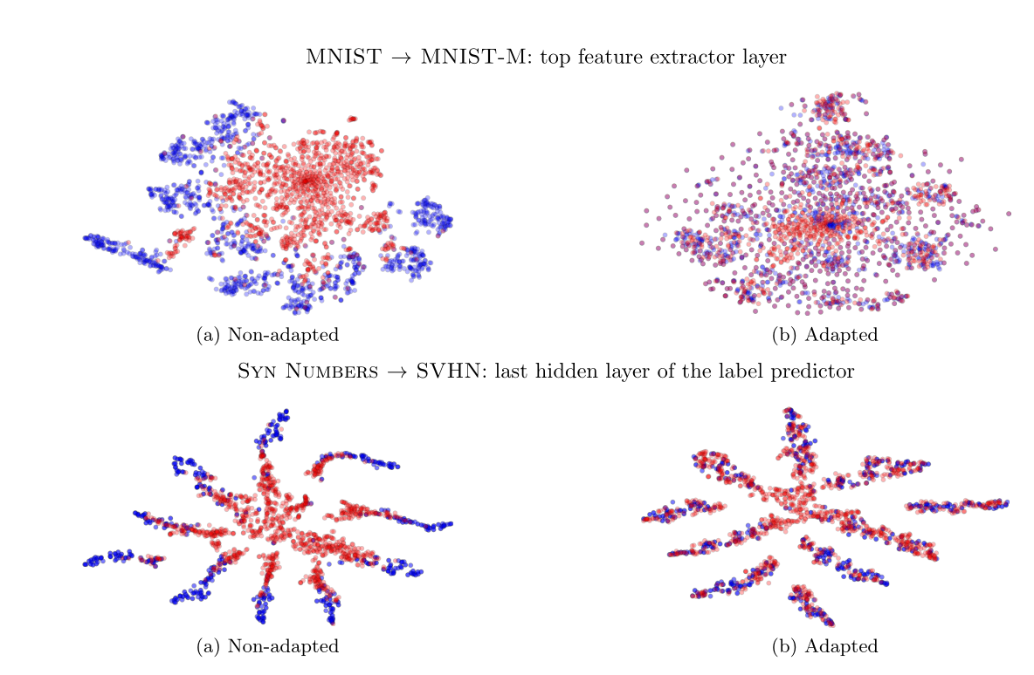
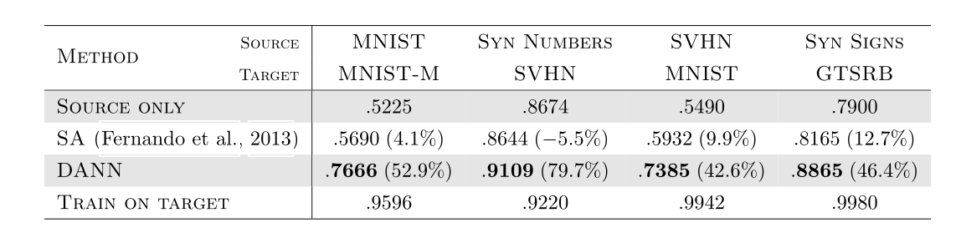
Experiments

Slide 17
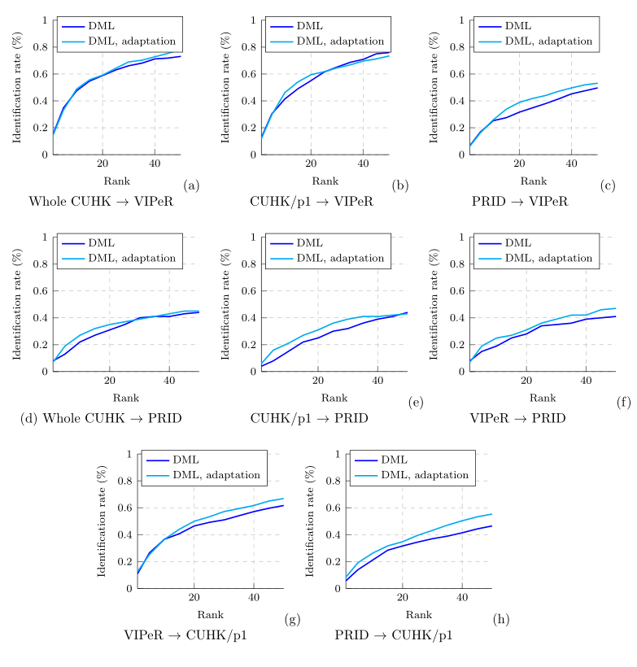
Experiments

Slide 18
conclusion
在Domain-Adversarial Training of Neural Networks论文中提出了DANN（域适应深度网络）架构，主要由特征提取网络、图像分类网络与域分类网络构成，图像分类网络与域分类网络共享特征提取网络的参数。
DANN的目标分成两个：最小化图像分类损失用于准确分类图像；最大化域分类损失用于混淆目标域数据与源域数据。
提出了梯度反转层（GRL），该层用于特征提取网络与域分类网络之间，反向传播过程中实现梯度取反，进而构造出了类似于GAN的对抗损失，又通过该层避免了GAN的两阶段训练过程。
论文实验证明，无论是小数据集还是大数据集中，DANN图像分类任务中取得了较高的分类精度，成功解决了数据集缺少标签的难题，即实现了无监督的图像分类。实现了域与域之间的特征级别自适应。

Slide 19
谢谢

