Slide 1
Introduction to Biostatistics GRD770
Dr. Richard Reynolds
Department of Medicine
Dr. Karen Gamble
Department of Psychiatry
Dr. Richard Kennedy
Department of Medicine

Slide 2
Goals of the course
Identify the appropriate statistical model for a given research design.
Assess the key assumptions of statistical models.
Use statistical decision theory for interpreting the results of models.
Effectively communicate experimental designs and results of statistical models.

Slide 3
Goals of the course
Learn how to perform basic statistical programming using R.
Explore data using graphical analysis and descriptive statistics.
Fit statistical models to datasets.

Slide 4
Graduate Curriculum
Bosch G, Casadevall A. 2017. Graduate biomedical science education needs a new philosophy. mBio 8:e01539-17. https://doi.org/10.1128/mBio.01539-17

Slide 5
Why do I need biostatistics?
If you plan to submit an NIH F31:
“Individual fellowship applications will be required to summarize in the research strategy section plans to ensure rigorous, well-controlled experiments that consider all relevant biological variables, use authenticated biological and chemical resources, and apply appropriate statistical tests for data analyses. In addition more detailed description of instruction in rigorous experimental design to ensure reproducibility will be required in the section on Institutional Environment and Commitment to Training. The impacted programs will include the following individual fellowships: F05, F30, F31, F32, F37, F38, and FI2.”
https://grants.nih.gov/grants/guide/notice-files/NOT-OD-16-034.html

Slide 6
Why do I need biostatistics?
In compliance with NIH “Principles and Guidelines for Reporting Preclinical Research” many high impact journals require:
policies for statistical analysis in the Information for Authors, and
a mechanism to check the statistical accuracy of submissions.
https://www.nih.gov/research-training/rigor-reproducibility/principles-guidelines-reporting-preclinical-research

Slide 7
Why do I need biostatistics?
From the International Committee of Medical Journal Editors:
Describe statistical methods with enough detail to enable a knowledgeable reader with access to the original data to judge its appropriateness for the study and to verify the reported results.
http://www.icmje.org/recommendations/browse/manuscript-preparation/preparing-for-submission.html

Slide 8
Why do I need biostatistics?
Example, Nature guide for authors includes this on statistical analysis:
“Comprehensive information on the statistical analyses used must be included in the paper. The Methods must include a statistics section where you describe the statistical tests used and whether they were one- or two-tailed. Please ensure that the error bars are defined throughout the figures. For all statistics (including error bars), provide the EXACT n values used to calculate the statistics (reporting individual values rather than a range if n varied among experiments). For representative results, report the number of times that the measurements were repeated. Where relevant, provide exact values for both significant and non-significant P values. For ANOVAs, provide F values and degrees of freedom. For t-tests, provide t-values and degrees of freedom. Please specifically define the replicates.”
https://www.nature.com/nature/for-authors/initial-submission

Slide 9
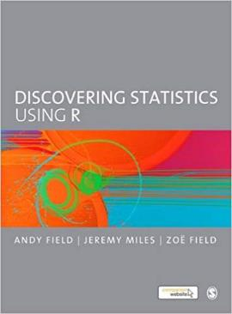
Textbook (R)
https://studysites.sagepub.com/dsur/main.htm
https://www.discoveringstatistics.com/

Slide 10
Course structure
Lectures
Mondays and Wednesdays at 8:00
Laboratory
Statistical programming in R
Mondays and Wednesdays at 9:00-10:00
Discussion
Oral discussions of statistical concepts
Fridays 8:00-10:00

Slide 11
Canvas
All course content will be accessed via the Canvas pages.
The course is organized into modules representing weeks during the fall semester.
Look for each module’s alignment table.
Contains specific objectives, activities and assignments.
Contact instructors and TAs using the canvas email facility only.
Notes:
Let’s log in to canvas right now.

Slide 12
Course Structure
In person lectures
Mondays and Wednesdays at 8:00
Designed to follow the textbook reading assignments or special topics.
Provide conceptual understanding of specific statistical models and assumptions.

Slide 13
Course Structure
R lab
In person Mondays and Wednesdays 9:00-10:00
Lab exercises will introduce you to fitting statistical models in R.
Lab exercises will not be reviewed.
Questions will be answered.
New assignments will be introduced.

Slide 14
Course Structure
Fridays: Small group activities and paper discussions.
In person meetings 8:00-10:00 Friday.
Class will be divided into groups.
Assignments will be completed and presented.
If a paper is to be read, please read the paper BEFORE coming to class.

Slide 15
Course Structure
Fridays: Oral exams
Oral exams
Each student will give one oral exam on an assigned Friday

Slide 16
Grading
Take home exams
75%
Friday classes are mandatory
Participation is 10% of your grade
Oral Exams
This will form 15% of your grade (Pass/Fail)

Slide 17
Take Home Exams
Grades (75%) are primarily made up of three exams (take-home):
Data analysis based, including a written report of the analysis, underlines the importance of the R lab.
Questions and data will be given one week in advance
You may not work with others or obtain any outside help (from other students or faculty)
Drs. Reynolds, Gamble, Kennedy, and/or TA’s are available for clarification/ questions.

Slide 18
Friday classes
Participation is mandatory
10% of your grade will be posting to discussion board.
One miss allowed.
Oral exams
15% of your grade will be one individual based presentation to class to discuss a hypothetical data-analysis plan.

Slide 19
Course policies
See Canvas/syllabus for details.
Submit all emails through canvas and not to our @uab.edu addresses.
Emails will not be answered on the weekend.
Office hours TBD.

Slide 20
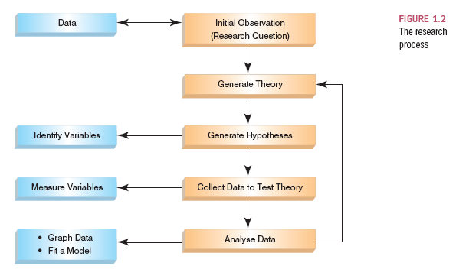
The Research Process

Slide 21
Initial Observation
Find something that needs explaining
Observe the real world
Read other research
Test the concept: collect data
Collect data to see whether your hunch is correct
To do this you need to define variables
Anything that can be measured and can differ across entities or time.

Slide 22
Generating and Testing Theories
Theories
An hypothesized general principle or set of principles that explain known findings about a topic and from which new hypotheses can be generated.
E.g., The immune system has evolved to protect multicellular organisms from pathogens.

Slide 23
Generating and Testing Theories
Hypothesis
A prediction from a theory.
E.g., Theory: the immune system has memory of previous encounters with pathogens.
Prediction/hypothesis: People injected with vaccines will have reduced risk of developing disease.

Slide 24
Generating and Testing Theories
Falsification
The act of disproving a theory or hypothesis.
Edward Jenner could have observed that material from cowpox pustules would not protect humans from small pox.
Helps to have a control placebo group for this purpose.

Slide 25
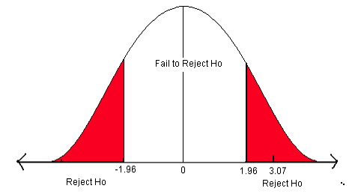
Statistical hypothesis testing

Slide 26
The Research Process

Slide 27
Reporting Data
Dissemination of Research
Findings are presented at conferences and in articles published in scientific journals.
Knowing how to report data
Chose a mode of presentation that optimizes the understanding of the data;
If you present three or fewer numbers then try using a sentence;
If you need to present between 4 and 20 numbers consider a table;
If you need to present more than 20 numbers then a graph is often more useful than a table.

Slide 28
