Slide 1
Creating Publication-Quality Graphics with ggplot2
Instructor: Shaurita D. Hutchins
 sdhutchins
 sdhutchins@uab.edu

Slide 2
Today’s Schedule
Time | Instructor | Workshop Day 2
11:05-12:00 | Shaurita | Creating Publication-Quality Graphics with ggplot2
12:00-1:00 |  | Lunch
1:00-1:30 | Shaurita | Creating Publication-Quality Graphics with ggplot2
1:30-2:30 | Sam | Functions Explained
2:30-2:45 |  | Break
2:45-3:15 | Sam | Writing Data
3:15-4:15 | Luke | Data Frame Manipulation with dplyr
4:15-4:45 | Austyn | Producing Reports With knitr
4:45 |  | Post Workshop Survey

Slide 3
Getting Started
Is your gapminder data available as a variable in your environment?
Check to see if you have ggplot2 installed.

Slide 4
Lesson Objectives
To be able to use ggplot2 to generate publication-quality graphics.
To apply geometry, aesthetic, and statistics layers to a ggplot plot.
To manipulate the aesthetics of a plot using different colors, shapes, and lines.
To improve data visualization through transforming scales and paneling by group.
To save a plot created with ggplot to disk.

Slide 5
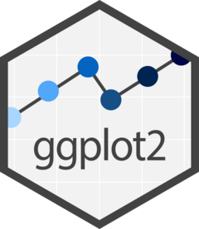
What is ggplot2?
A widely-used R library for plotting data
Publication-quality figures require customizability
R offers multiple plotting systems
ggplot2 is layered and reproducible
Learn more at: https://ggplot2.tidyverse.org

Slide 6
Key Terms
Data – the dataset used for the plot
Aesthetics (aes) – how variables map to visual properties
Geometries (geom_*) – how data are drawn (points, lines, bars)
Scales (scale_*) – how data values are transformed or displayed
Statistics (stat_*) – summaries or models computed from data
Facets (facet_*) – how data are split into multiple panels
Themes (theme()) – non-data appearance of the plot
Labels (labs()) – titles and text shown on the plot

Slide 7
Initializing a Plot
ggplot(data = gapminder) creates a plot object
Data are defined globally
No geometry means nothing is drawn
Think of this as a blank canvas

Slide 8
Mapping Aesthetics
aes() links data to visuals
Common mappings: x, y, color, group
Column names are referenced directly
Mappings apply to all layers by default

Slide 9
Adding Geometrics
“Geoms” control how data appear
geom_point() for scatterplots
geom_line() for trends over time
Layers are added with +
Order of layers matters

Slide 10
Lunch 😀
Get lunch and do it for the plot.

Slide 11
Transformations & Statistics
Scales change how data are displayed
Log scales handle skewed distributions
alpha helps with overplotting
geom_smooth() overlays models
Statistics are just another layer

Slide 12
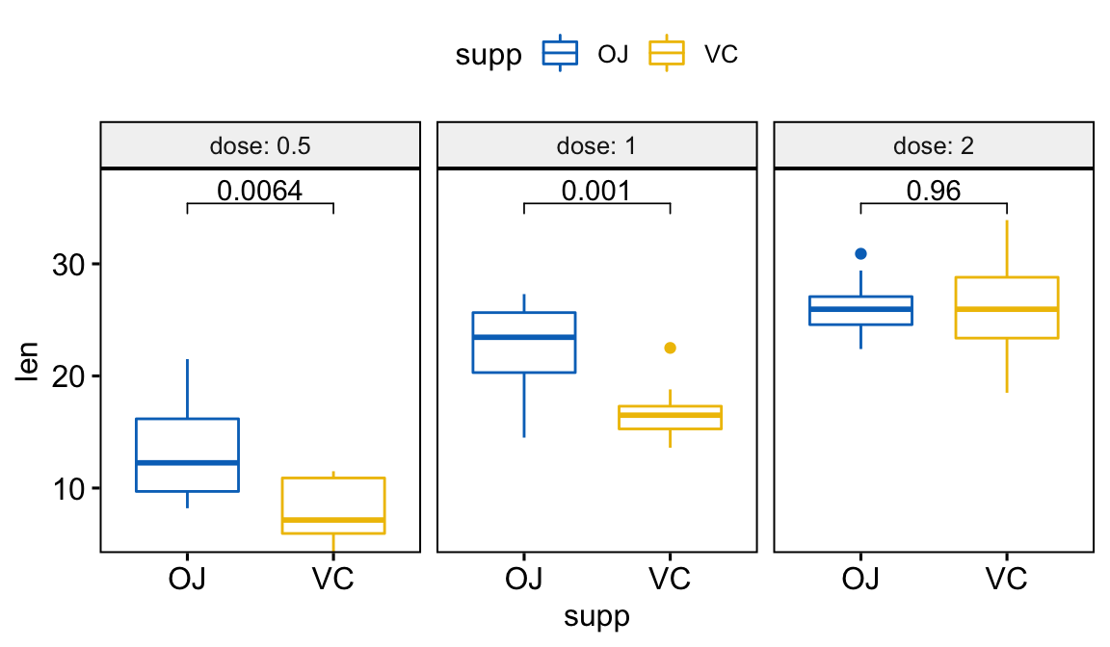
Faceting for Multi-Panel Plots
Facets split data into panels
One panel per group
Reduces clutter in dense plots
Useful for comparisons across categories

Slide 13
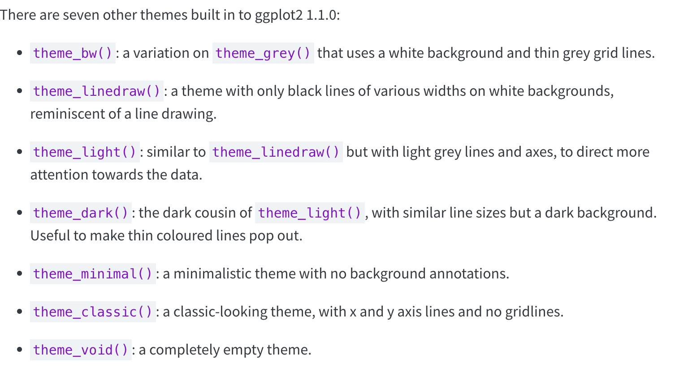
Labels, Themes, & Exporting Plots
Axis labels should be human-readable
Titles and legends clarify intent
labs() controls text
theme() adjusts appearance
ggsave() writes plots to disk
  Control size, resolution, and format

