Slide 1

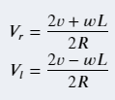
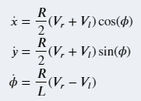
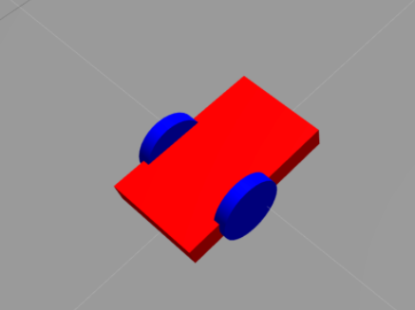
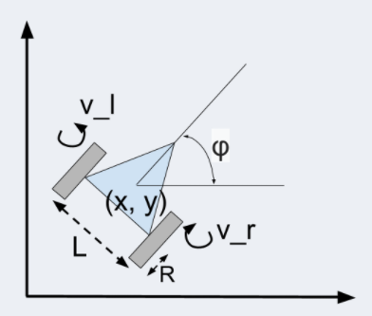

Slide 2
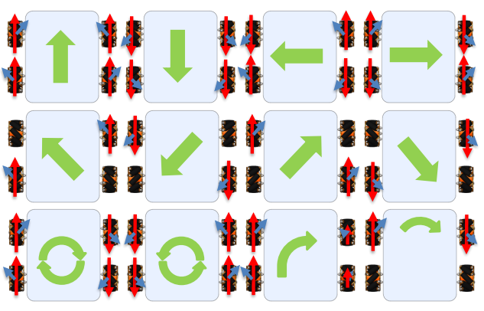
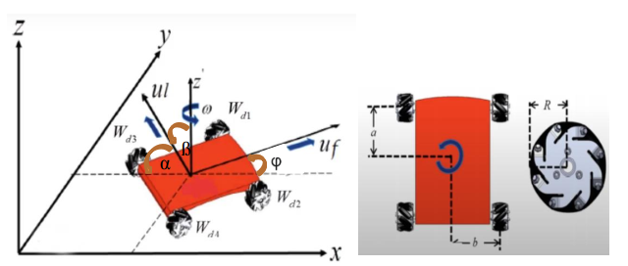

Slide 3
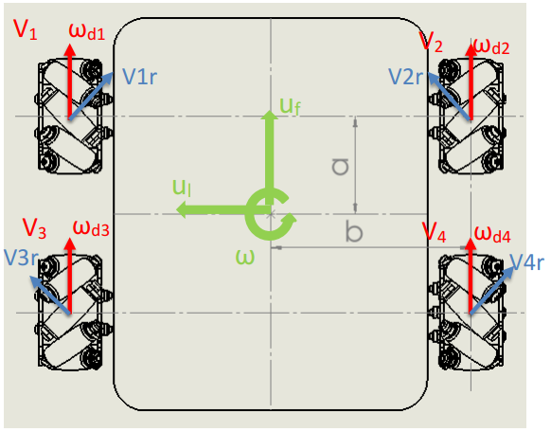
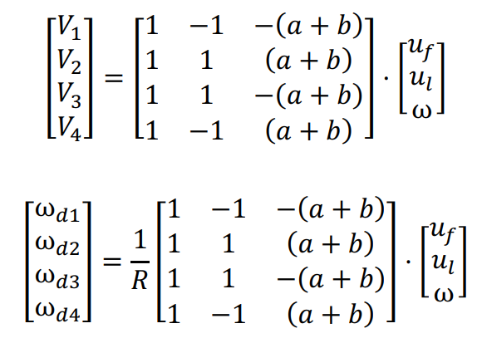

Slide 4
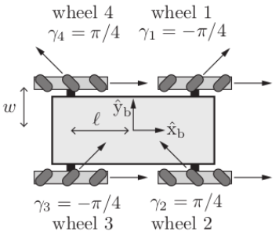

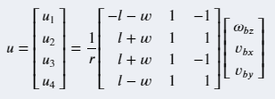

Slide 5
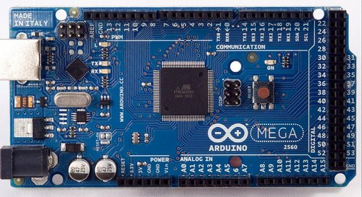
/pen_ orientation
/serial_node
std_msgs/Float32MultiArray
/pen_position
std_msgs/Bool
/pen_ open
std_msgs/Bool

Slide 6
/scan
/raspicam_node
Node
sensor_msgs/Image
/scan
/ydlidar_node
Node
sensor_msgs/LaserScan
Node
/cmd_vel
/rUBot_nav
/serial_node
geometry_msgs/Twist
/odom
nav_msgs/Odometry

