Slide 1
Mining the MAUDE
Spring 2015 SENG 474 Project
Simon Diemert, Scott Low, Paul Moon

Slide 2
MAUDE
Manufacturer and User Facility Device Experience
United States FDA
Medical device error/failure reports
1991 - present
3.7m reports

Slide 3
MAUDE – II
API allows programmatic querying of data base
https://open.fda.gov/
Returns:
Error report (textual description of error)
Degree of harm (none, injury, death)
Device manufacture
Other meta data (date, time, etc.)

Slide 4
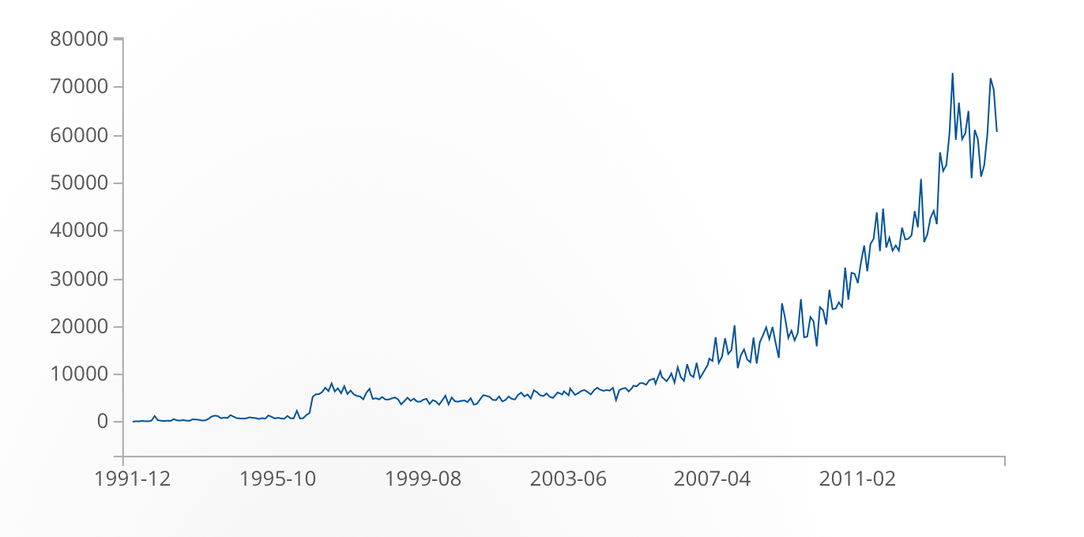
MAUDE - III
https://open.fda.gov/device/event/

Slide 5
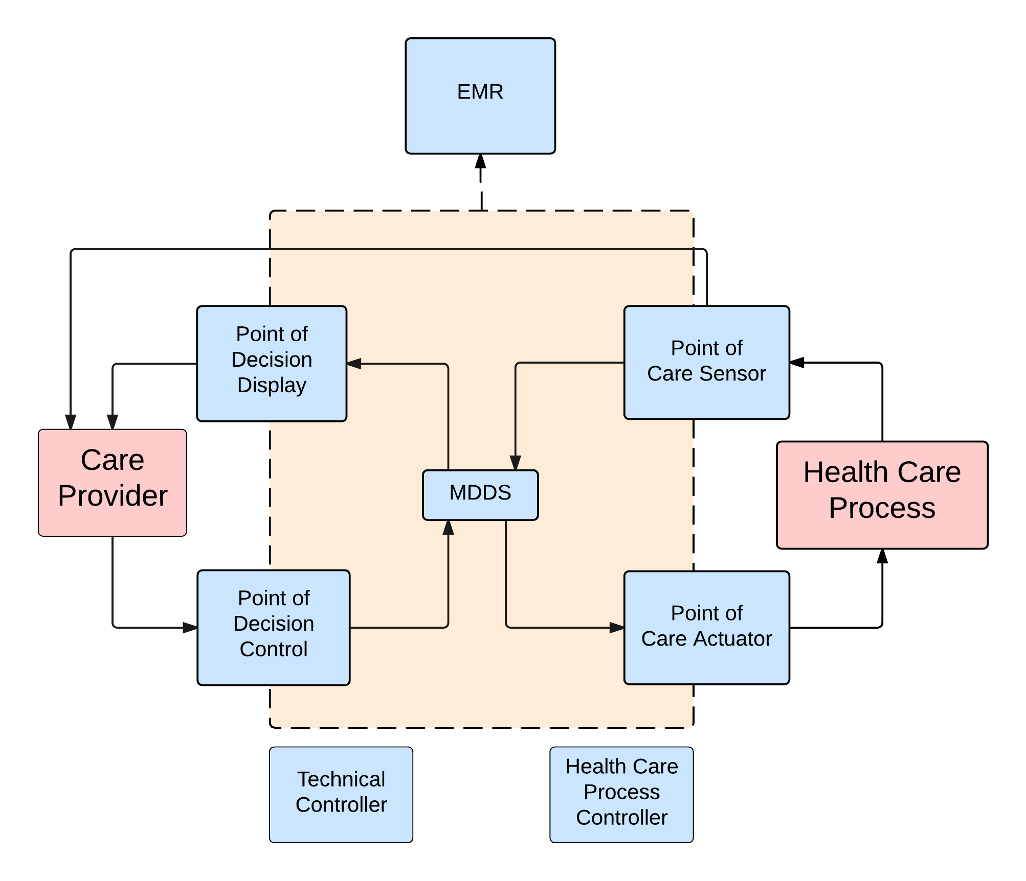
Previous Work
Categorization of reports in the MAUDE database
Focus on software based devices
Jens Weber
Fieran Mason-Blakely
Ryan Habibi

Slide 6
Two Approaches
Analyze natural language text to identify categories of failures
Analyze meta data to predict event type of failure (death, injury, malfunction etc.)

Slide 7
Approach I - Data Collection
PAUL! PUT SOME STUFF HERE

Slide 8
Approach I - Data Cleaning
PAUL! PUT SOME STUFF HERE

Slide 9
Approach I - Analysis
PAUL! PUT SOME STUFF HERE

Slide 10
Approach I - Results
FILL ME!

Slide 11
Approach II - Data Collection
Python script to scrape 50,000 most recent records from MAUDE
Timeouts required due to API throttling
VM management

Slide 12
Approach II - Data Cleaning
Selected 5 major metadata attributes to classify data on
Classifications: Death, Injury, Malfunction
Parsing JSON to .arff was non-trivial

Slide 13
Approach II – Analysis and Results
Naïve Bayes classifier used in Weka
RESULTS GO HERE BITCHES

Slide 14
Discussion – REMOVE THIS
MAUDE is not exhaustive
Bias towards those who report well
Multiclass classification issues
Classification data set (n=300)
OTHER ISSUES

