Slide 1
Mining the MAUDE
Spring 2015 SENG 474 Project
Simon Diemert, Scott Low, Paul Moon

Slide 2
MAUDE
Manufacturer and User Facility Device Experience
United States FDA
Medical device error/failure reports
1991 - present
3.7m reports

Slide 3
MAUDE – II
API allows programmatic querying of data base
https://open.fda.gov/
Returns:
Error report (textual description of error)
Degree of harm (none, injury, death)
Device manufacture
Other meta data (date, time, etc.)

Slide 4
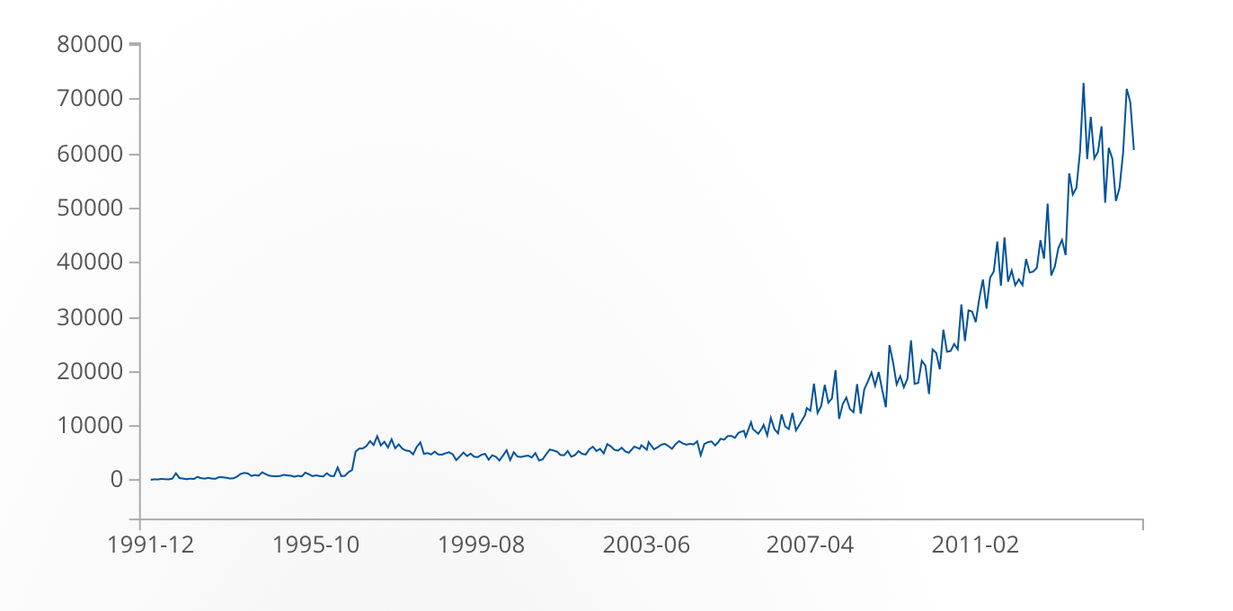
MAUDE - III
https://open.fda.gov/device/event/

Slide 5
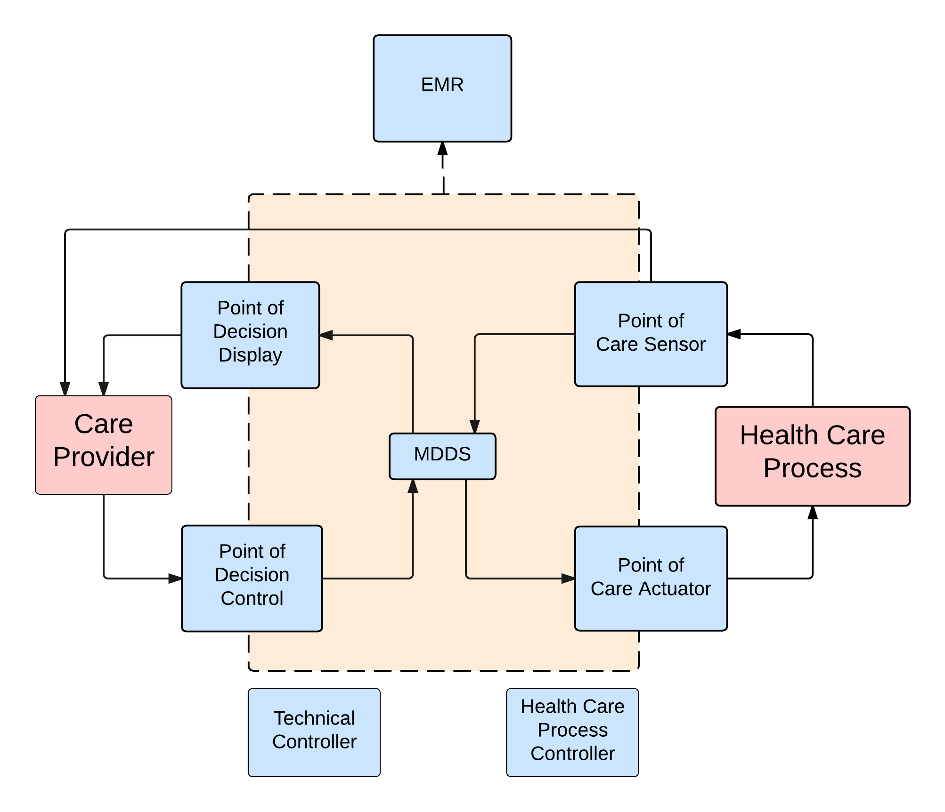
Previous Work
Categorization of reports in the MAUDE database
Focus on software based devices
Jens Weber
Fieran Mason-Blakely
Ryan Habibi

Slide 6
Two Approaches
Analyze natural language text to identify categories of failures
Analyze meta data to predict event type of failure (death, injury, malfunction etc.)

Slide 7
Approach I - Data Collection
We obtained a CSV file from Fieran and Ryan who classified failure events into the aforementioned categories e.g. EMR, Care Provider
A Python script used FDA’s API to get the descriptions of these device failure events.
https://api.fda.gov/device/event.json?

Slide 8
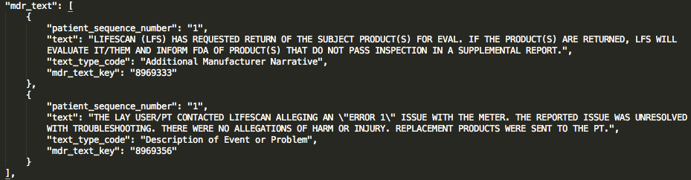
Approach I - Data Cleaning
Given a list of failure reports, extract mdr_text. Sample mdr_text:
Tokenize sentences and analyze part of speech.
Remove stopwords (e.g. the, at, is, which) and numbers.

Slide 9
Approach I - Analysis
Python script generated tuples with:
Attribute: Number of word occurrences for each word
Class: Class value from Fieran and Ryan’s CSV file
Run classification on these tuples with WEKA
10-fold cross-validation
NaiveBayes classifier

Slide 10
Approach I - Results
Class | Correctly classified instances | F-Measure (weighted avg.)
CareProvider | 85.94% | 0.88
EMR | 74.61% | 0.771
HealthCareProcess | 76.95% | 0.768
MDDS | 76.95% | 0.799
PointOfCareActuator | 56.25% | 0.546
PointOfCareSensor | 58.98% | 0.621
PointOfDecisionControl | 67.58% | 0.679
PointOfDecisionDisplay | 61.72% | 0.611
TechnicalProcess | 78.12% | 0.781

Slide 11
Approach II - Data Collection
Python script to scrape 50,000 most recent records from MAUDE
Timeouts required due to API throttling
VM management was necessary

Slide 12
Approach II - Data Cleaning
Selected 5 major metadata attributes to classify data on
Classifications: Death, Injury, Malfunction
Parsing JSON to .arff was non-trivial

Slide 13
Approach II – Analysis and Results
Naïve Bayes classifier used in Weka
76.67% positive correlation

Slide 14
Discussion – REMOVE THIS
MAUDE is not exhaustive
Bias towards those who report well
Multiclass classification issues
Classification data set (n=300)
OTHER ISSUES

