Slide 1
Mining the MAUDE
Spring 2015 SENG 474 Project
Simon Diemert, Scott Low, Paul Moon

Slide 2
MAUDE
Manufacturer and User Facility Device Experience
United States FDA
Medical device error/failure reports
1991 - present
3.7m reports

Slide 3
MAUDE – II
API allows programmatic querying of data base
https://open.fda.gov/
Returns:
Error report (textual description of error)
Degree of harm (none, injury, death)
Device manufacture
Other meta data (date, time, etc.)

Slide 4
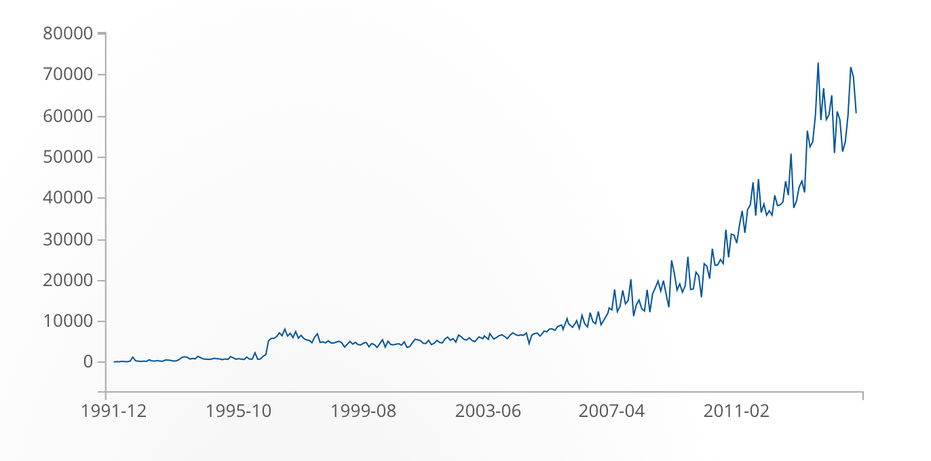
MAUDE - III
https://open.fda.gov/device/event/

Slide 5
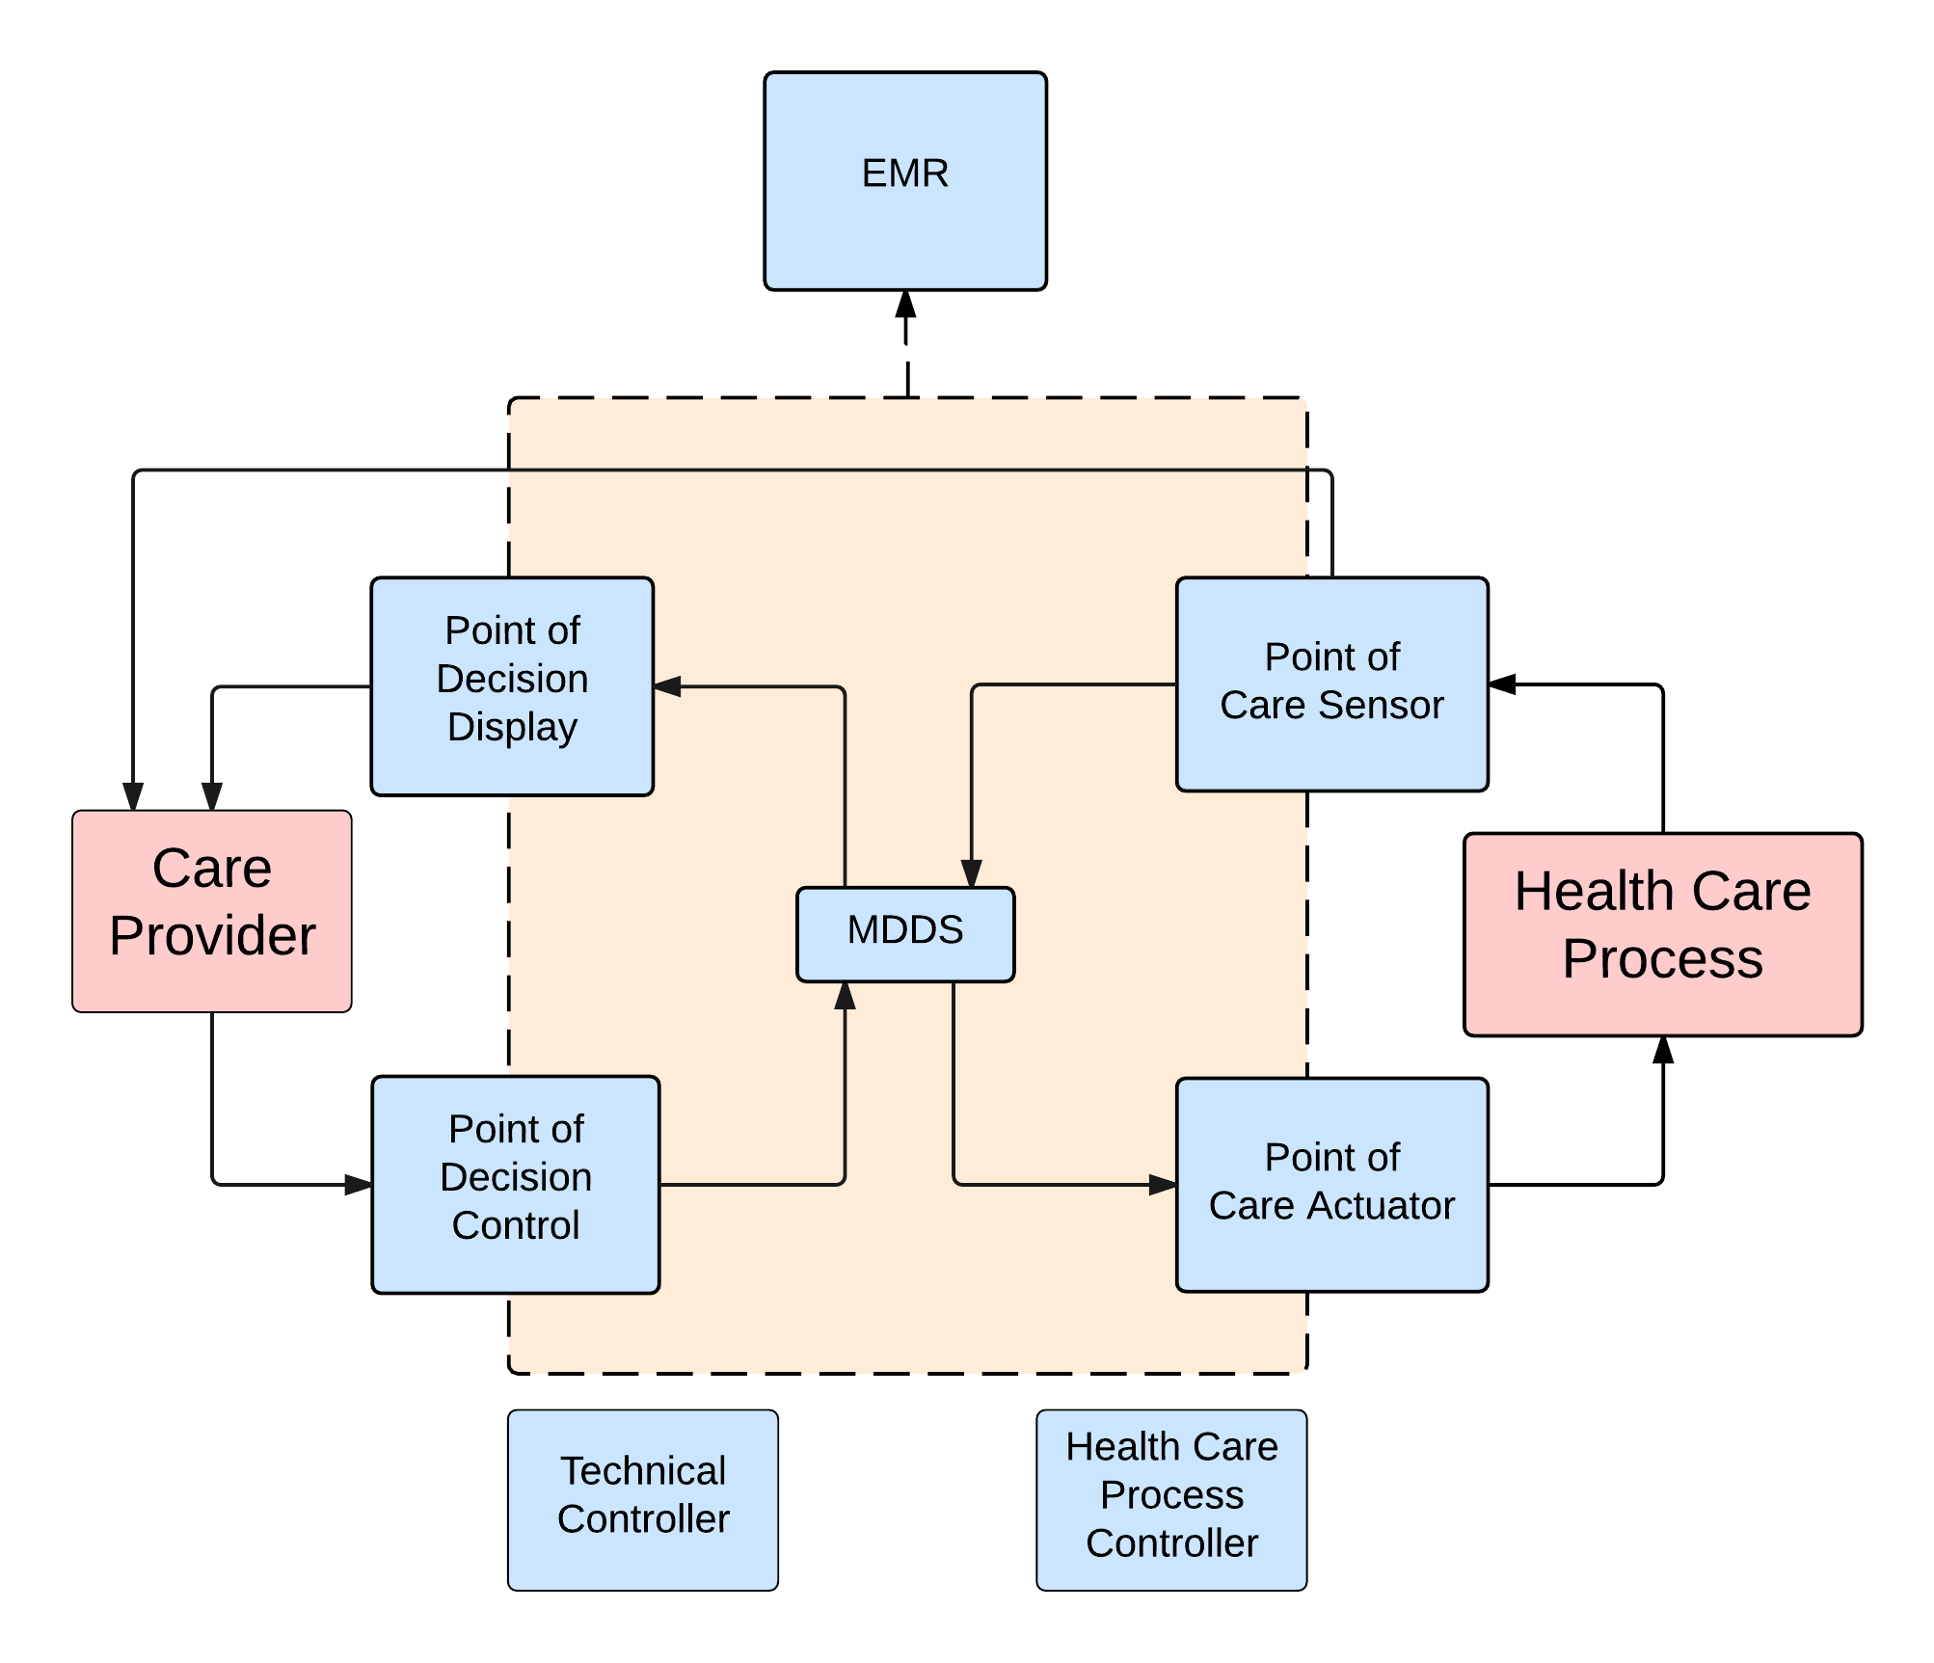
Previous Work
Categorization of reports in the MAUDE database
Focus on software based devices
Jens Weber
Fieran Mason-Blakely
Ryan Habibi

Slide 6
Two Approaches
Analyze natural language text to identify categories of failures
Analyze meta data to predict event type of failure (death, injury, malfunction etc.)

Slide 7
Approach I - Data Collection
We obtained a CSV file from Fieran and Ryan who classified failure events into the aforementioned categories e.g. EMR, Care Provider
A Python script used FDA’s API to get the descriptions of these device failure events.
https://api.fda.gov/device/event.json?

Slide 8
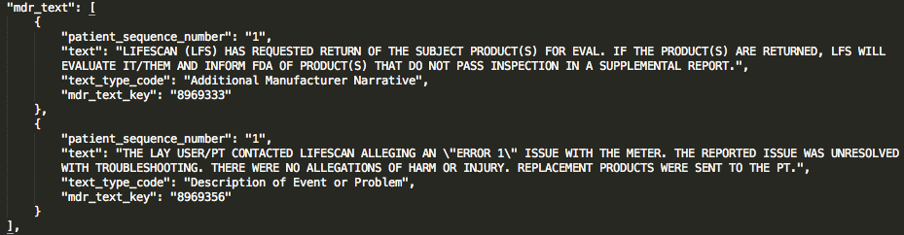
Approach I - Data Cleaning
Given a list of failure reports, extract mdr_text. Sample mdr_text:
Tokenize sentences and analyze part of speech.
Remove stopwords (e.g. the, at, is, which) and numbers.

Slide 9
Approach I - Analysis
Python script generated tuples with:
Attribute: Number of word occurrences for each word
Class: Class value from Fieran and Ryan’s CSV file
Run classification on these tuples with WEKA
10-fold cross-validation
NaiveBayes classifier

Slide 10
Approach I - Results
Class | Correctly classified instances | F-Measure (weighted avg.)
CareProvider | 85.94% | 0.88
EMR | 74.61% | 0.771
HealthCareProcess | 76.95% | 0.768
MDDS | 76.95% | 0.799
PointOfCareActuator | 56.25% | 0.546
PointOfCareSensor | 58.98% | 0.621
PointOfDecisionControl | 67.58% | 0.679
PointOfDecisionDisplay | 61.72% | 0.611
TechnicalProcess | 78.12% | 0.781

Slide 11
Approach II - Data Collection
Python script to scrape 50,000 most recent records from MAUDE
Timeouts required due to API throttling
Failsafe data collection
Data downloaded in chunks and merged after

Slide 12
Approach II - Data Cleaning
Selected 5 major metadata attributes to classify data on
device_operator, manufacturer_name, reporter_occupation_code, device_type_code, device_expired
Classifications: Death, Injury, Malfunction
Parsing JSON to .arff was non-trivial

Slide 13
Approach II – Analysis and Results
Naïve Bayes classifier used in Weka
10-fold cross-validation
76.67% positive correlation
0.764 F-Measure (Weighted Average)

Slide 14
Possible Extensions
Word frequencies is a crude way of analyzing text. Better text analysis could be used.
Explore with using more metadata for attributes.
Different classifiers.

Slide 15
Questions?

