Slide 1
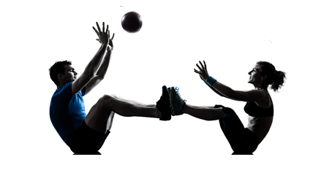

Don’t train alone!
Try a free small group training session between January 1st and 14th!
Sign up at the Personal Training Desk.

Slide 2
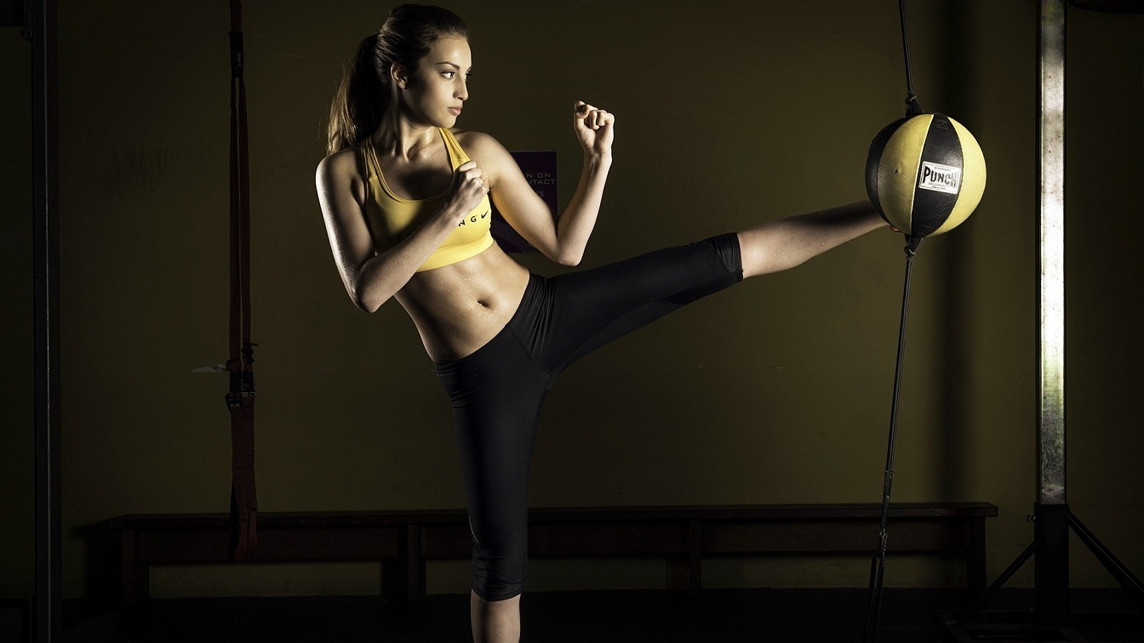

Slide 3
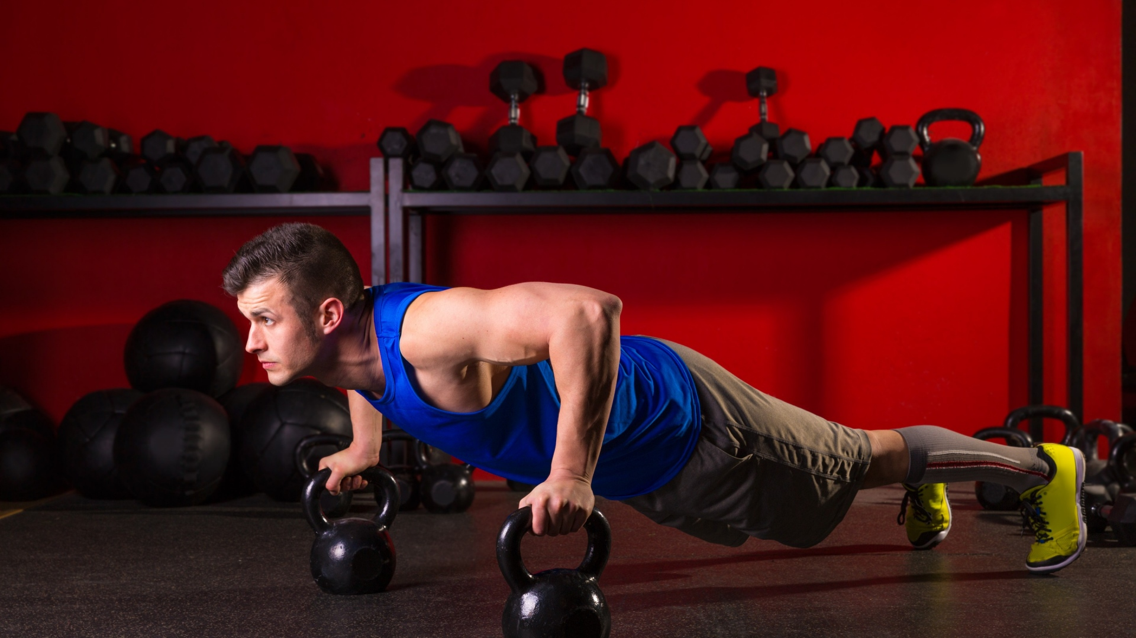

Slide 4
