Slide 1
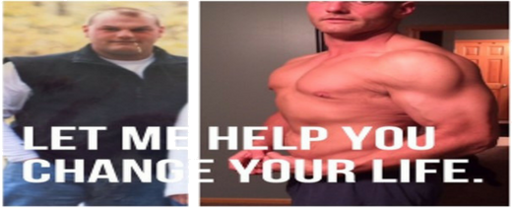
12 Week Transformation with Cory Rowland

