Slide 1
Project 2
Link prediction

Slide 2
Problem description
3
a
1
4
0
c
7
b
2
6
d
5
8
Networks are constructed from the observed interactions between entities, which may be incomplete or inaccurate. Link prediction refers to the task of predicting either missing interactions or links that may appear in the future in an evolving network, which attempts to discover missing links between nodes in a complex network, is of fundamental importance in numerous tasks in countless different domains. For instance, link prediction can identify likely but not yet established links in an evolving social network, thus enabling recommendations to be presented to users.

Slide 3
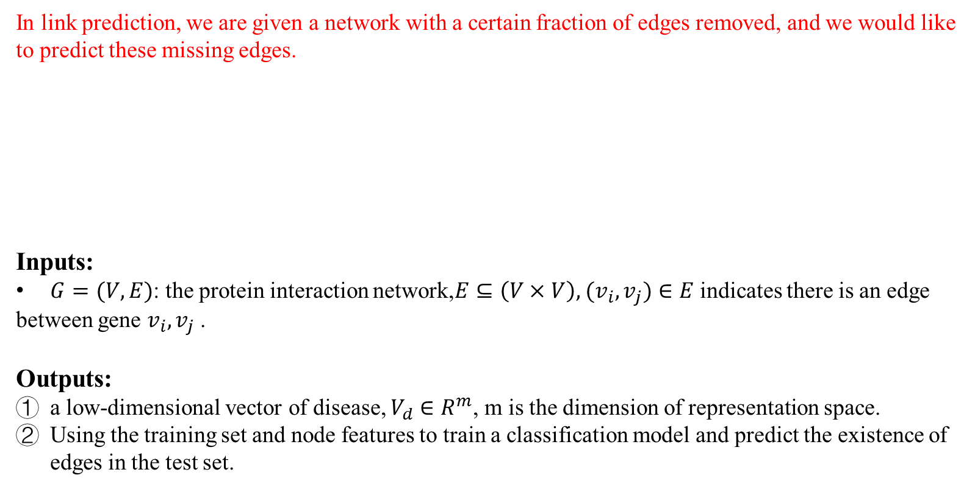
Problem description
In link prediction, we are given a network with a certain fraction of edges removed, and we would like to predict these missing edges.
Inputs:
$G=(V, E)$: the protein interaction network,$E⊆\left(V×V\right),$ $(v_{i},v_{j})∈E$ indicates there is an edge between gene $v_{i},v_{j}$ .
Outputs:
a low-dimensional vector of disease, $V_{d}∈R^{m}$, m is the dimension of representation space.
Using the training set and node features to train a classification model and predict the existence of edges in the test set.
3
a
1
4
0
c
7
b
2
6
d
5
8

Slide 4
Workflow
Network
Network
Question 1
Question 2
Feature extraction
Calculating similarity between nodes with some heuristic methods
Node feature
(node2vec, deepwalk, line)
Missing links prediction
Classifier
(LR, SVM）
Missing links prediction

Slide 5
Question 1: Node similarity calculation
Firstly, using some heuristic methods to calculate the similarity between nodes in the network such as the shortest distance, the common neighbors, secondly, predicting the missing links using node pair similarity score.

Slide 6
Question 2: Feature extraction and prediction
Feature extraction
Recently, methods which use the representation of network nodes in vector space have gained traction from the research community. We first learn features of each node in the network(This is called embedding!!). Then we can train a classifier such as SVM, KNN to predict the missing links.
There are some methods for feature construction:
We can construct the feature of each node based on the network structure such as the adjacency matrix.
Dimension reduction-based methods:
We can obtain the adjacency matrix of the input network, then employ some dimension reduction-based methods such as PCA, SVD or autoencoder etc. to obtain the low-dimensional representation of each node.
Random walk-based methods:
For node representation learning, random walk is exploited to capture structural relationships between vertices. By performing truncated random walks, an information network is transformed into a collection of vertex sequences, in which, the occurrence frequency of a vertex-context pair measures the structural distance between them.
Notes:
特征提取
最近，在向量空间中使用网络节点表示的方法已经获得了研究界的关注。我们首先学习网络中每个节点的功能（这称为嵌入!!）。然后我们可以训练一个分类器，如SVM，KNN来预测缺失的链接。
我们可以基于诸如邻接矩阵之类的网络结构来构造每个节点的特征。
基于维数减少的方法：我们可以获得输入网络的邻接矩阵，然后采用一些基于降维的方法，如PCA，SVD或自动编码器等，来获得每个节点的低维表示。
基于随机游走的方法：对于节点表示学习，利用随机游走来捕获顶点之间的结构关系。通过执行截断的随机游走，信息网络被转换为顶点序列的集合，其中顶点 - 上下文对的出现频率测量它们之间的结构距离。

Slide 7
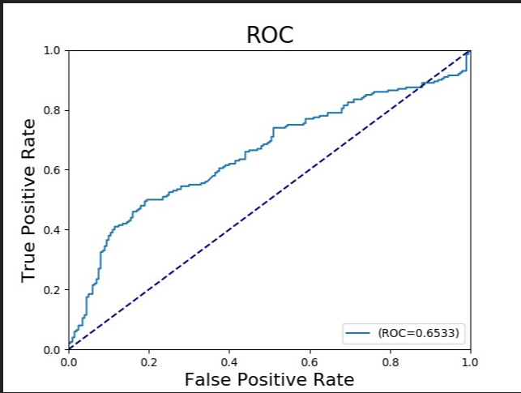
Question 2: Feature extraction and prediction
Link prediction
After obtaining the low-dimensional vector of each node, we can train a classifier (SVM, KNN, LR; sklearn package in python ) to predict whether a link in the test set exists or not.
The evaluation metrics is AUC value.
Notes:
链接预测
在获得每个节点的低维向量之后，我们可以训练分类器（SVM，KNN，LR; python中的sklearn包）来预测测试集中的链接是否存在。
评估指标是AUC值。

Slide 8
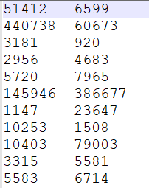
Data
To learn node embeddings:
interactome.txt : the input network (positive samples in training set)
To predict the missing links:
train_neg. txt: (negative samples in training set)
test_pos. txt : the missing links (positive samples in test set)
Test_neg. txt: (negative samples in test set)

Slide 9
Source code
python 3.6, networkx package; sklearn package; numpy package; pandas package
project.py :
Loading data
Question 1 : calculating the similarity between nodes directly based on some metrics such as the shortest distance.
Question 2: learning embeddings;
Training classifier and drawing ROC curve
Load_data.py:
Loading training set and test set;
Drawing ROC curve
Node_sequence.py & node2vec.py:
The source code of node2vec method.

Slide 10
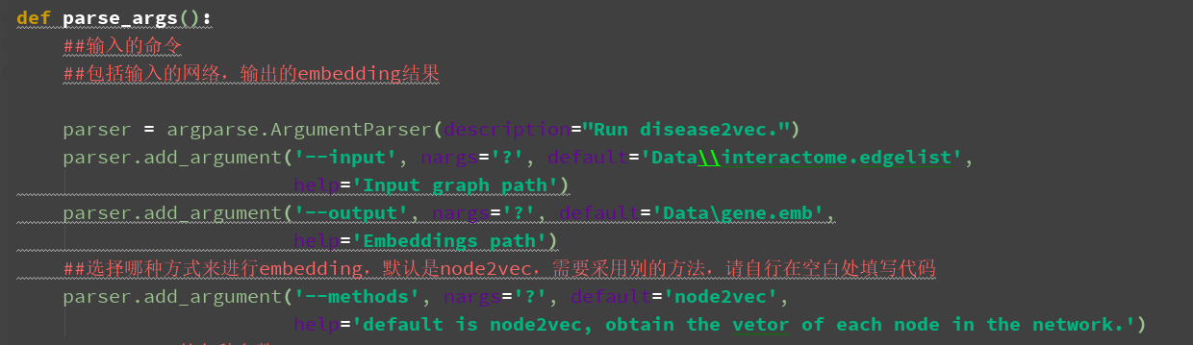
Source code
project.py :

Slide 11
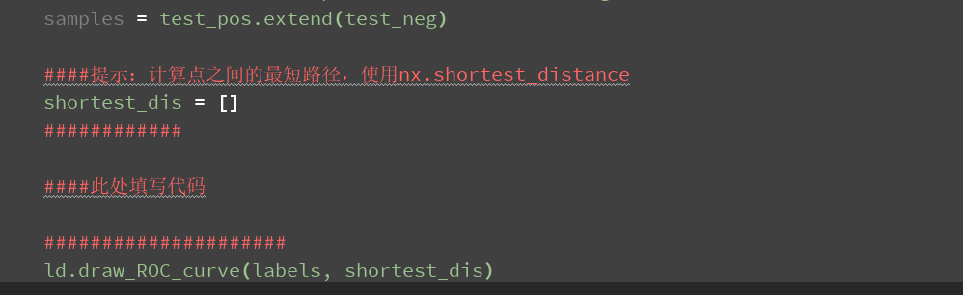
Source code
project.py :
Calculating the similarity between nodes ;

Slide 12
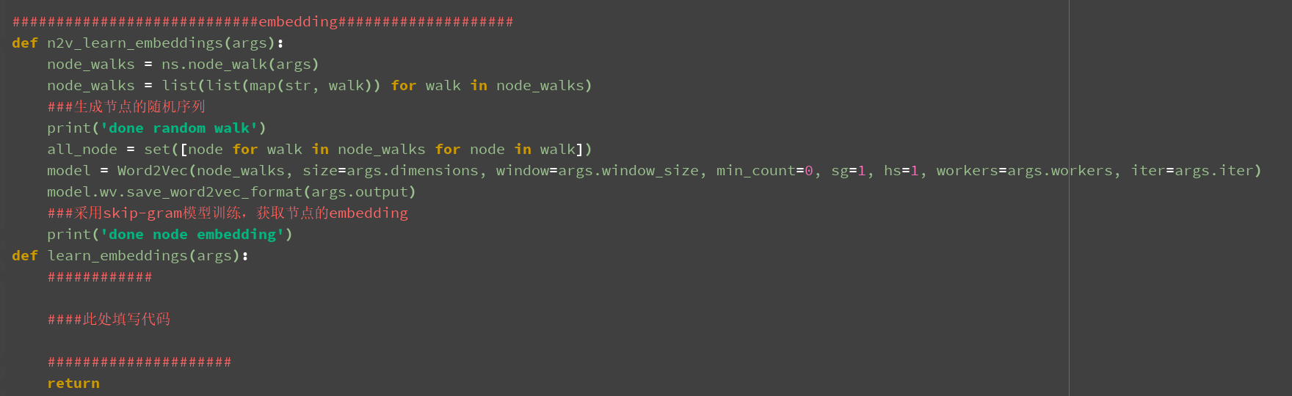
Source code
project.py :
Learning embeddings; (The network is the input and node embedding is the output.)

Slide 13
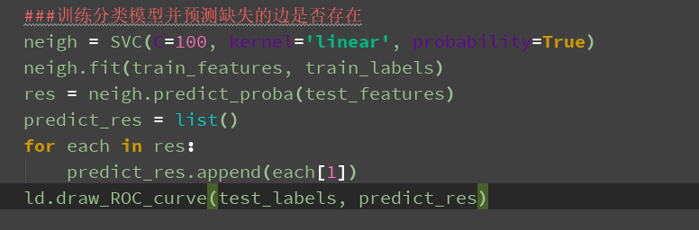
Source code
project.py :
Training model to predict missing links: (sklearn package)

Slide 14
result

Slide 15
reference
Some algorithms about node embedding:
[1]Grover A, Leskovec J. node2vec: Scalable Feature Learning for Networks[J]. 2016, 2016:855-864.
[2]Perozzi B, Alrfou R, Skiena S. DeepWalk: online learning of social representations[J]. 2014:701-710.
[3]Zhang M, Tang J, Qu M, et al. LINE: Large-scale Information Network Embedding[J]. 2015, 2(2):1067-1077.
[4]Wang D, Cui P, Zhu W. Structural Deep Network Embedding[C]// ACM SIGKDD International Conference on Knowledge Discovery and Data Mining. ACM, 2016:1225-1234.

Slide 16
Submitting your code and a report ( MAX 4 pages, 12pt font), through E-learning system in a zip file with the name “pj2-prediction-student name-student No.”.
Presentation.
Project 2 is due on Nov. 30, 2018.

