Slide 1


Max-Margin DeepWalk: Discriminative Learning of Network Representation
Cunchao Tu^{1*}, Weicheng Zhang^{2*}, Zhiyuan Liu¹, Maosong Sun¹
¹Tsinghua University
²Beijing University of Posts and Telecommunications

Slide 2
A good network representation?
Network analysis tasks:
vertex clustering/classification, link prediction
Notes:
一个好的网络表示对于网络分析任务非常重要。网络表示可以作为特征用来进行节点的聚类、分类，以及链接预测等等。

Slide 3

Typical Approaches for Network Representation
1-hot representation: represents each vertex as a discrete symbol
v1
[0, 0, 0, 0, 0, 0, 0, 1, 0, 0, 0, 0, 0, …]
v2
[0, 0, 0, 0, 0, 0, 0, 0, 1, 0, 0, 0, 0, …]
dimension=|V|
sim(v1, v2) = 0

Slide 4
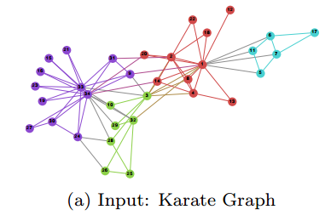
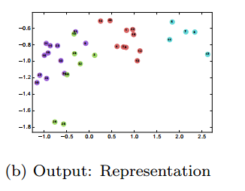
Network Representation Learning
NRL aims to encode the structure role of each vertex into a low-dimensional representation space

Slide 5
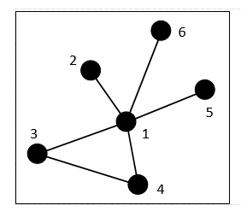
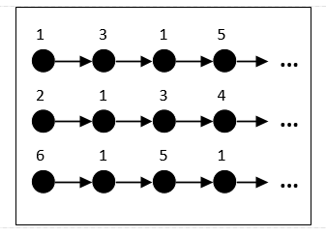
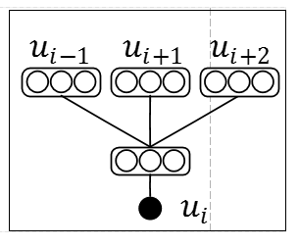

DeepWalk
Social Network
Random Walk Sequences
Skip-Gram
Notes:
deepWalk是网络表征学习的比较基本的算法，用于学习网络中顶点的向量表示（即学习图的结构特征即属性，并且属性个数为向量的维数），使得能够应用传统机器学习算法解决相关的问题。
通过随机游走得到短的结点序列，通过skip-gram更新结点向量表示。

Slide 6

DeepWalk
The objective of DeepWalk

Slide 7


DeepWalk as Matrix Factorization
DeepWalk actually factorizes a matrix M
The objective of matrix factorized DeepWalk aims to minimize

Slide 8
DeepWalk: Unsupervised and weak in prediction tasks.

Slide 9
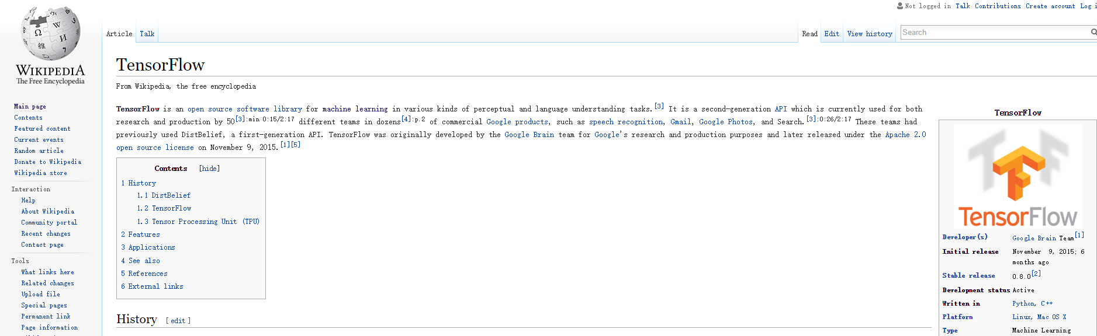
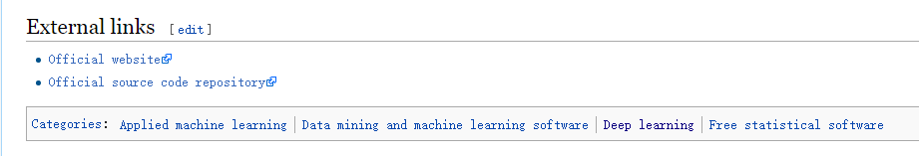
Social networks in real-world
Wikipedia
Additional labeling information!
Notes:
对于实际的许多社交网络来说，网络节点往往具有丰富的异构信息，例如标签类别信息。例如，对于wikipedia的词条页面，在页面的下部通常会标识该页面的内容属于哪个类别。这里是tensorflow的网页截图，可以看到它属于deep learning等类别。

Slide 10
How to incorporate labeling information into NRL?
Notes:
那么我们怎么才能把标签信息融入到网络表示学习中呢

Slide 11
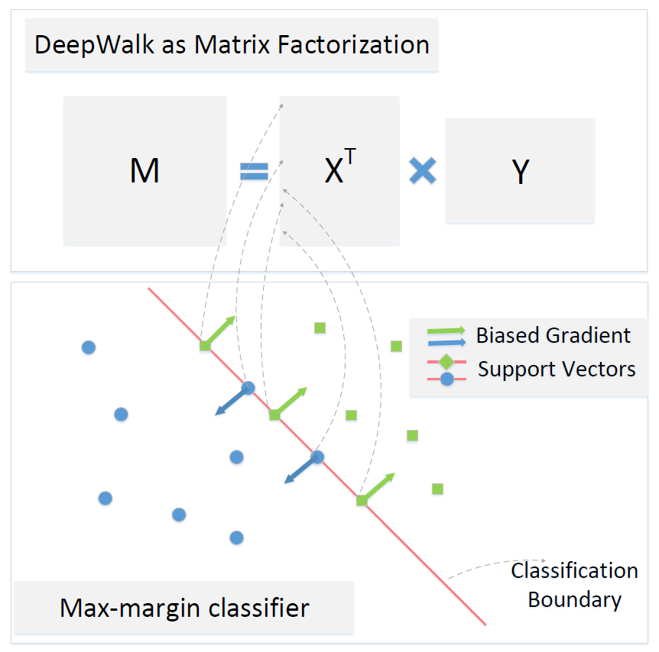
Max-margin DeepWalk
Max-margin classifier + DeepWalk
Learn initial representations using DeepWalk as MF (MFDW)
Train max-margin classifier using representations of labelled vertices
Calculate biased gradient for labelled vertices
Re-train DeepWalk as MF
Notes:
为了将标签类别信息融入到网络表示学习中，我们提出了max-margin deepWalk，来学习更有区分性的网络表示。如右图所示，mmdw是通过将max-margin分类器和矩阵分解形式的deepwalk进行结合，来将类别信息融入节点的表示中。
具体来说，第一步，需要通过MFDW进行矩阵分解，得到节点的初始表示。第二部，利用学习到的节点表示，及训练集节点的标签信息，训练max-margin分类器。第三部，根据训练得到的分类器，计算训练集节点的偏置梯度。最后，将训练集节点的偏置梯度添加到MFDW矩阵分解的梯度下降过程中。

Slide 12
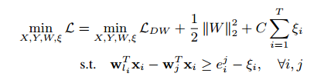
The objective of MMDW
Combination of DeepWalk and max-margin classifier
MFDW
SVM
Notes:
MMDW的目标函数就是DeepWalk和max-margin分类器的结合，约束为svm分类器的约束。

Slide 13
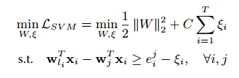
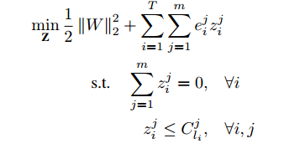
Optimization of SVM
SVM part:
The dual form:
Lagrangian multiplier
Support vectors

Slide 14

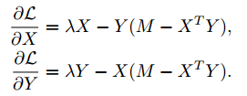
Optimization of MFDW
DeepWalk part:
Without the consideration of constraints, we have
Notes:
DeepWalk的优化部分变成了在MFDW的基础上加上了SVM的约束。在没有约束的情况下，我们可以直接对X、Y两个矩阵求梯度，利用梯度下降进行优化。

Slide 15


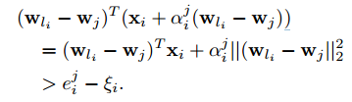
Biased Gradient
According to KKT conditions, for support vectors (Lagrangian multiplier ):
We aim to bias the support vector away from the boundary favors a more accurate prediction
For the j-th constraint, Add a component to
The Biased Gradient becomes
Notes:
在考虑约束的时候，我们根据KKT条件，可以得到，对于第i个向量的第j个约束，当拉格朗日乘子不等于0时，对应的向量为支持向量，此时，该约束恰好满足，该向量处于分类边界上。MMDW的目标，就是对于分类边界上的支持向量，让其偏离分类边界，使得对于这些向量的分类更加准确。
具体来说，就是根据每个约束条件，对向量添加对应的偏置，使得等式约束变成不等式约束。最后X的梯度就是在原来梯度的基础上加上由约束计算得来的偏置梯度。
通过利用约束条件来改变DeepWalk梯度下降训练过程中的梯度，可以得到更有判别性的表示向量X和模型参数Y

Slide 16
Experiments
Datasets
Cora: 2708 machine learning papers, 7 classes
Citeseer: 3312 publications, 6 classes
Wiki: 2405 web pages, 17 categories
Baseline：DeepWalk, DeepWalk as Matrix Factorization, LINE
Evaluation: vertex classification

Slide 17
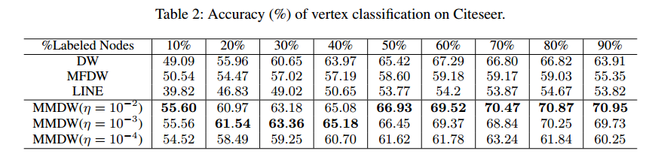
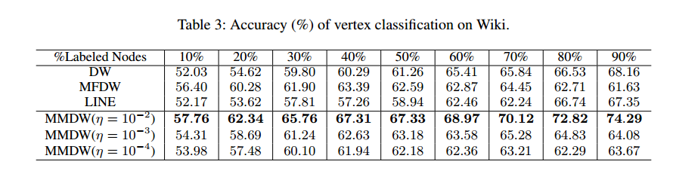
Vertex classification
>5% improvements than baselines
Outperforms DW with half less training data

Slide 18
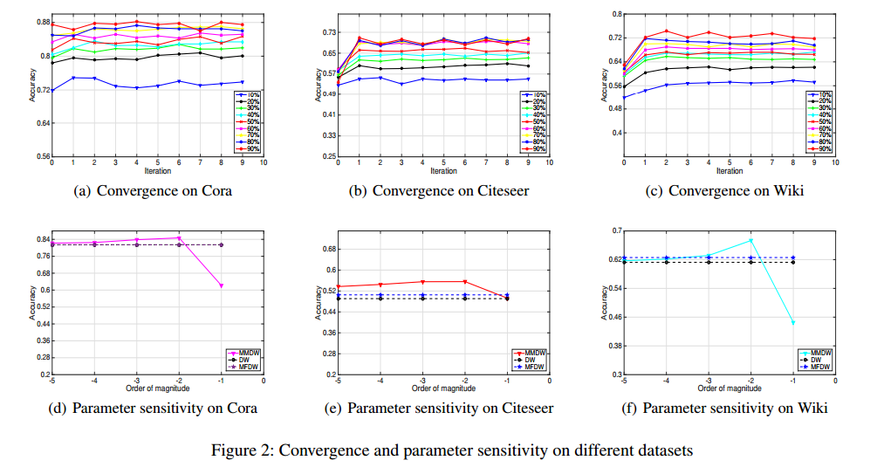
Vertex classification
MMDW convergences after 2 or 3 iterations
MMDW has a stable performance when eta=10⁻²

Slide 19
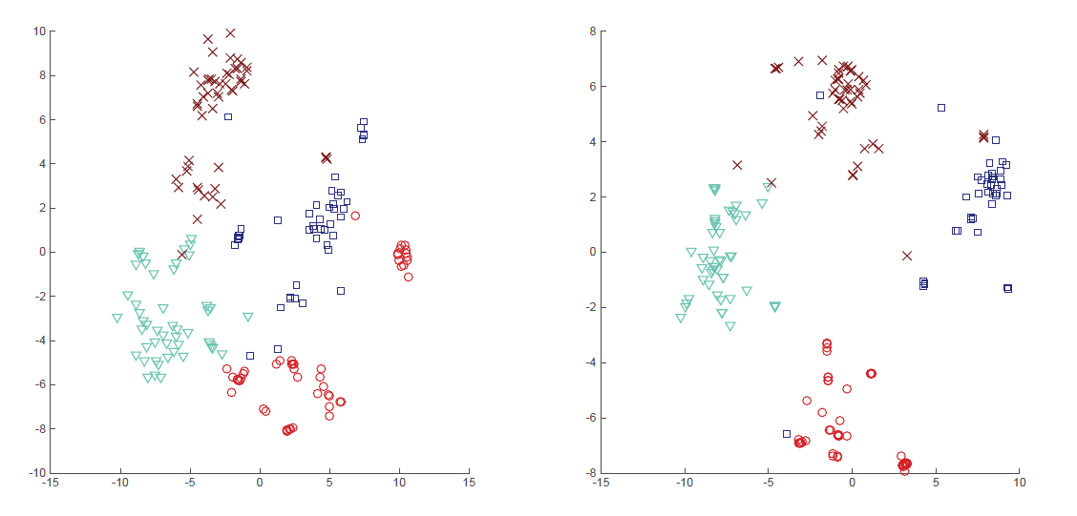
VISUALIZATION
t-SNE 2D representations on Wiki

Slide 20
Conclusion
We propose MMDW to incorporate labeling information into NRL
We put forward the idea of Biased Gradient in NRL.
It indicates the direction the vector should move towards
We conduct vertex classification experiments on several real-world dataset
MMDW achieves 5% to 10% improvements compared to typical NRL methods.

Slide 21
Thanks!

