Slide 1
The Data Incubator Project Pitch
Predicting Housing Price Growth Using County-Level Data
or: where should I buy a house?
Sam Dillavou

Slide 2
Many, Many Factors in Housing Prices
Individual
+
Neighborhood/County
+
Global/Market
Size/Style
Bed/Bathrooms
Location
Year Constructed
Upkeep
Quirks
Schools (DoEd.)
Unemployment (BLS)
Crime Rates (DoJ)
Demographics
Local Businesses (USDA)
Location
Supply/Demand
Mortgage Rates
Rent Prices
Market Fluctuations
Pandemics
Properties Mostly Static
Heavily Studied
High Variance Locally
Slowly Varying
Fewer Forecasts
*Data Available*
Volatile in Time
Heavily Studied
Immensely Complex
Which house do I buy?
Where should I buy a house?
When do I buy?

Slide 3


First Step: School and Housing Data
Dept of Education
Public school test assessments in math and reading by grade, demographic, and district since 2009.
~200 MB
Seasonally adjusted house price index by county and month since 1996.
~6MB
Ridge Regression with SciPy
Currently: dividing data by district and year
Currently: dividing data by county and year

Slide 4
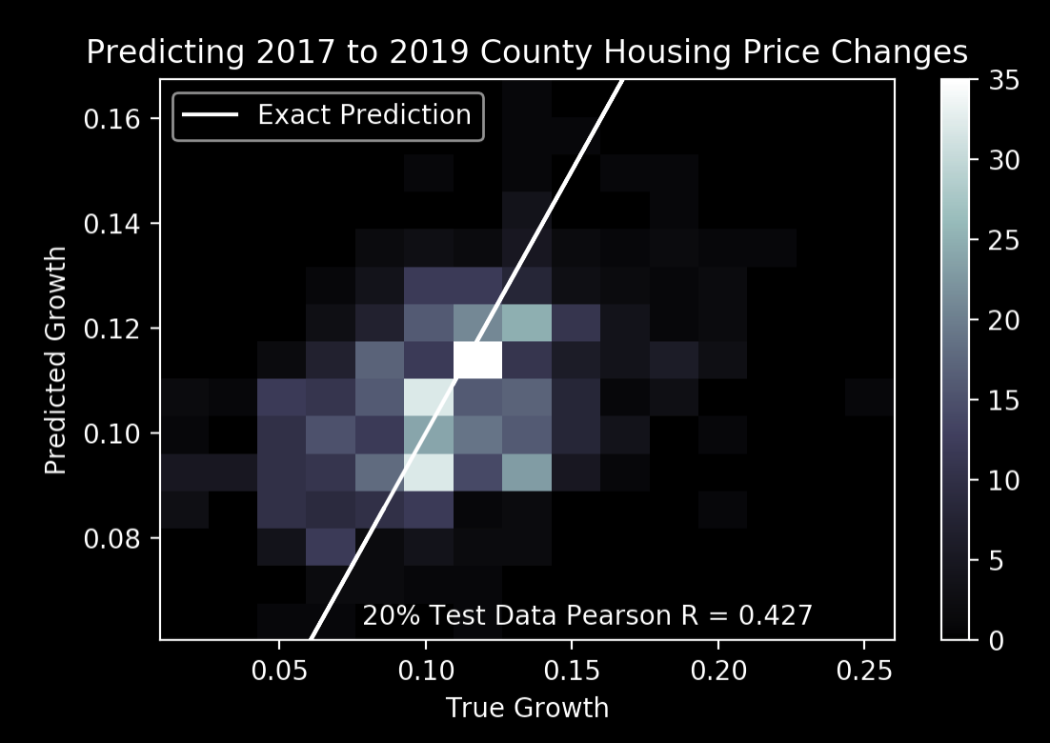
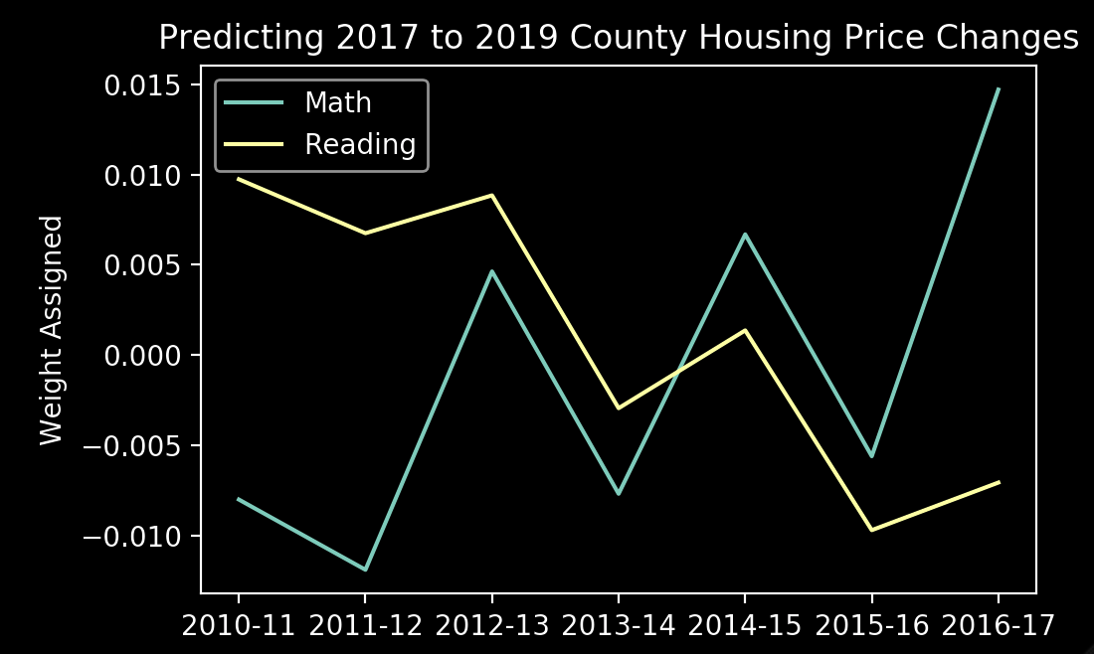
Math Up, Reading Down → Housing Price Rise!?
Predicting 2017-19 Housing Price Changes Using Ridge Regression on Public School Test Data 2010-16
Past school test data correlates with future housing price changes: current algorithm adds 1.9% (2 year) growth over median of 5 options.
Surprisingly, the model consistently correlates falling reading performance with rising prices.

Slide 5
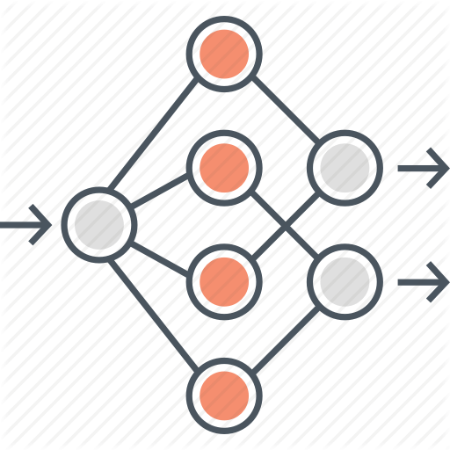


Next Steps
Add unemployment (BLS) and crime (DoJ) data. Both publicly available by county for decades.
Increase model capability by using neural network.
Separate training and test data in time.
Visualization tool for county selection and data source overlay.
https://www.bls.gov/lau/
https://www.ucrdatatool.gov/Search/Crime/Crime.cfm

