Slide 1
The Data Incubator Project Pitch
Predicting Housing Price Growth Using County-Level Data
or: where should I buy a house?
Sam Dillavou

Slide 2
No Available Quantitative Local Growth Forecasts
Individual
+
Neighborhood/County
+
Global/Market
Size/Style
Bed/Bathrooms
Location
Year Constructed
Upkeep
Quirks
Schools (DoEd.)
Unemployment (BLS)
Crime Rates (DoJ)
Demographics
Local Businesses (USDA)
Location
Supply/Demand
Mortgage Rates
Rent Prices
Market Fluctuations
Pandemics
Properties Mostly Static
Heavily Studied
High Variance Locally
Slowly Varying
Fewer Forecasts
*Data Available*
Volatile in Time
Heavily Studied
Immensely Complex
Which house do I buy?
Where should I buy a house?
When do I buy?

Slide 3


First Step: School and Housing Data
Dept of Education
Public school test assessments in math and reading by grade, demographic, and district since 2009.
~200 MB
Seasonally adjusted house price index by county and month since 1996.
~6MB
Ridge Regression with SciPy
Currently: dividing data by district and year
Currently: dividing data by county and year

Slide 4
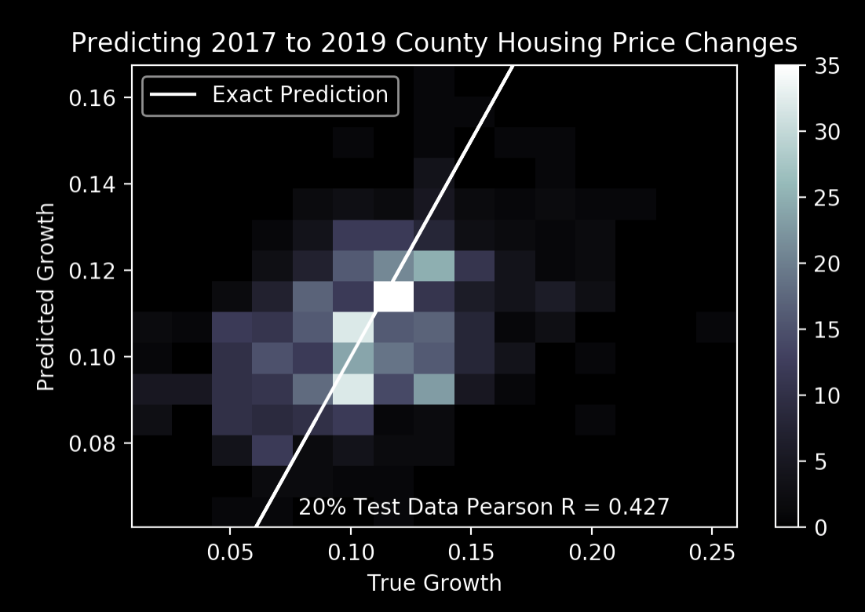
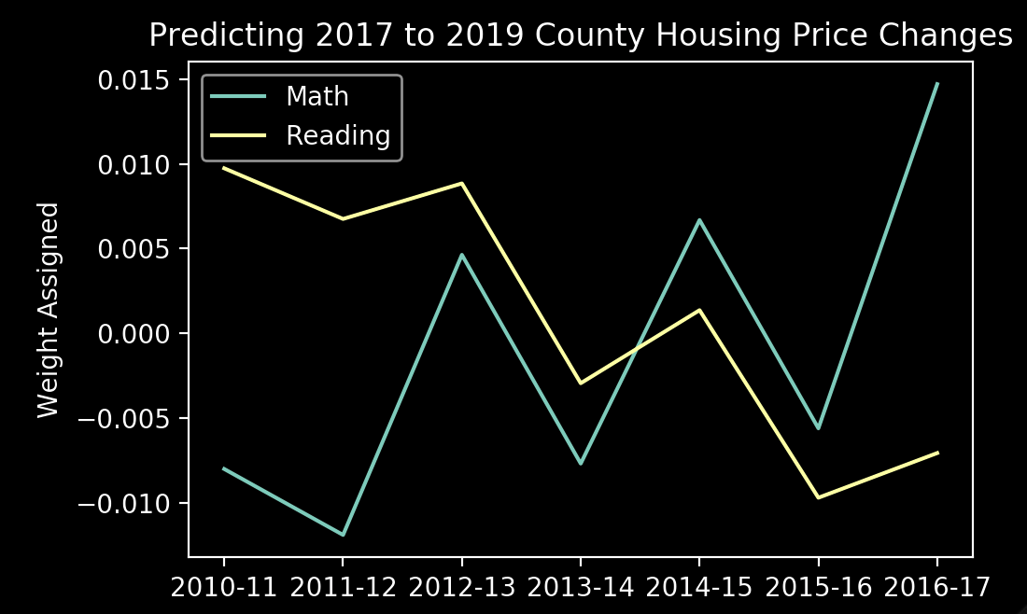
Math Up, Reading Down → Housing Price Rise!?
Predicting 2017-19 Housing Price Changes Using Ridge Regression on Public School Test Data 2010-16
Past school test data correlates with future housing price changes: current algorithm adds 1.9% (2 year) growth over median of 5 options.
Surprisingly, the model consistently correlates falling reading performance with rising prices.

Slide 5

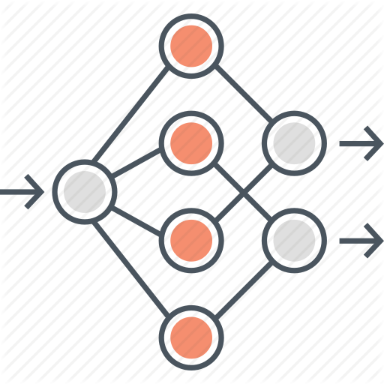

8 Week Plan
https://www.bls.gov/lau/
https://www.ucrdatatool.gov/Search/Crime/Crime.cfm
Add unemployment (BLS) and crime (DoJ) data. Both publicly available by county for decades.
Increase model
capability by using a
shallow neural network.
Visualization tool for county selection and data source overlay.

Slide 6
Thank You!
The Data Incubator Project Pitch
Where should I buy a house?
Sam Dillavou

