Slide 1
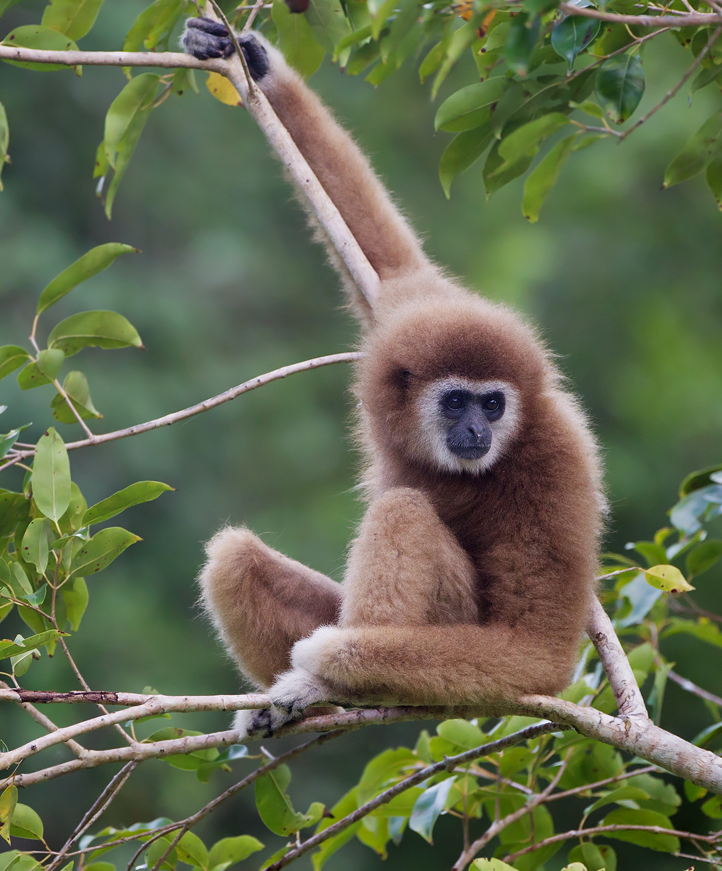
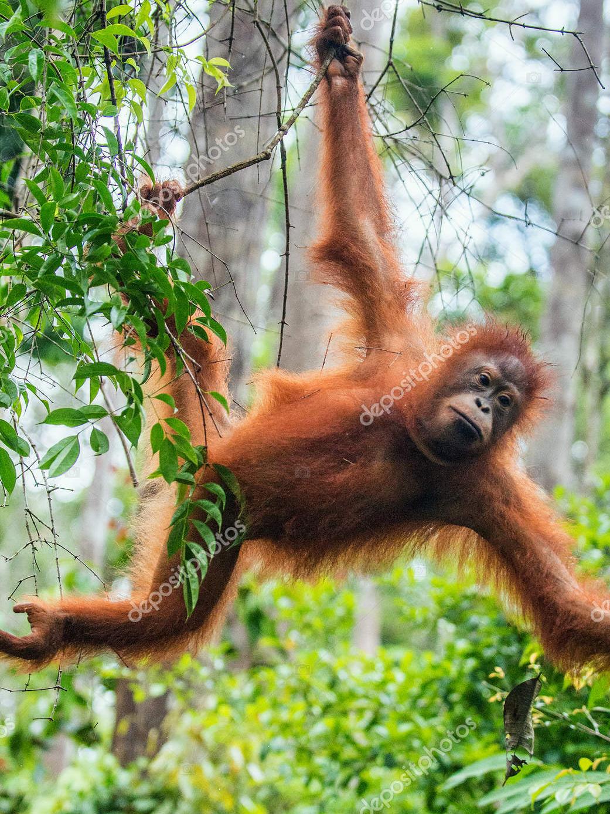
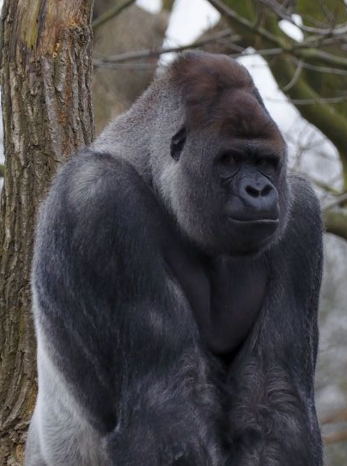
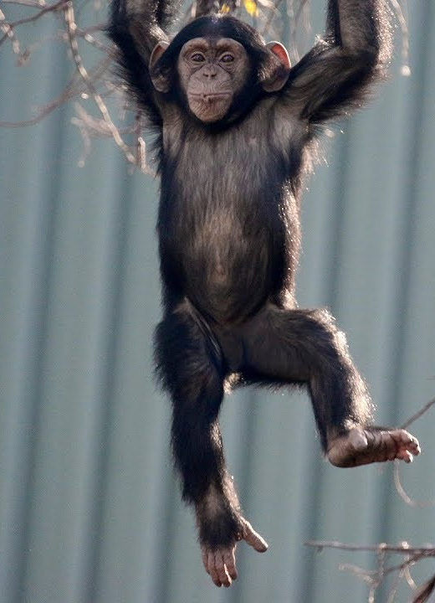
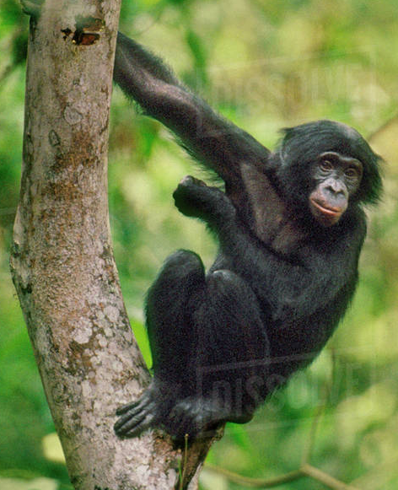
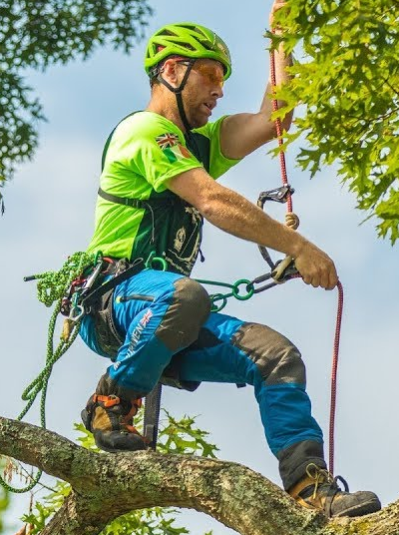







GIBBON
ORANGUTAN
GORILLA
CHIMPANZEE
BONOBO
HUMAN
2.5 million years ago
5-6 million years ago
8-9 million years ago
15 million years ago
22 million years ago

Slide 2


ORANGUTAN
GORILLA
HUMAN
BONOBO
CHIMPANZEE
2 million years ago
4-6 million years ago
6-8 million years ago
12-16 million years ago

Slide 3


Slide 4
Keith
Prisoner’s dilemma
Temp > Reward > Punishment > Sucker
SPLIT
STEAL
$17,802
$0
Emma
SPLIT
$17,802
$35,605
$35,605
$0
STEAL
$0
$0

Slide 5
Prisoner B
Prisoner’s dilemma
Temp > Reward > Punishment > Sucker
Cooperate (silence)
Defect (confess)
2 years
12 years
Cooperate (silence)
Prisoner A
2 years
6 months
6 months
8 years
Defect (confess)
12 years
8 years

Slide 6
Prisoner B
Prisoner’s dilemma
Temp > Reward > Punishment > Sucker
Cooperate (silence)
Defect (confess)
2 years
12 years
Cooperate (silence)
Prisoner A
2 years
6 months
6 months
8 years
Defect (confess)
12 years
8 years

Slide 7
Prisoner B
Chicken
Temp > Reward > Sucker > Punishment
Cooperate (silence)
Defect (confess)
2 years
8 years
Cooperate (silence)
Prisoner A
2 years
6 months
6 months
12 years
Defect (confess)
8 years
12 years

Slide 8
 | Player 1 | Player 2 | Player 3 | Player 4 | Player 5 | Player 6
Initial | $20 | $20 | $20 | $20 | $20 | $20
Round 1 investment
Final total
Total invested | Total/ number of players

Slide 9


x20
x20
x20
x20
x20
x20
x20

Slide 10
x18
x0
x10
C
x56
x6
x16
x14
x20
S

Slide 11
x18
x0
x10
C
56*1.5 =
x84
x6
x16
x14
x20
S

Slide 12
x18
x0
x10
C
x12
x12
x12
x6
x16
x12
x12
x12
x12
x14
x20
S

Slide 13
x30
x12
x22
C
x18
x28
x26
x32
S

Slide 14
x30
x12
x22
C
Sample game
x18
x28
x26
x32
S

Slide 15
x30
x30
x30
Earnings after first round if everyone is cooperative
(gives all)
x30
x30
x30
x30

Slide 16
x20
x20
x20
Earnings after first round if everyone is selfish
(gives 0)
x20
x20
x20
x20

Slide 17
x30
x30
x30
Round 1 earnings if everyone is cooperative
(gives all)
x30
x30
x30
x30

Slide 18
x30
x12
x22
x18
x28
x26
x32
x20
x50
x20
x50
x20
x50
Round 1 earnings if everyone is selfish
(gives 0)
Round 1 earnings if everyone is cooperative
(gives all)
x20
x50
x20
x50
x20
x50
x20
x50

Slide 19
x0
x0
x0
x30
x0
x0
x0
x0

Slide 20
x1
x0
x2
x14
x3
x3
x2
x5

Slide 21
x1
x0
x2
14*1.5 =
x21
x3
x3
x2
x5

Slide 22
x4
x0
x4
x0
x6
x4
x4
x15

Slide 23
?
x10
?
x10
Selfish
x10
x0
x8
x2
Altruistic/ fair
x5
x5
REJECT
ACCEPT
x0
x0
x8
x2

Slide 24
?
x10
?
x10
Selfish
x10
x0
x8
x2
Altruistic/ fair
x5
x5
REJECT
ACCEPT
x0
x0
x8
x2

Slide 25
?
x10
?
x10
Selfish
x10
x0
x10
x0
Altruistic/ fair
x5
x5

Slide 26
?
x10
x10
6*1.5
= x9
Trust game
x10
x4
?
x19
x4
x13
x10

Slide 27
x10

Slide 28
Matrix 1
1.34 | 7.13 | 2.80
4.86 | 5.24 | 0.59
5.78 | 4.89 | 4.21
3.11 | 6.41 | 2.87
8.21 | 5.20 | 8.61
Matrix 2
5.83 | 6.06 | 3.31
0.15 | 1.55 | .93
1.55 | 9.42 | 7.04
4.04 | 8.38 | 6.03
3.96 | 3.31 | 3.97
Matrix 3
4.59 | 1.55 | 9.01
2.33 | 5.80 | 8.66
6.48 | 3.62 | 9.32
2.66 | 6.83 | 2.06
8.45 | 3.42 | 6.77
Matrix 4
3.82 | 7.45 | 2.65
0.15 | 1.45 | 7.33
8.44 | 5.47 | 1.56
4.04 | 8.38 | 3.89
3.96 | 3.31 | 5.80
Matrix 5
3.44 | 8.86 | 2.11
2.21 | 5.42 | 6.66
7.88 | 5.79 | 2.34
4.21 | 9.38 | 5.60
8.91 | 6.11 | 4.30
Matrix 6
8.12 | 6.02 | 1.88
5.25 | 1.66 | 1.22
1.21 | 3.45 | 3.42
4.55 | 7.33 | 7.13
7.56 | 1.00 | 2.97

Slide 29
Matrix 1
1.34 | 7.13 | 2.80
4.86 | 5.24 | 0.59
5.78 | 4.89 | 4.21
3.11 | 6.41 | 2.87
8.21 | 5.20 | 8.61
Matrix 2
5.83 | 6.06 | 3.31
0.15 | 1.55 | .93
1.55 | 9.42 | 7.04
4.04 | 8.38 | 6.03
3.96 | 3.31 | 3.97
Matrix 3
4.59 | 1.55 | 9.01
2.33 | 5.80 | 8.66
6.48 | 3.62 | 9.32
2.66 | 6.83 | 2.06
8.45 | 3.42 | 6.77
Matrix 4
3.82 | 7.45 | 2.65
0.15 | 1.45 | 7.33
8.44 | 5.47 | 1.56
4.04 | 8.38 | 3.89
3.96 | 3.31 | 5.80
Matrix 5
3.44 | 8.86 | 2.11
2.21 | 5.42 | 6.66
7.88 | 5.79 | 2.34
4.21 | 9.38 | 5.60
8.91 | 6.11 | 4.30
Matrix 6
8.12 | 6.02 | 1.88
5.25 | 1.66 | 1.22
1.21 | 3.45 | 3.42
4.55 | 7.33 | 7.13
7.56 | 1.00 | 2.97

Slide 30
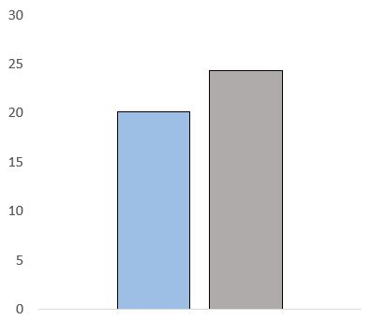
Morning
Afternoon

Slide 31
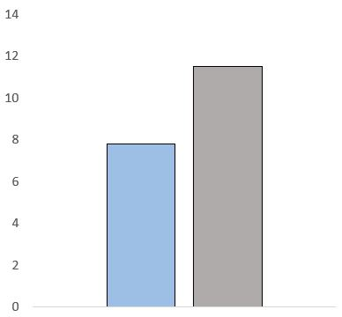
Well lit
Dark

Slide 32
Creativity score
Cheaters
Non-cheaters
Well lit
Dark

Slide 33
Willingness to act unethically
Neutral
Anxiety
Well lit
Dark

Slide 34
 | Individual opponent | Group opponent
Low cost (13 cents) | Initial amount: $2.50 Deduction: 13 cents | Initial amount: $10 Deduction: 50 cents (13 cents each)
High cost (50 cents) | Initial amount: $10 Deduction: 50 cents | Initial amount: $40 Deduction: $2 (50 cents each)

Slide 38
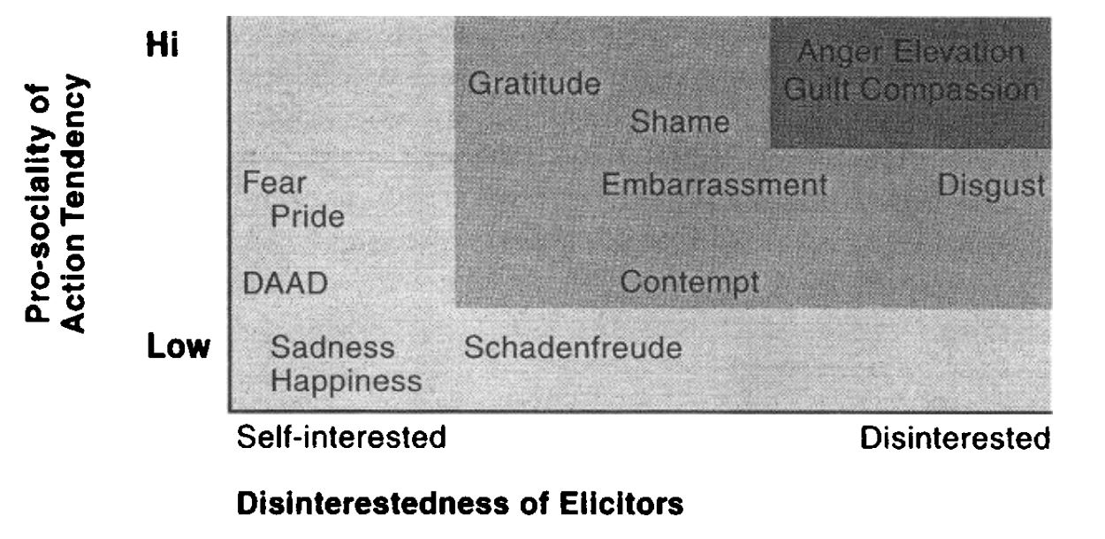
Moral emotions
High
Anger
Elevation
Gratitude
Compassion
Guilt
Shame
Fear
Embarrassment
Disgust
Pro-sociality
of action tendency
Pride
DAAD
Contempt
Low
Schadenfreude
Sadness
Happiness
Self-interested
Disinterested
Disinterestedness of elicitors
Emotion
family
Other-condemning
Other-praising
Self-conscious
Other-suffering

Slide 39
Autonomy
Care/harm
Fairness
Community
Loyalty
Authority
Divinity
Purity

Slide 40


Actual

