Slide 1

SHOPPER SPECTRUM
Customer Segmentation & Product Recommendation Engine for E-Commerce
RFM Analysis • K-Means Clustering • Collaborative Filtering • Streamlit Deployment
Project Report | E-Commerce & Retail Analytics

Slide 2




01 PROBLEM STATEMENT
Why This Project Matters
The global e-commerce industry generates massive volumes of transaction data every day. Buried inside that data are clear patterns of customer purchasing behavior — patterns that, if uncovered, let a business identify its most valuable buyers and recommend the right products to the right shoppers.
Targeted Marketing
Segment customers for focused campaigns
This project analyzes online retail transaction data to segment customers using RFM (Recency, Frequency, Monetary) analysis and to power a product recommendation system built on collaborative filtering.
Personalized Recs
Product suggestions on the storefront
Retention Programs
Spot at-risk customers early
Dynamic Pricing
Price strategy by purchase behavior
SHOPPER SPECTRUM
2

Slide 3
02 DATASET
Online Retail Transaction Dataset
Real-world e-commerce transaction records containing everything needed to compute RFM values and build a product similarity model — invoice numbers, product codes, quantities, prices and customer IDs.
InvoiceNo
StockCode
Description
Quantity
Transaction number
Unique product / item code
Name of the product
Number of products purchased
InvoiceDate
UnitPrice
CustomerID
Country
Date and time of transaction
Price per product
Unique identifier for each customer
Country where the customer is based
SHOPPER SPECTRUM
3

Slide 4







03 PROJECT WORKFLOW
End-to-End Analytics Pipeline
1
2
3
4
5
6
7
Data Collection
Preprocessing
EDA
RFM Engineering
Clustering
Recommendation
Streamlit App
Load online retail transaction dataset
Clean nulls, cancellations & invalid rows
Explore trends, top products & countries
Recency, Frequency, Monetary per customer
K-Means segmentation of customers
Cosine similarity between products
Deploy interactive prediction UI
SHOPPER SPECTRUM
4

Slide 5


04 DATA PREPROCESSING
Getting the Data Analysis-Ready
Remove missing CustomerID
Rows without a customer identifier can't be attributed to any shopper, so they are dropped.
Exclude cancelled invoices
Any InvoiceNo starting with 'C' represents a cancellation and is removed from the dataset.
Remove negative / zero values
Transactions with non-positive Quantity or UnitPrice are filtered out as invalid records.
SHOPPER SPECTRUM
5

Slide 6


05 EXPLORATORY DATA ANALYSIS
Understanding Purchase Behavior
Transaction volume by country
Top-selling products
Purchase trends over time
Monetary distribution per customer
RFM value distributions
Elbow curve for cluster selection
SHOPPER SPECTRUM
6

Slide 7
06 FEATURE ENGINEERING
Building the RFM Feature Set
Recency (R)
Frequency (F)
Monetary (M)
Days since the customer's last purchase, measured against the latest date in the dataset.
Total number of transactions made by the customer.
Total amount spent by the customer across all transactions.
Pipeline: Standardize RFM values → Elbow Method + Silhouette Score → Run K-Means → Label & Visualize Clusters
Standardize
Elbow / Silhouette
K-Means Fit
Cluster Labels
SHOPPER SPECTRUM
7

Slide 8

07 CUSTOMER SEGMENTATION
Four Customer Segments from RFM Clustering
High-Value
Regular
Occasional
At-Risk
High R, High F, High M
Medium F, Medium M
Low F, Low M, older R
High R, Low F, Low M
Regular, frequent, recent, and big spenders
Steady purchasers but not premium
Rare, occasional purchases
Haven't purchased in a long time
SHOPPER SPECTRUM
8

Slide 9
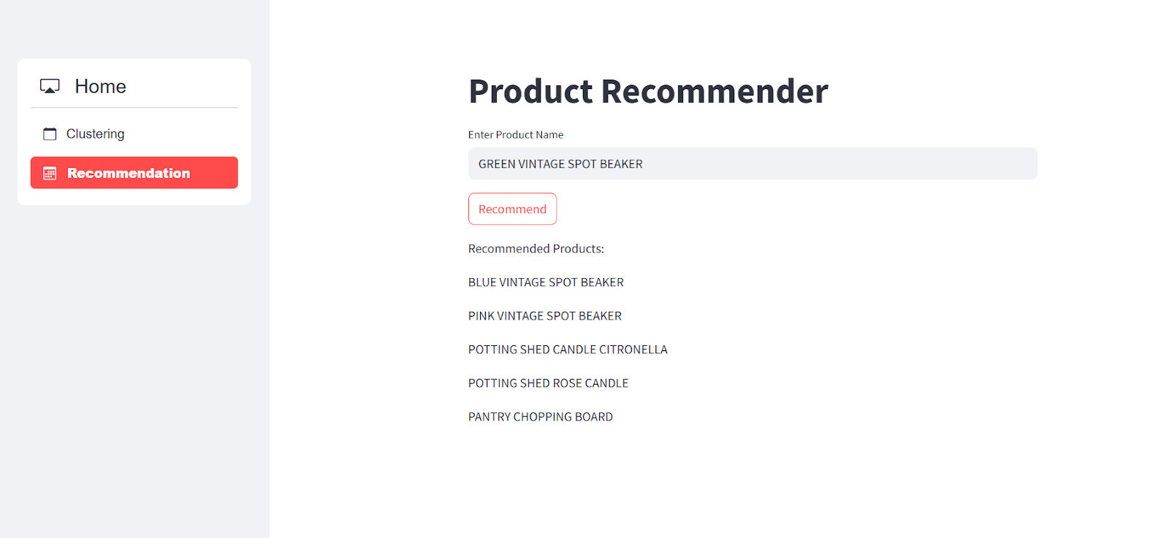
08 RECOMMENDATION ENGINE
Item-Based Collaborative Filtering
A CustomerID – Description purchase matrix captures how often each customer buys each product. Cosine similarity between product vectors surfaces items that tend to be purchased by similar customers, so the app can return the top 5 most similar products for any product name entered.
Purchase Matrix
Cosine Similarity
Ranked Products
Top 5 Recommendations
SHOPPER SPECTRUM
9

Slide 10
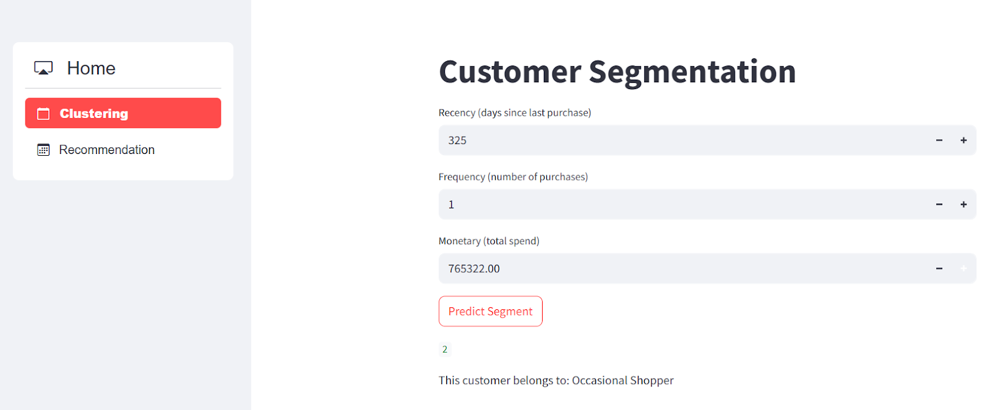
09 DEPLOYMENT
Interactive Streamlit Application
Two modules, one app: a product recommender for shoppers, and a live customer-segment predictor for the business.
Product Recommendation Module
Customer Segmentation Module
SHOPPER SPECTRUM
10

Slide 11
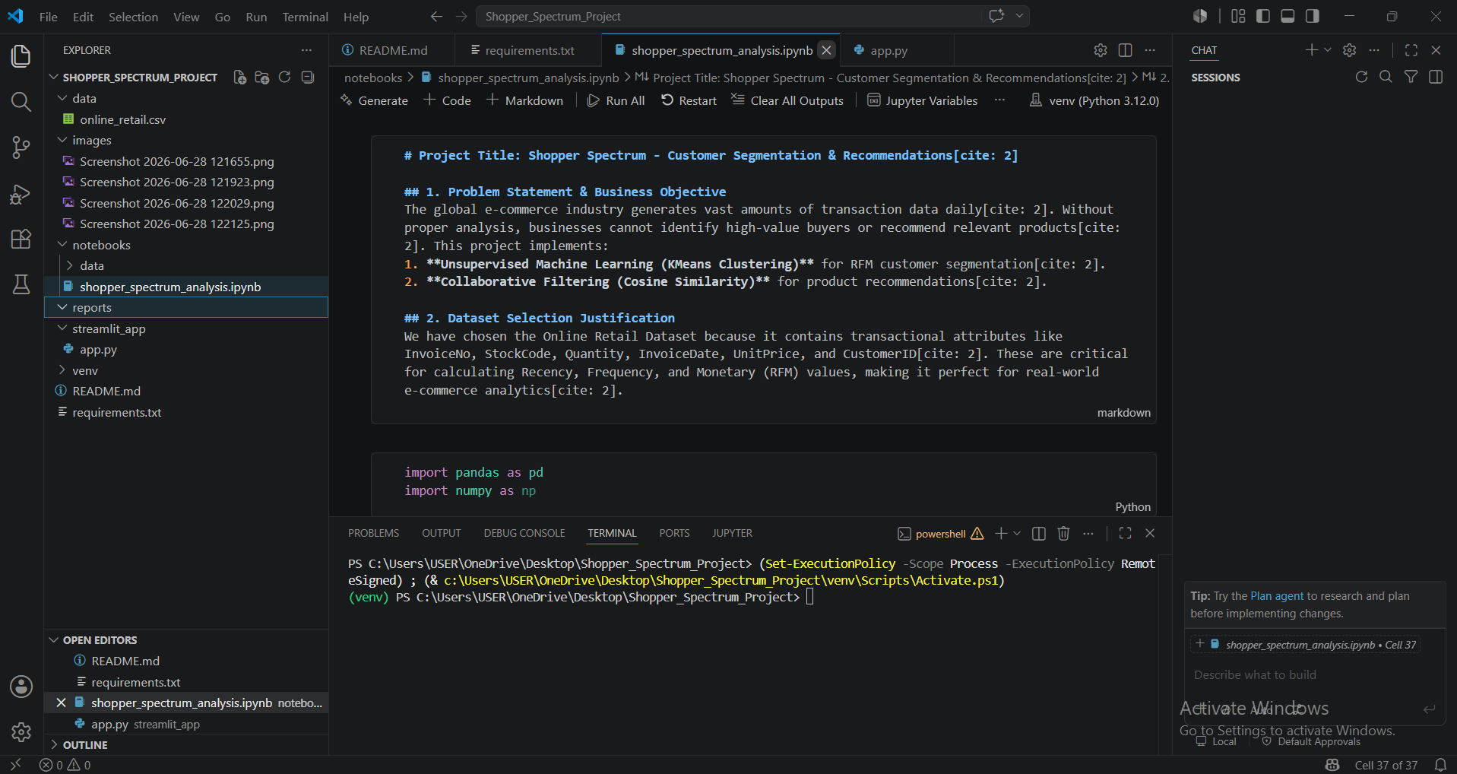

10 IMPLEMENTATION
Project Structure & Development Environment
data/
Raw retail transaction CSV
notebooks/
Analysis notebook (EDA, RFM, clustering)
streamlit_app/
app.py — the deployed web app
README + requirements.txt
Documentation & dependencies
SHOPPER SPECTRUM
11

Slide 12
11 TECHNICAL TAGS
Tools & Techniques Used
Pandas
NumPy
Data Cleaning
Feature Engineering
EDA
RFM Analysis
Customer Segmentation
K-Means Clustering
Collaborative Filtering
Cosine Similarity
Product Recommendation
Scikit-Learn
StandardScaler
Streamlit
Machine Learning
Data Visualization
Pivot Tables
Real-Time Prediction
SHOPPER SPECTRUM
12

Slide 13

12 DELIVERABLES
Project Outcomes & Deliverables
Python Notebook
Streamlit Web App
Clean, well-documented code with comments
EDA & clustering visualizations
RFM segmentation and product similarity analysis
Model evaluation: inertia & silhouette score
Product name → 5 similar product recommendations
RFM inputs → predicted customer segment
Clean, interactive UI with real-time outputs
Timeline: Completed within 8 days of assignment
SHOPPER SPECTRUM
13

Slide 14
Thank You
Shopper Spectrum — Customer Segmentation & Product Recommendations in E-Commerce

