Slide 1
Twitter Sentiment Analysis

Slide 2
Introduction to Twitter Sentiment Analysis

Slide 3
Abstract
The blast of Web 2.0 has prompted expanded action in Podcasting, Blogging, Tagging, Contributing to RSS, Social Bookmarking, and Social Networking.
Subsequently there has been a sudden increase of enthusiasm for individuals to mine these tremendous assets of information for suppositions. Sentiment analysis or Opinion Mining is mining of sentiment polarities from online social media.
In this project we will talk about a procedure which permits use and understanding of twitter information for sentiment analysis.
We perform several steps of text pre-processing, and then experiment with multiple classification mechanisms.
Using a dataset of 50000 tweets and TFIDF features, we comparison the accuracy obtained using various classifiers for this task.
We find that linear SVMs provide us the best accuracy results among the various classifiers tried.
Sentiment analysis classifier could be useful for many applications like market analysis of different features of a new product or public opinion for a new movie or speech by a political candidate.

Slide 4
Motivation for the project
Sentiment analysis (SA), also known as opinion mining is the process of classifying the emotion conveyed by a text, for example as negative, positive or neutral.
Also called as Opinion extraction, Opinion mining, Sentiment mining, Subjectivity analysis
Applications
Movie: is this review positive or negative?
Products: what do people think about the new iPhone?
Public sentiment: how is consumer confidence? Is despair increasing?
Politics: what do people think about this candidate or issue?
Prediction: predict election outcomes or market trends from sentiment

Slide 5
Large data for sentiment analysis on Twitter
A popular social medium is Twitter, a micro-blogging site that allows users to write textual entries of up to 140 characters, commonly referred to as tweets.
As of June 2015, Twitter has over 302 million monthly active users according to their homepage, whereof approximately 88 % have their tweets freely readable.
Data created by Twitter is made available through Twitter’s API, and represents a realtime information stream of opinionated data.

Slide 6
Challenges in handling Twitter data
Tweets often contain misspellings, and the constrictive limit of 140 characters encourages slang and abbreviations.
Unconventional linguistic means are also used, such as capitalization or elongation of words to show emphasis.
Additionally, tweets contain special features like emoticons and hashtags that may have an analytical value.
Hashtags are labels used for search and categorization, and are included in the text prepended by a “#”.
Emoticons are expressions of emotion, and can either be written as a string of characters e.g., “:-)”, or as a unicode symbol.
Finally, if a tweet is a reply or is directed to another Twitter user, mentions can be used by prepending a username with “@”.

Slide 7
Problem Definition
Given: Tweet
Predict: Sentiment polarity of the tweet – positive vs negative.

Slide 8
Basic ML and NLP techniques and tools needed for Twitter Sentiment Analysis

Slide 9
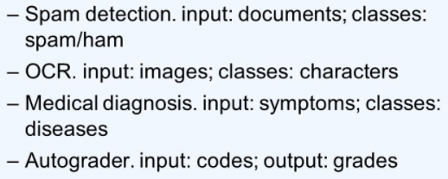
Approaches: Machine Learning (Decision Trees)
categorical
categorical
continuous
class
Refund
Yes
No
NO
MarSt
Single, Divorced
Married
TaxInc
NO
< 80K
> 80K
A tree-like graph or model of decisions and their possible consequences
NO
YES
Training Data
Model: Decision Tree
Predict whether a person will cheat or not?

Slide 10
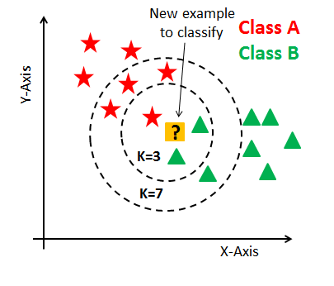
Approaches: Machine Learning (KNNs)
Pros:
Simple process
Quick to train
Cons
Curse of dimensionality
Slow to test
Requires more memory
Missing values need to be handled separately

Slide 11
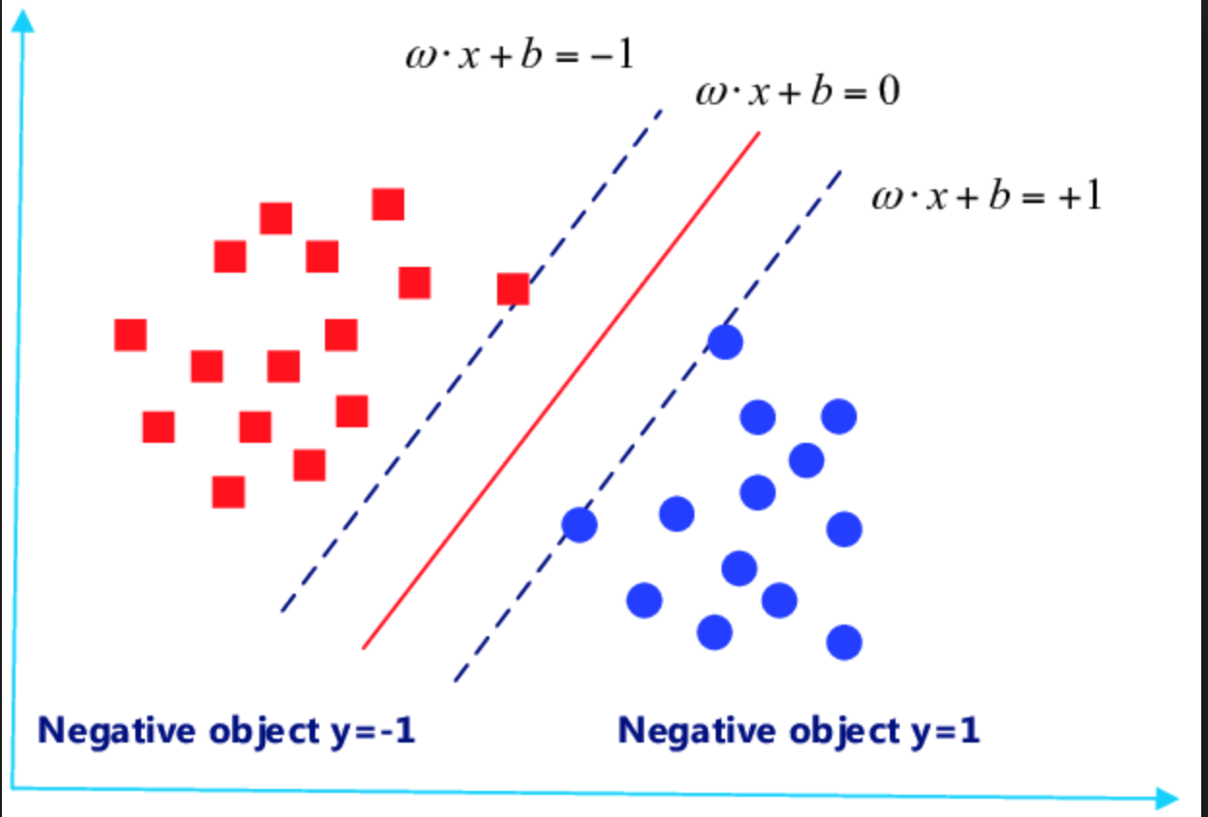
Approaches: Machine Learning (SVMs)
SVM searches for the hyperplane with the largest margin, i.e., maximum marginal hyperplane (MMH) using constrained convex quadratic optimization
Pros: 1. High accuracy 2. Nice theoretical guarantees regarding overfitting 3. With an appropriate kernel they can work well even if your data is not linearly separable in the base feature space 4. Good for high-dimensional data (like text)
Cons: 1. Memory-intensive 2. Hard to interpret 3. Annoying to run and tune (long training time) 4. Not easy to incorporate domain knowledge (priors)
Kernel Trick

Slide 12
Approaches: Machine Learning (Ensemble Learning)
Use a combination of models to increase accuracy
Popular ensemble methods
Bagging: averaging the prediction over a collection of classifiers
Boosting: weighted vote with a collection of iteratively learned classifiers
AdaBoost
Gradient Boosting
Random Forest: Each classifier in the ensemble is a decision tree classifier and is generated using a random selection of attributes at each node to determine the split
Pros: Highly effective in presence of large amount of training data
Cons: Take long time to train

Slide 13
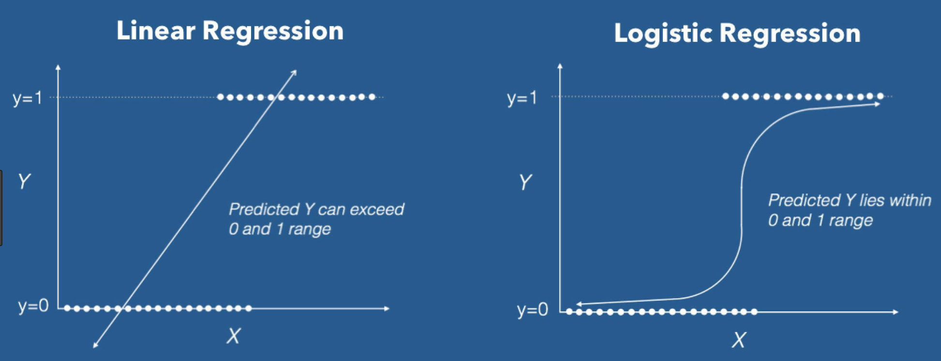
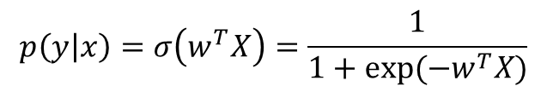
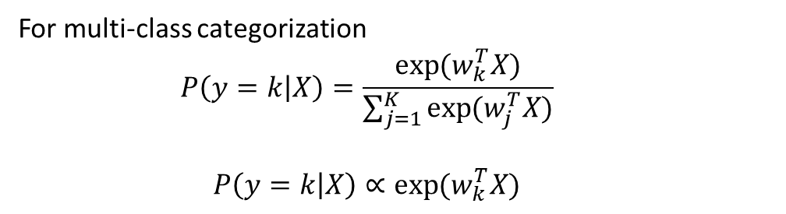
Approaches: Machine Learning (Logistic Regression)
For multi-class categorization
$$P\left(y=k | X\right)=\frac{\exp{(w_{k}^{T}X)}}{\sum_{j=1}^{K}{\exp{(w_{j}^{T}X)}}}$$
$$P\left(y=k | X\right)∝\exp{(w_{k}^{T}X)}$$
$$p\left(y | x\right)=σ\left(w^{T}X\right)=\frac{1}{1+exp⁡(−w^{T}X)}$$

Slide 14
Approaches: Machine Learning (Naïve Bayes)
Likelihood
Prior
Normalization Constant

Slide 15


Approaches: NLP (TF-IDF)
Term frequency-inverse document frequency (TF-IDF) is a common term weighting scheme for the bag-of-words model, which lets us identify words in a collection of documents that can guide in deciding a document’s topic.
Here D is the entire corpus of documents, and N is the total number of documents in the corpus. As the number of documents where a term appears increases, the ratio inside the logarithm will decrease towards 1, making the idf approach 0.

Slide 16
Approaches: NLP (TF-IDF example)
Consider a document containing 100 words wherein the word 'Cauvery' appears 3 times.
The term frequency (tf) for 'Cauvery' is then TF = (3 / 100) = 0.03.
Now, assume we have 10 million documents and the word 'Cauvery' appears in 1000 of these. Then, the inverse document frequency (idf) is calculated as IDF = log(10,000,000 / 1,000) = 4.
Thus, the Tf-idf weight is the product of these quantities TF-IDF = 0.03 * 4 = 0.12.

Slide 17
Tools: Scikit Learn
Scikit-learn [Pedregosa et al., 2011] is a framework for the Python programming language that offers machine learning models as well as tools for performing preprocessing and data analysis.
Transformer objects are an essential part of performing machine learning with Scikit-learn, and are objects that may “clean, reduce, expand, or generate feature representations”.
Scikit-learn provides a framework for pipelining machine learning tools, making it easy to chain tasks such as preprocessing and feature extraction together with a machine learning algorithm in a tidy manner.
One of the benefits of using the Pipeline framework is that it allows performing a parameter grid search across all the estimators in the Pipeline.

Slide 18
Tools: Pandas
Pandas [McKinney, 2012] is an open-source library providing high-performance data structures and data analysis tools for the Python programming language.
It also includes tools for efficiently reading and writing data between in-memory data structures and different textual file formats, such as comma-separated value files.

Slide 19
Exploratory data analysis and Pre-processing for Twitter Sentiment Analysis

Slide 20
Related Work
Sentiment analysis has been studied for a long time in the research community.
While the simplest version of the problem is to classify a document as positive or negative, a more difficult version is to assign a rating, say on a scale of 1-10. Further, in some settings, finding the source and target of the sentiment is useful. In some other settings, fine grained moods like happy, peaceful, calm, etc. are more useful to discover from the documents.
Typically researchers have used classification based approaches for sentiment analysis. There has been quite some work on extracting interesting feature values for the task, including simple frequency counts to TFIDF to scaled likelihood.
There have also been efforts to build sentiment lexicons. Quite a few manually generated sentiment lexicons are publicly available. SentiWordNet is an automatically generated lexicon which is quite popular as well.
There have also been semi-supervised approaches proposed for the sentiment analysis task to increase sentiment lexicon size. These include using simple heuristics like (a) words separated by “and” have same sentiment polarity while words separated by “but” have different sentiment polarity. (b) dictionaries and thesaurus can be used to include synonyms of positive words in positive set and antonyms of positive words in negative set, and (c) words frequently co-occurring with extremely positive words are positive, while words frequently cooccurring with extremely negative words are negative.
Recently there has also been work on extracting sentiment lexicons per domain, extracting sentiment carrying phrases, and also performing aspect based sentiment analysis.
[Pang and Lee, 2008] and [Liu 2012] are good books on research done in the field of sentiment analysis. Further, we redirect the reader interested in reading more about previous work on sentiment analysis for Twitter data to [Alexander and Paroubek, 2010], [Kouloumpis et al., 2011], [Agarwal et al., 2011], and [Jørgen and Reitan, 2011].

Slide 21
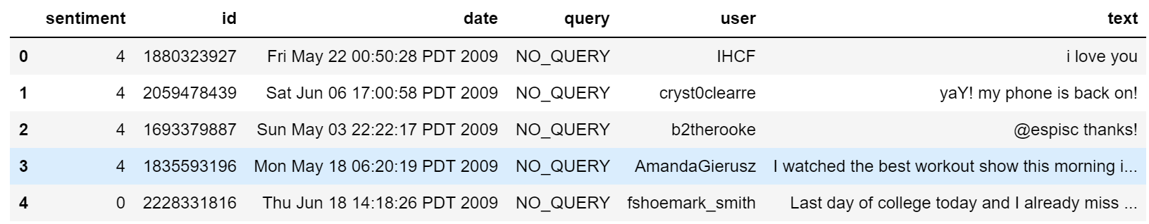
Dataset Details
Some people build a program to collect automatically a corpus of tweets based on two classes, “positive” and “negative”, by querying Twitter with two type of emoticons:
Happy emoticons, such as “:)”, “:P”, “:­)” etc.
Sad emoticons, such as “:(“, “:’(”, “=(“.
Others make their own dataset of tweets my collecting and annotating them manually which very long and fastidious.
Our dataset consists of 1600000 tweets in English coming from two sources: Kaggle and Sentiment140.

Slide 22
Challenges with Twitter data
The presence of acronyms "bf" or more complicated "APL". Does it means apple ? Apple (the company) ?
The presence of sequences of repeated characterssuch as "Juuuuuuuuuuuuuuuuussssst", "hmmmm". In general when we repeat several characters in a word, it is to emphasize it, to increase its impact.
The presence of emoticons, ":O", "T_T", ":¬|" and much more, give insights about user's moods.
Spelling mistakes and “urban grammar” like "im gunna" or "mi".
The presence of nouns such as "TV", "New Moon".
Furthermore, we can also add,
People also indicate their moods, emotions, states, between two such as, *\cries*, *hummin*, *sigh*.
The negation, “can't”, “cannot”, “don't”, “haven't” that we need to handle like: “I don’t like chocolate”, “like” in this case is negative.

Slide 23
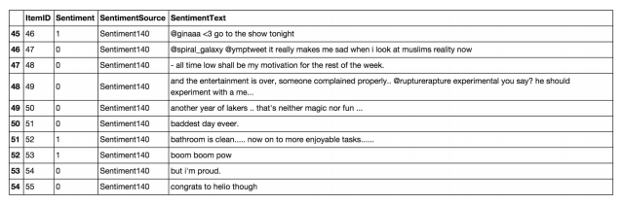
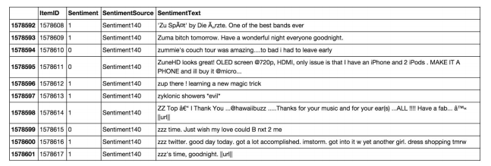
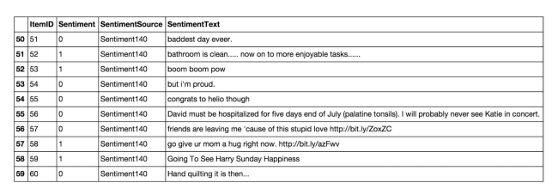
Exploratory data analysis
Data contains HTML entities
Data contains @mentions
Data contains UTF8 encoded symbols
Data contains URLs
Data contains URLs

Slide 24
Pre-processing the dataset
Cleaning up the HTML entities, and any other HTML tags
Remove @mentions
Remove URLs from tweets
Convert short forms of negation words to their full forms.
"isn't":"is not", "aren't":"are not", "wasn't":"was not", "weren't":"were not", "haven't":"have not", "hasn't":"has not", "hadn't":"had not", "won't":"will not", "wouldn't":"would not", "don't":"do not", "doesn't":"does not", "didn't":"did not", "can't":"can not", "couldn't":"could not", "shouldn't":"should not", "mightn't":"might not", "mustn't":"must not”
Decode UTF8 encoded symbols
Replace non-alphabetic characters to spaces.
Ignore words of size 1.
Remove punctuations
Perform word lemmatization

Slide 25
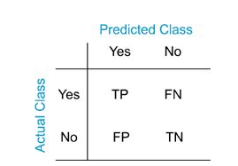
TF-IDF vectorization, train/test split, cross validation
We start by splitting the data randomly into two parts: train and test. We use 80% data for training and the remaining for testing.
We extract TFIDF features from tweets using TFIDF vectorizer. It converts a collection of raw documents to a matrix of TF-IDF features.
Further, we use these features to learn multiple classifiers. For each type of classifier, we first train the classifier on train data and report the accuracy on test data. We also report cross validation accuracy with 10 folds.
We report confusion matrix and accuracy values for each classifier.

Slide 26
Twitter Sentiment Analysis Results

Slide 27
Results
Classifier | Test Acc. | Cross Validation Acc.
Naïve Bayes | 0.7623 | 0.7524
Logistic Regression | 0.7776 | 0.7757
Linear SVM | 0.7867 | 0.7842
Decision Trees | 0.5663 | 0.5758
Boosted Trees | 0.7284 | 0.7161
Random Forests | 0.7637 | 0.7609
Nearest Neighbors | 0.5347 | 0.5163
We obtain the maximum accuracy using Linear SVM. However, also notice that logistic regression and random forests also lead to similar accuracy values.
However, simple classifiers like decision trees and nearest neighbors somehow cannot provide good results at all.
We used default hyper parameter settings for all the classifiers as provided by scikit learn. Tuning those hyper parameters can lead to further accuracy boost and we plan to explore that as part of future work.

Slide 28







Results: Confusion Matrices
Naive Bayes:
Decision Trees:
Boosted Trees:
Logistic Regression:
Random Forests:
Linear SVM
Nearest Neighbors:

Slide 29
Code and data
The code is contained in the Jupyter notebook: TwitterSentimentAnalysis.ipynb
To be able to run this, you must have Jupyter notebook installed on your machine.
It can be run on any platform: Windows, Linux, Mac-OS
The data is supplied as a csv file: TwitterSentimentAnalysis.csv
Installations needed
Anaconda prompt, Jupyter notebook, numpy, pandas, sklearn, NLTK

Slide 30
Model Deployment
Hardware requirement: Any operating system that supports Python. Less than 2 GB RAM.
Training the model takes a few hours on a machine with 8 processors.
Software requirement: Python
All the generated models can be saved using Python pickle library and can be easily loaded on machines with small RAM.

Slide 31
Concluding the Twitter Sentiment Analysis Project

Slide 32
Conclusion
In this project, we discussed the problem of classifying whether a tweet is positive or negative.
We performed classification using TF-IDF features and experimented with multiple classifiers.
We used a Python library, Scikit Learn for building classifiers.
The results show that Linear SVMs work well on our dataset.
The solution can be useful for multiple stake-holders.

Slide 33
Future Work
We could further improve our classifier
By trying to extract more features from the tweets,
By trying different kinds of features,
By tuning the parameters of the classifiers, or
We could try logistic regression without any regularization or try say L1 regularization.
For SVMs, we could try SVMs with various kinds of kernels or also vary the complexity parameter C and see the impact.
For decision trees, we could try different levels of pruning.
For random forests, we experimented with 100 trees, but we could vary the number of trees and check its impact on accuracy.
For nearest neighbors, we used k=5. We could try varying the value of k.
By trying more classifiers like deep learning architectures.

Slide 34

References
Beevolve. (2012, October 10). An exhaustive study of Twitter users across the world. Retrieved December 18, 2014, from http://www.beevolve.com/twitter-statistics/#c1
Councill, I. G., McDonald, R. & Velikovich, L. (2010). What’s great and what’s not: learning to classify the scope of negation for improved sentiment analysis. In Proceedings of the workshop on negation and speculation in natural language processing (pp. 51–59). NeSp-NLP ’10. Uppsala, Sweden: Association for Computational Linguistics.
Kiritchenko, S., Zhu, X. & Mohammad, S. M. (2014). Sentiment analysis of short informal texts. Journal of Artificial Intelligence Research, 50, 723–762.
Cortes, C. & Vapnik, V. (1995). Support-vector networks. Machine Learning, 20 (3), 273–297.
Fletcher, T. (2009). Support vector machines explained, tutorial paper. http://www.tristanfletcher.co.uk/SVM%20Explained.pdf. Retrieved June 11, 2015.
Hsu, C.-W. & Lin, C.-J. (2002). A comparison of methods for multiclass support vector machines. IEEE Transactions on Neural Networks, 13 (2), 415–425.
Mitchell, T. M. (1997). Machine learning (1st ed.). New York, NY, USA: McGraw-Hill, Inc.
Vryniotis, V. (2013, November 20). Machine learning tutorial: the max entropy text classifier. Retrieved December 16, 2014, from http: //blog.datumbox.com/machine-learning-tutorial-the-maxentropy- text-classifier/
Givón, T. (1993). English grammar: a function-based introduction. John Benjamins Publishing.
Morante, R. & Sporleder, C. (2012). Modality and negation: an introduction to the special issue. Computational Linguistics, 38 (2), 223–260.
Tottie, G. (1991). Negation in English speech and writing: a study in variation. Academic Press.
Polanyi, L. & Zaenen, A. (2006). Contextual valence shifters (J. G. Shanahan, Y. Qu & J. Wiebe, Eds.). Springer.
Manning, C. D., Raghavan, P. & Schütze, H. (2008). Introduction to information retrieval. Cambridge, UK: Cambridge University Press.
Marcus, M. P., Marcinkiewicz, M. A. & Santorini, B. (1993). Building a large annotated corpus of English: the Penn Treebank. Computational Linguistics, 19 (2), 313–330.

Slide 35
References
Gimpel, K., Schneider, N., O’Connor, B., Das, D., Mills, D., Eisenstein, J., Heilman, M., Yogatama, D., Flanigan, J. & Smith, N. A. (2011). Part-of-speech tagging for Twitter: annotation, features, and experiments. In Proceedings of the 49th annual meeting of the Association for Computational Linguistics: human language technologies: short papers (Vol. 2, pp. 42–47). Association for Computational Linguistics. Portland, Oregon.
Collins, M. (2003). Head-driven statistical models for natural language parsing. Computational Linguistics, 29 (4), 589–637.
Hudson, R. (2010). An encyclopedia of word grammar and English grammar. Retrieved December 16, 2014, from http://tinyurl.com/wgencyc
McKinney, W. (2012). Pandas: a Python data analysis library. Retrieved May 13, 2015, from http://pandas.pydata.org
Kong, L., Schneider, N., Swayamdipta, S., Bhatia, A., Dyer, C. & Smith, N. (2014). A dependency parser for tweets. In Proceedings of the conference on empirical methods in natural language processing (pp. 1001– 1012). EMNLP ’14. Doha, Qatar.
Owoputi, O., O’Connor, B., Dyer, C., Gimpel, K., Schneider, N. & Smith, N. A. (2013). Improved part-of-speech tagging for online conversational text with word clusters. In Proceedings of the 2013 conference of the North American Chapter of the Association for Computational Linguistics: human language technologies (pp. 380–390). Atlanta, GA, USA.
Pedregosa, F., Varoquaux, G., Gramfort, A., Michel, V., Thirion, B., Grisel, O., Blondel, M., Prettenhofer, P., Weiss, R., Dubourg, V., Vanderplas, J., Passos, A., Cournapeau, D., Brucher, M., Perrot, M. & Duchesnay, E. (2011). Scikit-learn: machine learning in Python. Journal of Machine Learning Research, 12, 2825–2830.
Pang, Bo, and Lillian Lee. "Opinion mining and sentiment analysis." Foundations and Trends® in Information Retrieval 2, no. 1–2 (2008): 1-135.
Liu, Bing. "Sentiment analysis and opinion mining." Synthesis lectures on human language technologies 5, no. 1 (2012): 1-167.
Pak, Alexander, and Patrick Paroubek. "Twitter as a corpus for sentiment analysis and opinion mining." In LREc, vol. 10, no. 2010, pp. 1320-1326. 2010.
Kouloumpis, Efthymios, Theresa Wilson, and Johanna D. Moore. "Twitter sentiment analysis: The good the bad and the omg!." Icwsm 11, no. 538-541 (2011): 164.
Agarwal, Apoorv, Boyi Xie, Ilia Vovsha, Owen Rambow, and Rebecca Passonneau. "Sentiment analysis of twitter data." In Proceedings of the workshop on languages in social media, pp. 30-38. Association for Computational Linguistics, 2011.
Faret, Jørgen, and Johan Reitan. "Twitter sentiment analysis." (2011).

Slide 36
Thanks!

