Slide 1

QLang
The Qubit Language

Slide 2
Team
Christopher Campbell (System Architect)
Sankalpa Khadka (Language Guru)
Winnie Narang (Verification and Validation)
Jonathan Wong (Manager)
Clément Canonne

Slide 3
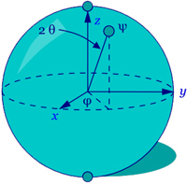
Overview & Motivation

Slide 4
Overview & Motivation

Slide 5
Overview & Motivation

Slide 6
Tutorial Introduction

Slide 7
Tutorial Introduction

Slide 8
Tutorial Introduction

Slide 9
Implementation

Slide 10
Testing and Verification

